Slide 1
A Locking-free
Smoothed Finite Element Formulation (Modified Selective FS/NS-FEM-T4) with Tetrahedral Mesh Rezoning for Large Deformation Problems
Yuki ONISHI, Kenji AMAYA
Tokyo Institute of Technology (Japan)

Slide 2
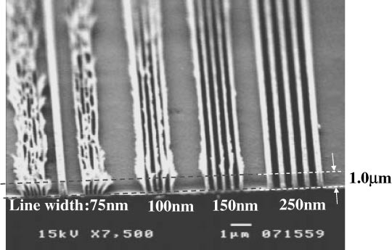
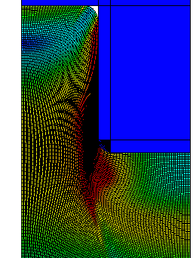
Motivation & Background
Motivation
  We want to analyze severely large
  deformation problems in solids
  accurately and stably!
  (Target: automobile tire, thermal nanoimprint, etc.)
Background
  Finite elements are distorted
  in a short time, thereby resulting
  in convergence failure.
Mesh rezoning method (h-adaptive
mesh-to-mesh solution mapping)
is indispensable.
Mold
Polymer

Slide 3
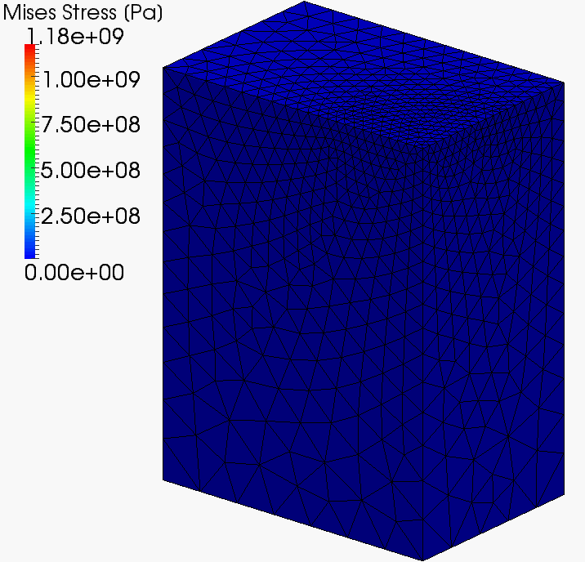
Our First Result in Advance
What we want to do:
Static
Implicit
Large deformation
Mesh rezoning

Slide 4
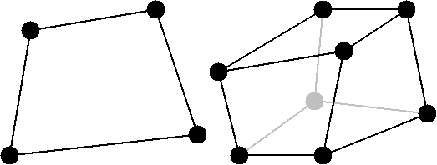
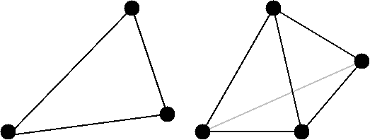
Issues
The biggest issue
in large deformation mesh rezoning
It is impossible to remesh arbitrary deformed 2D or 3D domains with quadrilateral or hexahedral elements.
However, the standard (constant strain) triangular or tetrahedral elements induce shear and volumetric locking easily, which leads to inaccurate results.
NO
YES
We have to use triangular or tetrahedral elements...

Slide 5
Conventional Methods
Higher order elements:
✗ Not volumetric locking free; Not effective
in large deformation due to intermediate nodes.
EAS elements:
✗ Unstable.
B-bar, F-bar and selective integration elements:
✗ Not applicable to triangular/tetrahedral mesh.
F-bar patch elements:
✗ Difficult to construct good patches
u/p hybrid (mixed) elements
✗ No sufficient formulation for triangular/tetrahedral mesh is
presented so far. (There are almost acceptable hybrid
elements such as C3D4H or C3D10H of ABAQUS.)
Selective smoothed finite elements:
? Unknown potential (since 2009~). Let’s try!

Slide 6
Objective
Develop a locking-free
modified selective S-FEM
for large deformation problems
with mesh rezoning
Table of Body Contents
- Part 1: Introduction to our modified selective S-FEMs
- Part 2: Demonstration of our methods
with mesh rezoning
- Summary

Slide 7
Part 1:
Introduction to Our Modified selective S-FEM

Slide 8
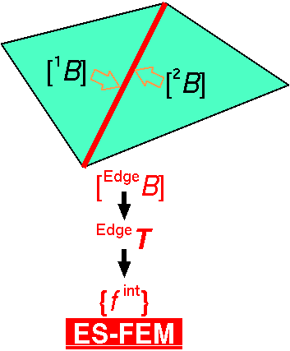

Review of Edge-based S-FEM (ES-FEM)
Calculate $[B]$ at element as usual.
Distribute $[B]$ to the connecting edges and make $[ ^{Edge}B]$.
F, T etc and {f ^{int}} are calculated on smoothed edge domains.
Generally accurate but induces volumetric locking.
Substituting "face" for "edge"
gives FS-FEM for 3D

Slide 9
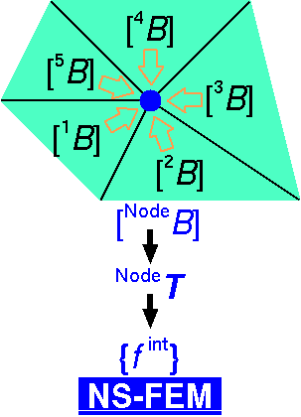

Review of Node-based S-FEM (NS-FEM)
Calculate $[B]$ at element as usual.
Distribute $[B]$ to the connecting nodes and make $[ ^{Node}B]$
F, T etc and {f ^{int}} are calculated on smoothed node domains.
Generally not accurate but volumetric locking free.
(due to zero-energy modes,
which are arisen in
reduced integration
finite elements as
hour-glass modes)
close to FVM with
vertex-based control volume

Slide 10
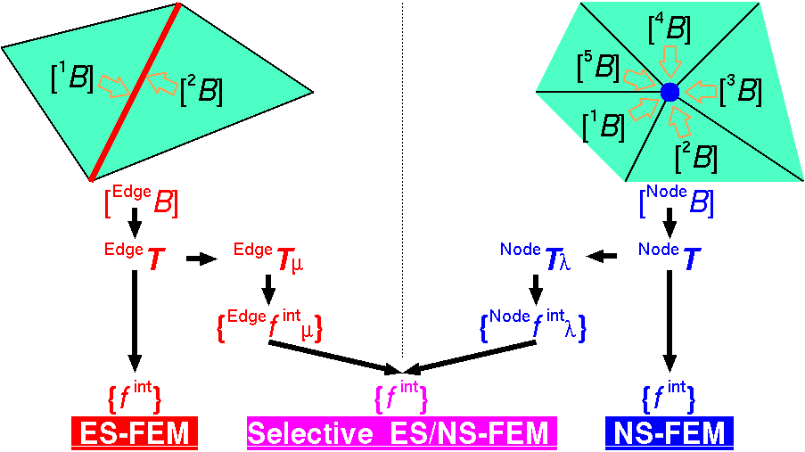

Review of Selective ES/NS-FEM
Separate stress into "$μ$ part" and "$λ$ part", where $μ$ and $λ$ are the Lame's parameters.
F, T etc and {f ^{int}} are calculated on both smoothed domains.
Only applicable to elastic constitutive models.
Substituting
"face"
for
"edge"
gives
FS/NS-FEM
for 3D

Slide 11


Modified Selective ES/NS-FEM
Separate stress into "deviatoric part" and "hydrostatic part"
instead of "$μ$ part" and "$λ$ part".
F, T etc and {f ^{int}} are calculated on both smoothed domains.
Applicable to any kind of material constitutive models.
Substituting
"face"
for
"edge"
gives
FS/NS-FEM
for 3D

Slide 12

3 Types of Selective S-FEMs
Method | Deviatoric Part | Hydrostatic Part
2D ES/NS-FEM-T3 | ES-FEM | NS-FEM
3D ES/NS-FEM-T4 | ES-FEM | NS-FEM
3D FS/NS-FEM-T4 | FS-FEM | NS-FEM
No increase in DOF!!
Displacement vector $\{u\}$ is only the unknown.

Slide 13
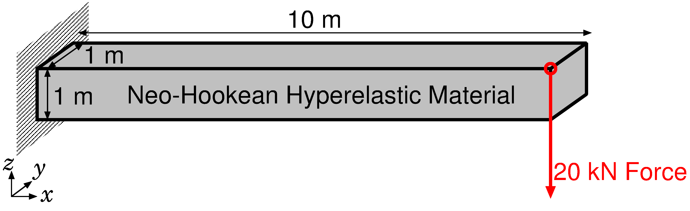
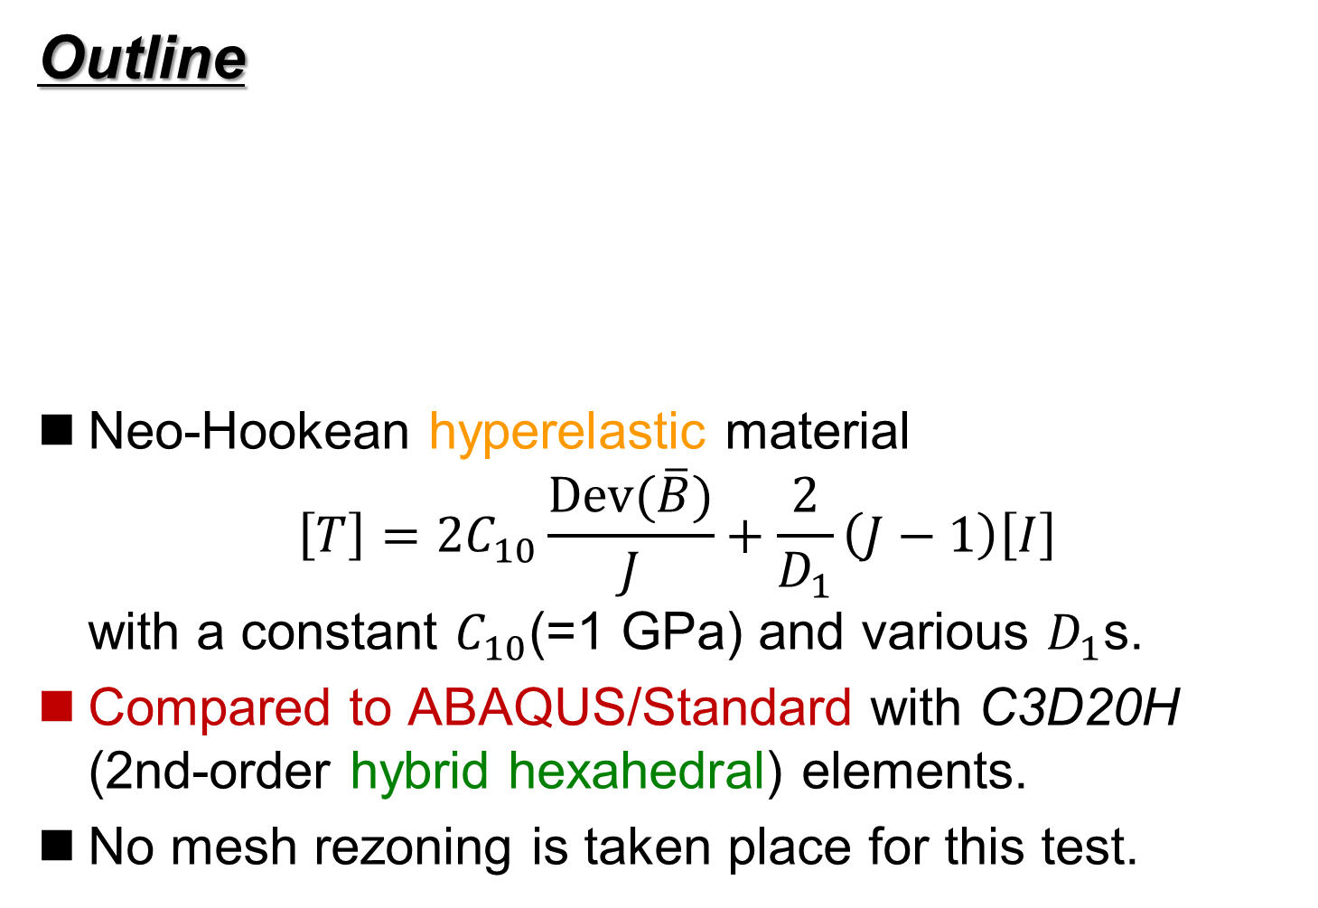
Verification ~ Bending of Cantilever ~
Outline
Neo-Hookean hyperelastic material
$\left[T\right]=2C_{10}\frac{Dev(\overline{B})}{J}+\frac{2}{D_{1}}\left(J−1\right)\left[I\right]$
with a constant $C_{10}$(=1 GPa) and various $D_{1}$s.
Compared to ABAQUS/Standard with C3D20H (2nd-order hybrid hexahedral) elements.
No mesh rezoning is taken place for this test.

Slide 14
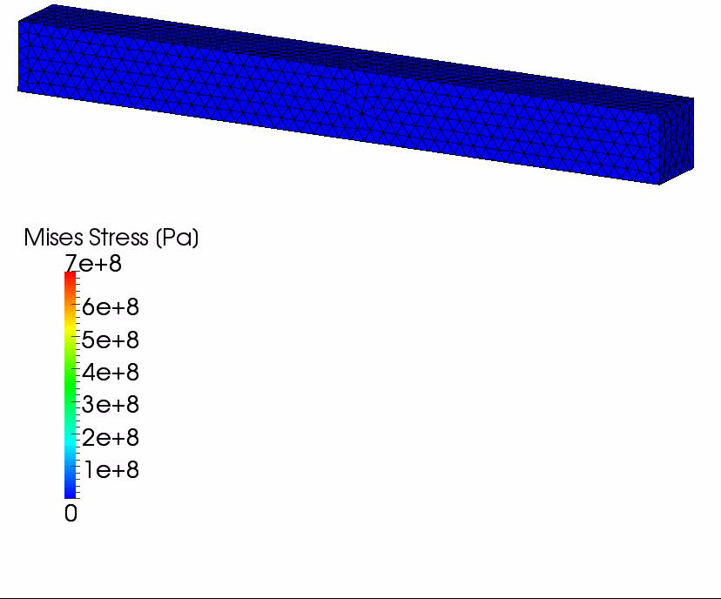

Verification ~ Bending of Cantilever ~
Results with $D_{1}=2×10^{−15} [Pa^{−1}]$ ($ν_{ini}$=0.499999)
The amount of
vertical deflection
is about
6.5 m.
If we use
constant strain
tetrahedral,
the amount of
vertical deflection
is about only
0.1 m.

Slide 15
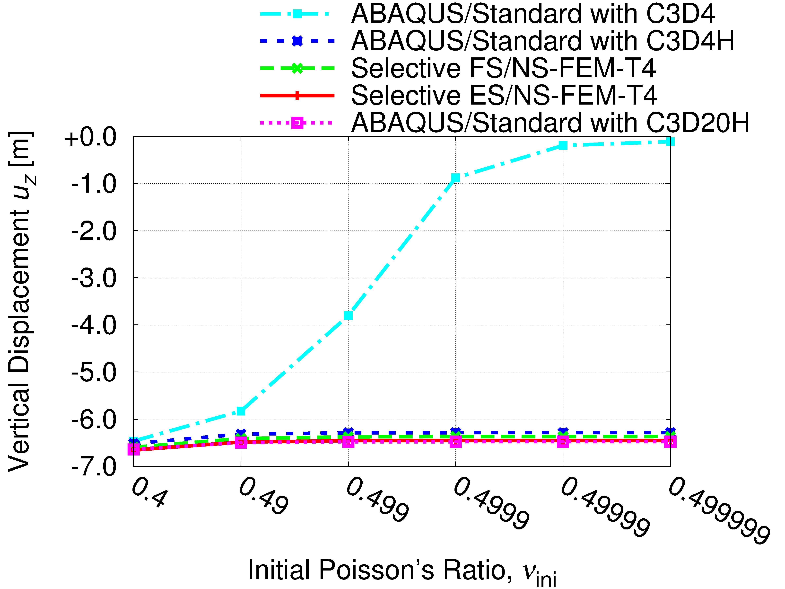
Verification ~ Bending of Cantilever ~
Comparison of Deflection Displacements

Slide 16
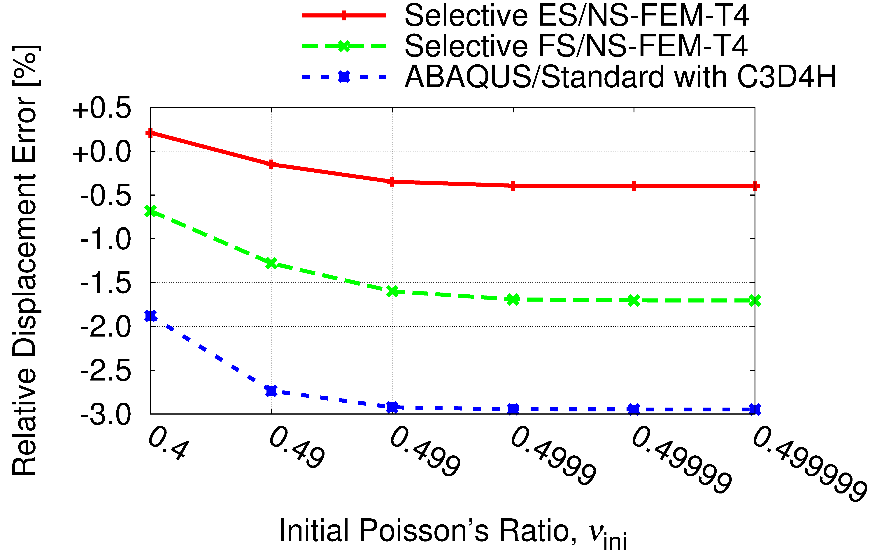
Verification ~ Bending of Cantilever ~
Comparison to 2nd-order Hybrid Hex Element (C3D20H)
Selective S-FEM is locking-free
in large deflection analysis!!

Slide 17
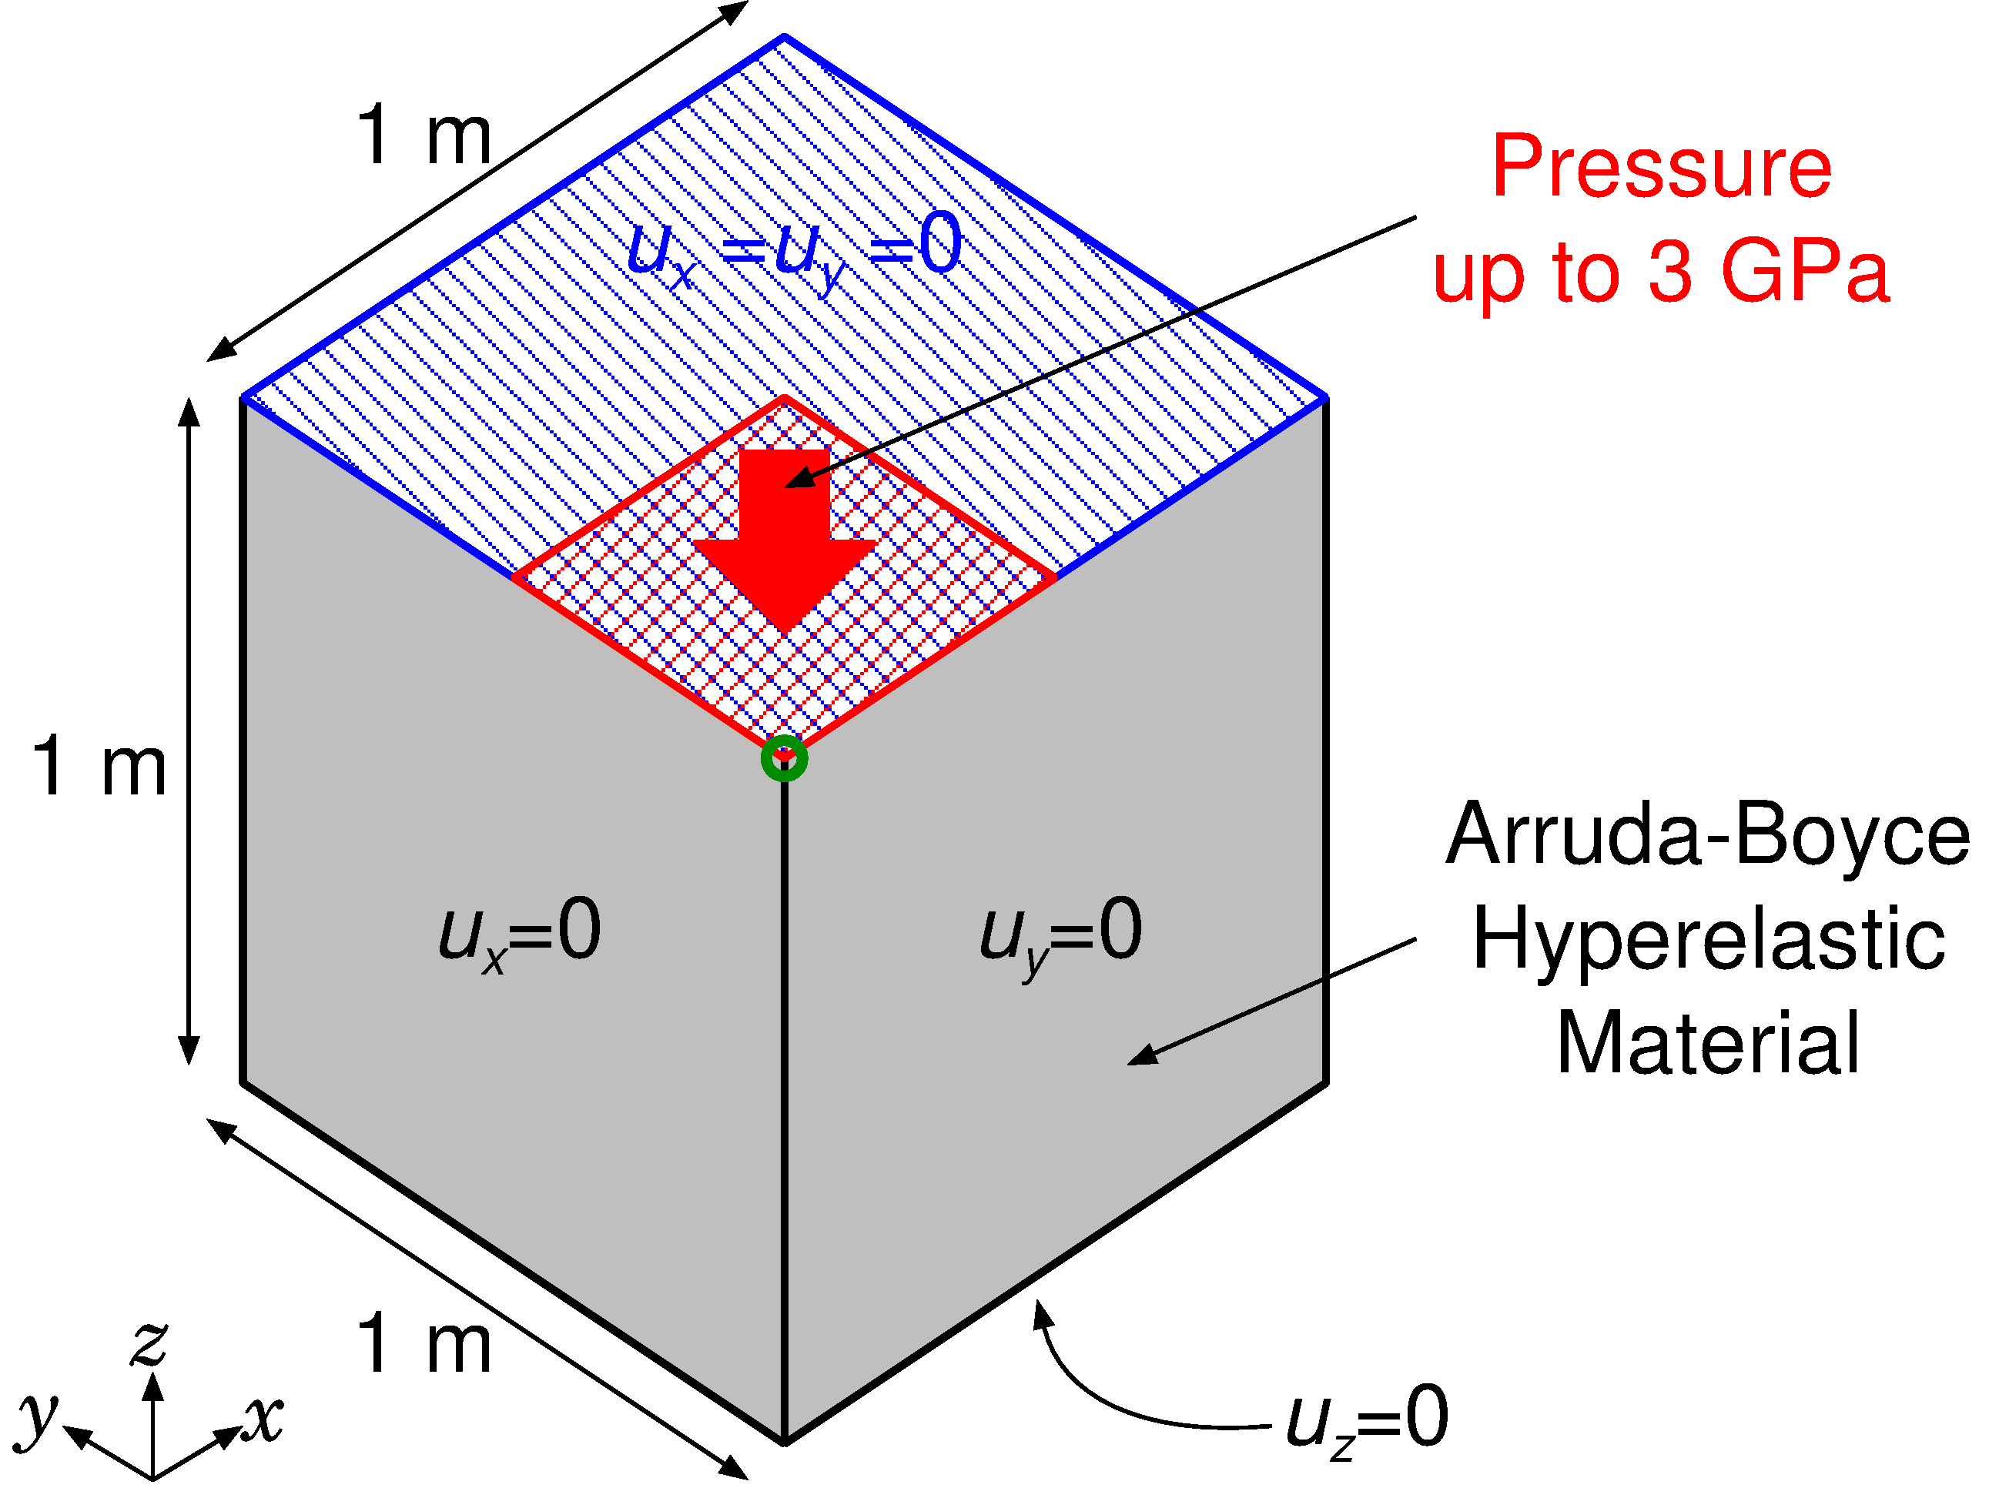

Verification ~Partial Compression of Block ~
Outline
Arruda-Boyce Hyper elastic Material
with $ν_{ini}=0.4999$
Applying pressure on ¼ of the top face

Slide 18
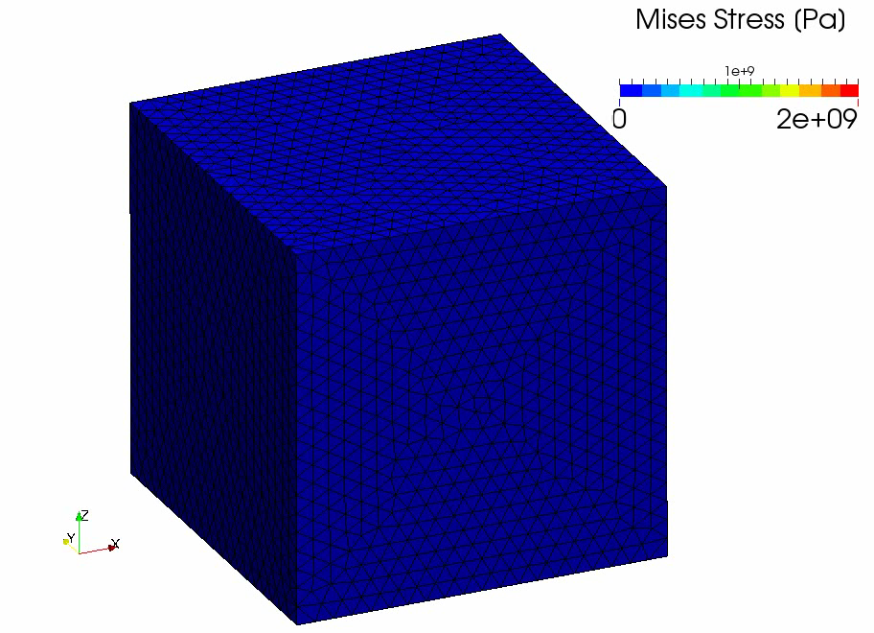
Verification ~Partial Compression of Block ~
Result of
Selective
FS/NS-
FEM-T4

Slide 19
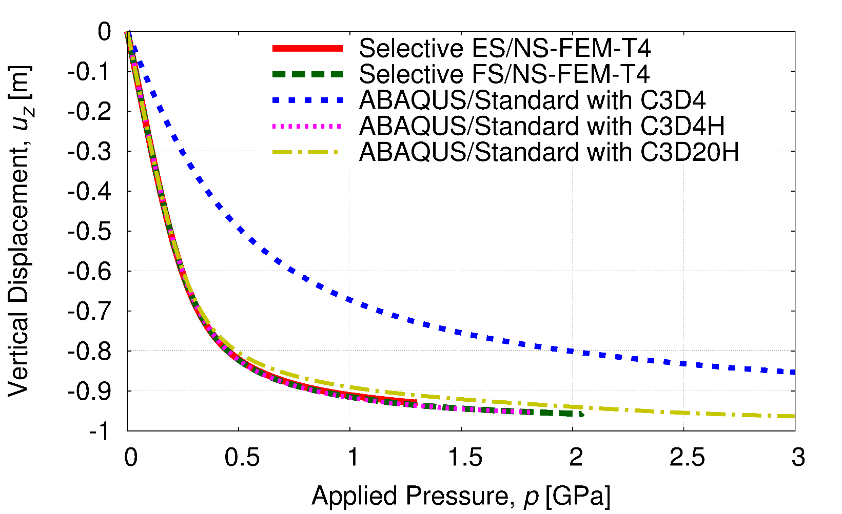
Verification ~Partial Compression of Block ~
Vertical Displacements vs. Applied Pressure
Constant strain element (C3D4) locks quickly.
Other elements including selective S-FEMs do not lock.
Selective S-FEMs are locking-free in large strain analysis!!

Slide 20
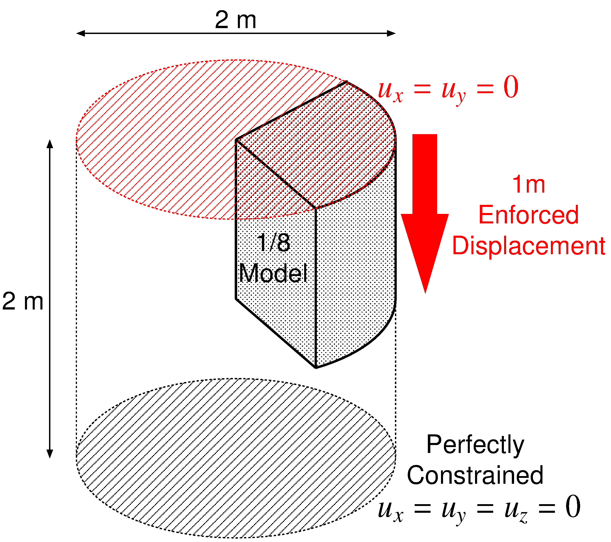

Verification ~ Compression of 1/8 Cylinder ~
Outline
50% axial compression.
Neo Hookean hyper elastic material of $C_{10}=40×{10}^{6} Pa, D=5×{10}^{−12} Pa^{−1}$ (i.e., $ν_{ini}=0.4999$).
Compared to C3D4H element of ABAQUS/Standard with exactly the same mesh.

Slide 21
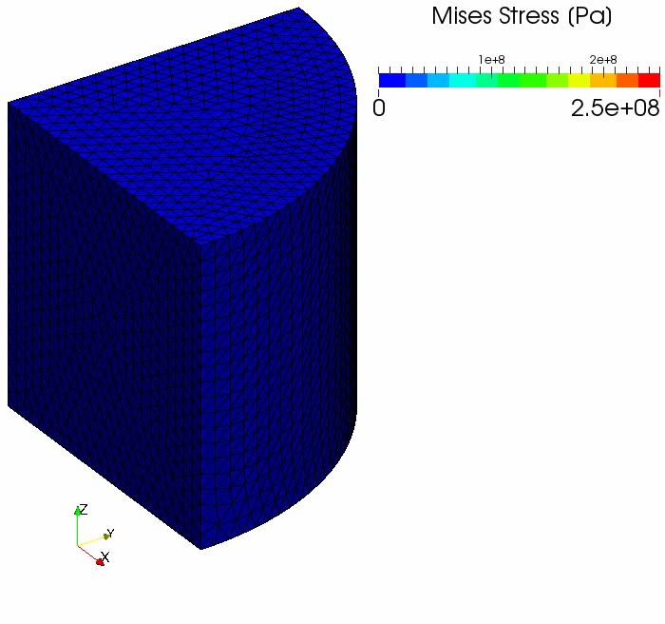
Verification ~ Compression of 1/8 Cylinder ~
Result of
Selective
FS/NS-
FEM-T4

Slide 22
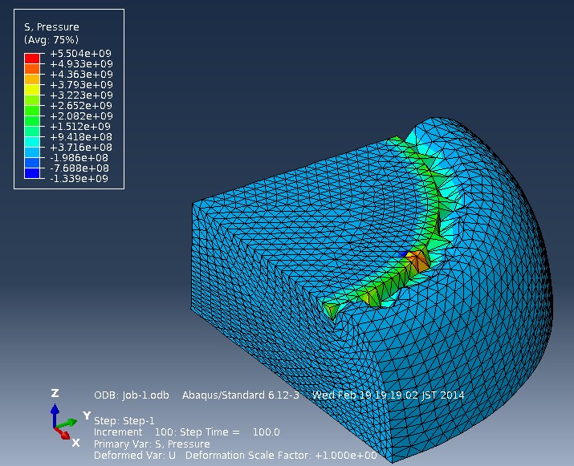
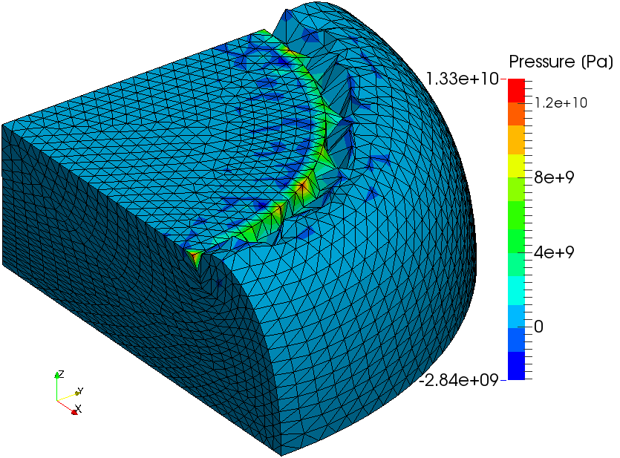
Verification ~ Compression of 1/8 Cylinder ~
Comparison to ABAQUS
Deformation is almost the same each other.
Pressure oscillation is about double in our result.
Locking of corner/edge elements is observed.
C3D4H
of ABAQUS/Standard
Selective
ES/NS-FEM-T4

Slide 23
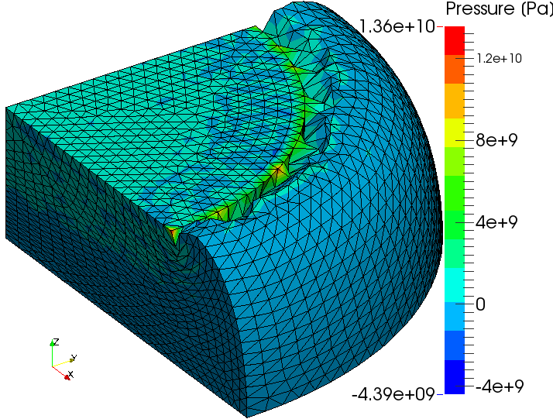
Verification ~ Compression of 1/8 Cylinder ~
Comparison to ABAQUS
Deformation is almost the same each other.
Pressure oscillation is about double in our result.
Locking of corner/edge elements is observed.
C3D4H
of ABAQUS/Standard
Selective
FS/NS-FEM-T4

Slide 24
Part 2:
Demonstration of our methods
with mesh rezoning

Slide 25
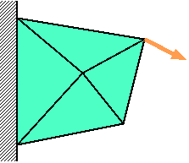
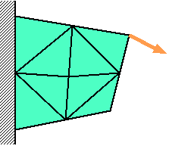
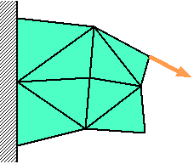



Procedure of Mesh Rezoning
Time:
t_{n-1}
Time:
t_{n}
Time:
t_{n+1}
Force
$$f^{\text{ext}}=f^{\text{int}}$$
$$f^{\text{ext}}≠f^{\text{int}}$$
$$f^{\text{ext}}=f^{\text{int}}$$
Solve
Equilibrium
Remesh
&
Map States
Resolve
Equilibrium
Solve
Equilibrium

Slide 26
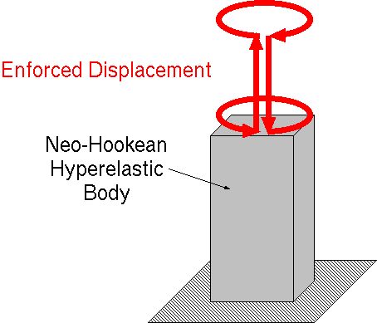
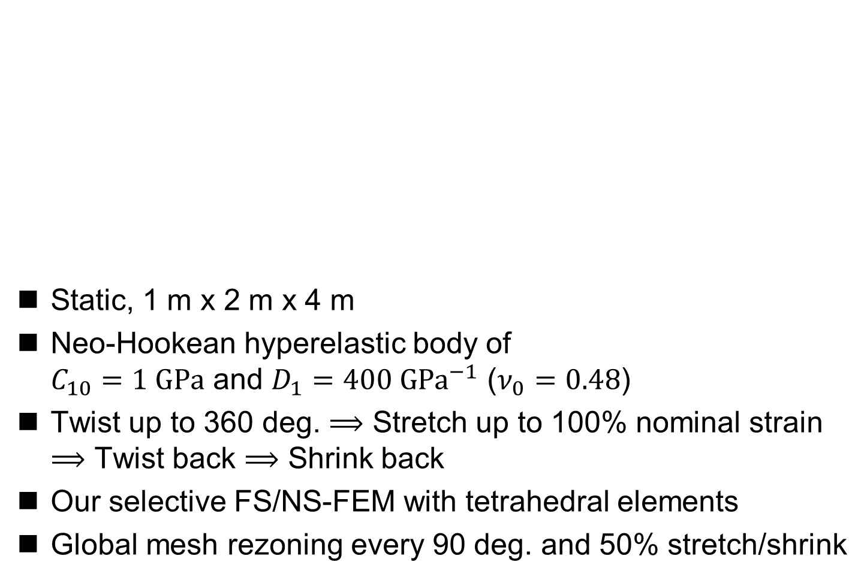
Demo ~ Twist & Stretch of Rubber Cuboid ~
Static, 1 m x 2 m x 4 m
Neo-Hookean hyperelastic body of
$C_{10}=1 GPa$ and $D_{1}=400 GPa^{−1}$ ($ν_{0}=0.48$)
Twist up to 360 deg. $⟹$ Stretch up to 100% nominal strain
$⟹$ Twist back $⟹$ Shrink back
Our selective FS/NS-FEM with tetrahedral elements
Global mesh rezoning every 90 deg. and 50% stretch/shrink

Slide 27
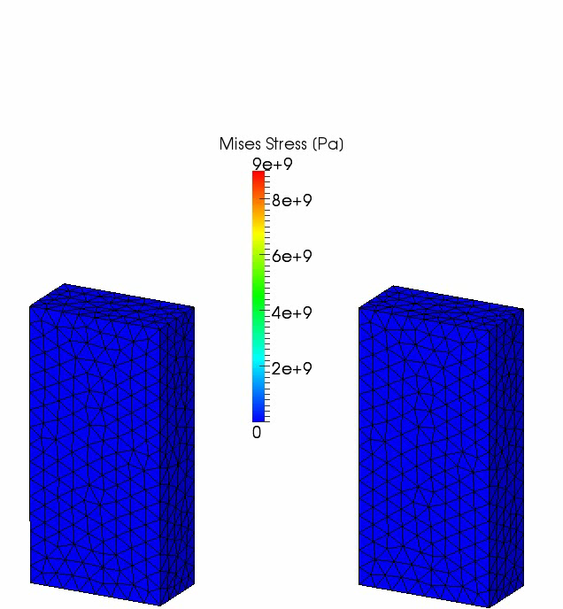
Demo ~ Twist & Stretch of Rubber Cuboid ~
Our selective
FS/NS-FEM
with
mesh rezoning
Our selective
FS/NS-FEM
without
mesh rezoning

Slide 28
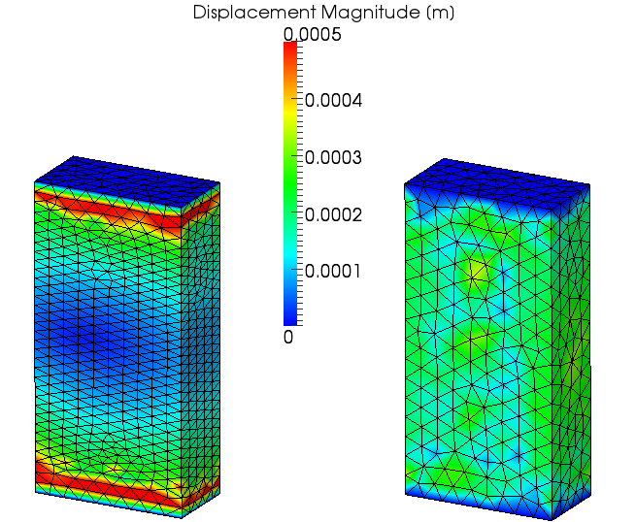
Demo ~ Twist & Stretch of Rubber Cuboid ~
Residual Displacement
It
spring-
backed
almost
perfectly!!

Slide 29
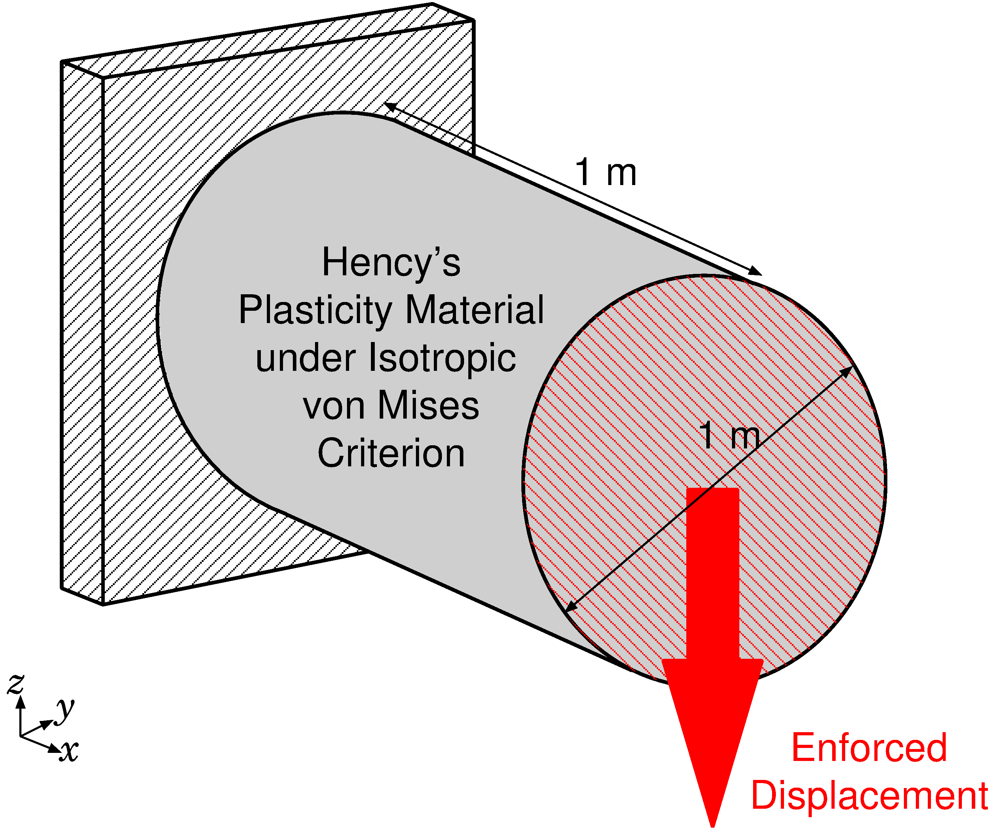

Demo ~ Shearing & Necking of Plastic Rod ~
Outline
Static, 3D
Hencky's elasto-plastic material, $T=C :h_{el}/J$,
with von Mises yield criterion and isotropic hardening.
Young's Modulus: 1 GPa, Poisson's Ratio: 0.3,
Yield Stress: 1 MPa, Hardening Coeff.: 0.5 MPa.

Slide 30
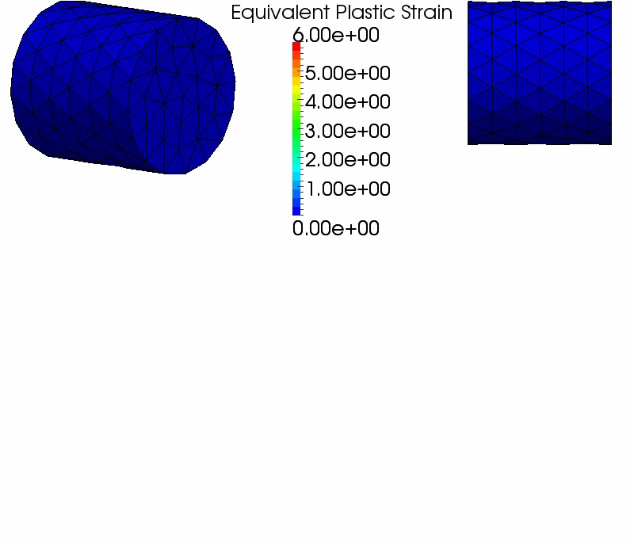
Demo ~ Shearing & Necking of Plastic Rod ~
3D Result
The deformation
seems
to be valid.
After 2.8 m disp.,
mesh rezoning
error
occurred.

Slide 31
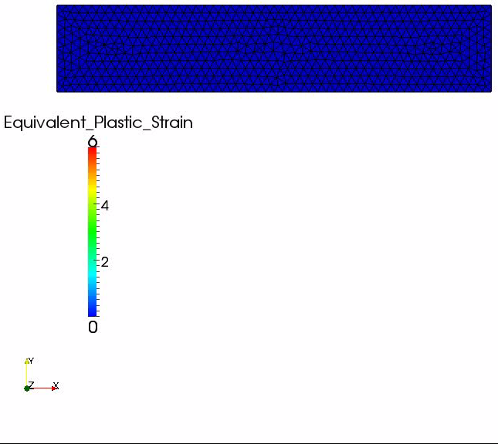
Demo ~ Shearing & Necking of Plastic Rod ~
Result of
Similar
Analysis
in 2D with
Selective
ES/NS-
FEM-T3

Slide 32
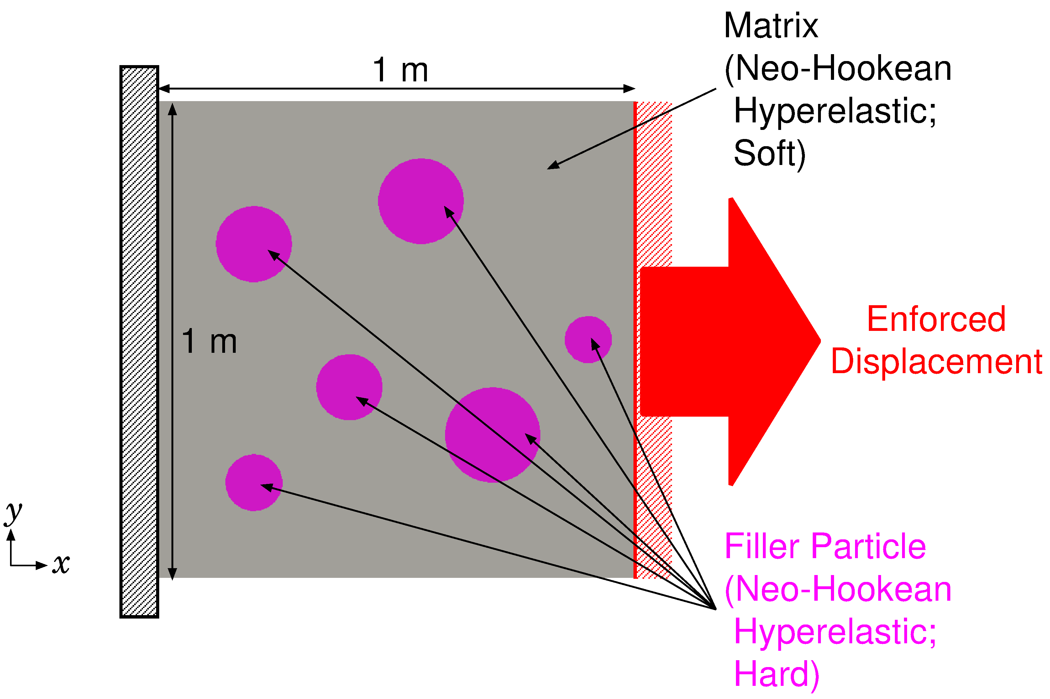

Demo ~Tension of Filler Particle Composite~
Outline
2D, plane-strain, static
Neo-Hookean Hyperelastic
  Filler: hard rubber（$E^{initial}=100 \text{GPa}, { ν}^{initial}=0.49$）
  Matrix: soft rubber（$E^{initial}=1 \text{GPa}, { ν}^{initial}=0.49$）

Slide 33
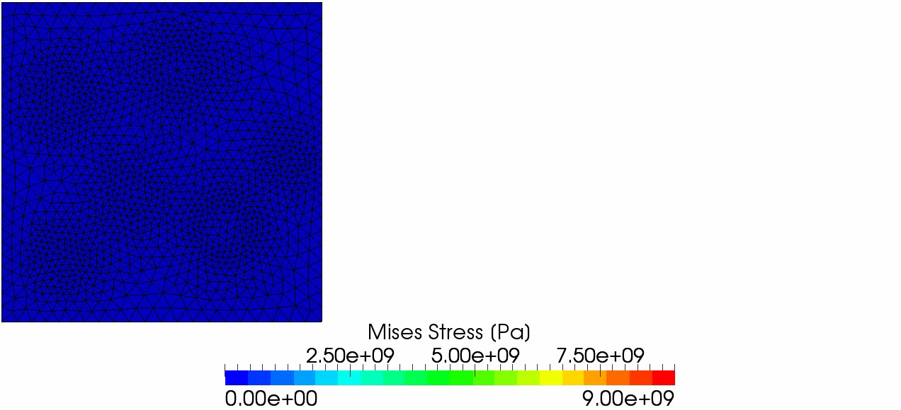
Demo ~Tension of Filler Particle Composite~
Result of Selective ES/NS-FEM-T4
The deformation seems to be valid.
After 180% stretch, analysis stopped due to mesh rezoning error.

Slide 34
Summary

Slide 35
Characteristics of S-FEMs & C3D4H
 | Shear Locking | Volumetric Locking | Zero Energy Mode | No Increase in DOF | Pressure Oscillation | Dev/Vol Coupled Material
Standard FEM-T4 | ✗ | ✗ | ✓ | - | ✗ | ✓
Selective FS/NS-FEM-T4 & ES/NS-FEM-T4 | ✓ | ✓ | ✓ | ✓ | ✗ | ✗
ABAQUS C3D4H | ✓ | ✓ | ✓ | ✗ | ✗ | ✓
Issues in Future

Slide 36
Take-Home Messages
Selective S-FEMs with triangular or tetrahedral elements are locking free and easy to implement.
The accuracy of selective S-FEMs is almost the same as C3D4H of ABAQUS, which is one of the current best hybrid elements.
Selective S-FEMs go well together with mesh rezoning.

Slide 37
Summary and Future Work
Summary
  A new implicit static mesh rezoning method for severely large deformation analysis is proposed.
  It adopts our modified selective S-FEM, which separates stress into deviatoric part and hydrostatic part.
  Its accuracy are verified with hyperelastic material and elasto-plastic material.
Future Work
  Resolve pressure oscillation issue
  Apply to contact forming, crack propagation, etc.
  Explicit dynamic formulation
  Local mesh rezoning
Thank you for your kind attention.
I appreciate your question in slow and easy English!!

