Slide 1
A Novel
Smoothed Finite Element Formulation
Based on the
Implicit Incremental Equilibrium Equation for Large Deformation Analysis with Mesh Rezoning
Yuki ONISHI, Kenji AMAYA
Tokyo Institute of Technology (Japan)

Slide 2
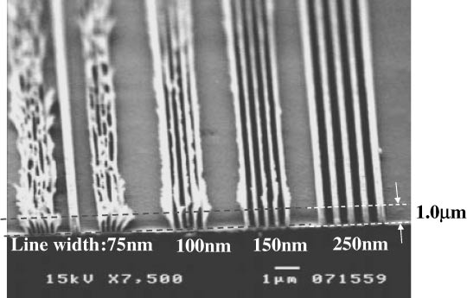
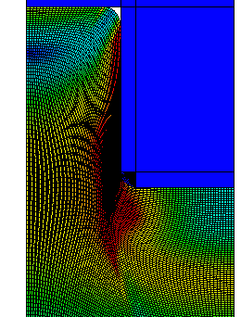
Motivation and Background
Motivation
  We want to solve severely large deformation problems
  accurately and stably!
  (Final target: thermal nanoimprinting)
Background
  Finite elements are distorted
  in a short time, thereby resulting
  in convergence failure.
Mesh rezoning method (h-adaptive
mesh-to-mesh solution mapping)
is indispensable.
Mold
Polymer

Slide 3
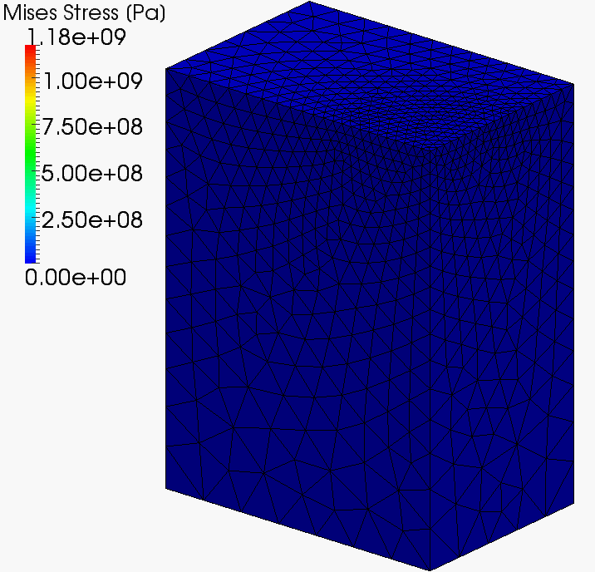
Our First Result in Advance
static-implicit
large deformation
analysis
with
mesh rezoning

Slide 4
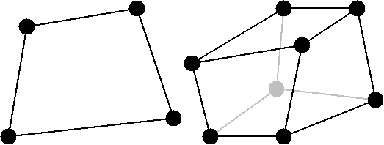
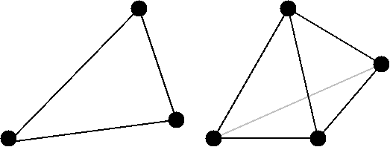
2 Major Problems in Mesh Rezoning
Problem 1: accuracy
It is impossible to remesh arbitrary deformed 2D or 3D domains with quadrilateral or hexhedral elements.
However, the standard (constant strain) triangular or tetrahedral elements induce shear and volumetric locking easily, which leads to inaccurate results.
Higher order elements are not effective in large deformation.
Neither B-bar nor F-bar is applicable to triangular/tetrahedral.
EAS is unstable. Mixed/Hybrid formulation is complicated.
NO
YES
We have to use triangular or tetrahedral elements...

Slide 5
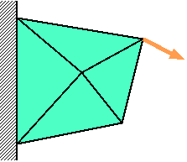
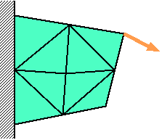
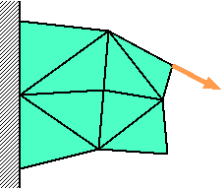



2 Major Problems in Mesh Rezoning
Problem 2: stability
The resolving process in mesh rezoning sometimes induces extremely large deformation.
Convergence
Failure
Time:
t_{n-1}
Time:
t_{n}
Time:
t_{n+1}
Large
deformation
is induced.
Force
$$f^{\text{ext}}=f^{\text{int}}$$
$$f^{\text{ext}}≠f^{\text{int}}$$
$$f^{\text{ext}}=f^{\text{int}}$$
Solve
Equilibrium
Remesh
&
Map States
Resolve
Equilibrium
Solve
Equilibrium

Slide 6
Our Ideas
Idea for accuracy improvement
We adopt smoothed finite element method (S-FEM) to avoid shear and volumetric locking even with use of triangular or tetrahedral elements.
Idea for stability improvement
We adopt the incremental implicit equilibrium equation (IIEE) as the equation to solve.
In this talk today,
I focus on Problem 1 and the idea of S-FEM.

Slide 7
Objective
Develop an accurate
mesh rezoning method
for large deformation problems
with our modified S-FEM formulation
Table of Body Contents
- Part 1: Introduction of our modified S-FEM formulation
- Part 2: Procedure of our mesh rezoning method
- Part 3: Examples analysis
- Summary

Slide 8
Part 1:
Introduction of Our Modified S-FEM Formulation

Slide 9
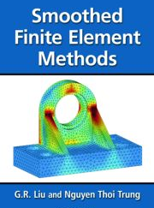
What is Smoothed FEM (S-FEM)?
One of strain smoothing techniques.
There are several types of S-FEM.
  Edge-based (ES-FEM) for 2D
  Face-based (FS-FEM) for 3D
  Node-based (NS-FEM) for both 2D and 3D
  Selective edge/node-based (ES/NS-FEM) for 2D
  Selective face/node-based (FS/NS-FEM) for 3D, etc..
Selective S-FEMs are thought to be the best choice because they can avoid both shear and volumetric locking even with use of triangular or tetrahedral elements.
I will explain ES-FEM, NS-FEM,
and selective ES/NS-FEM one by one.

Slide 10
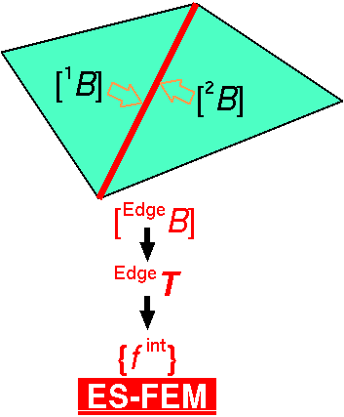

Edge-based S-FEM (ES-FEM)
Calculate $[B]$ at element as usual.
Distribute $[B]$ to the connecting edges and make $[ ^{Edge}B]$.
F, T etc and {f ^{int}} are calculated on smoothed edge domains.
Generally accurate but induces volumetric locking.
Substituting "face" for "edge"
gives FS-FEM for 3D

Slide 11
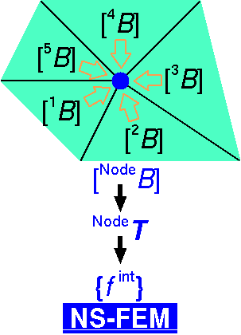

Node-based S-FEM (NS-FEM)
Calculate $[B]$ at element as usual.
Distribute $[B]$ to the connecting nodes and make $[ ^{Node}B]$
F, T etc and {f ^{int}} are calculated on smoothed node domains.
Generally not accurate but volumetric locking free.
(due to zero-energy modes,
which are arisen in
reduced integration
finite elements as
hour-glass modes)
close to FVM with
vertex-based control volume

Slide 12
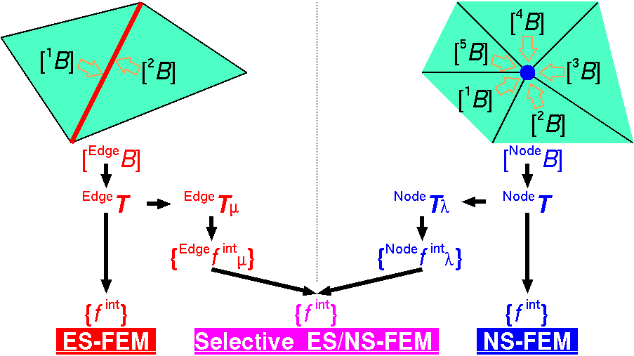

Original Selective ES/NS-FEM
Separate stress into "$μ$ part" and "$λ$ part", where $μ$ and $λ$ are the Lame's parameters.
F, T etc and {f ^{int}} are calculated on both smoothed domains.
Only applicable to elastic constitutive models.
Substituting
"face"
for
"edge"
gives
FS/NS-FEM
for 3D

Slide 13


Our Selective ES/NS-FEM
Separate stress into "deviatoric part" and "hydrostatic part"
instead of "$μ$ part" and "$λ$ part".
F, T etc and {f ^{int}} are calculated on both smoothed domains.
Applicable to any kind of material constitutive models.
Substituting
"face"
for
"edge"
gives
FS/NS-FEM
for 3D

Slide 14
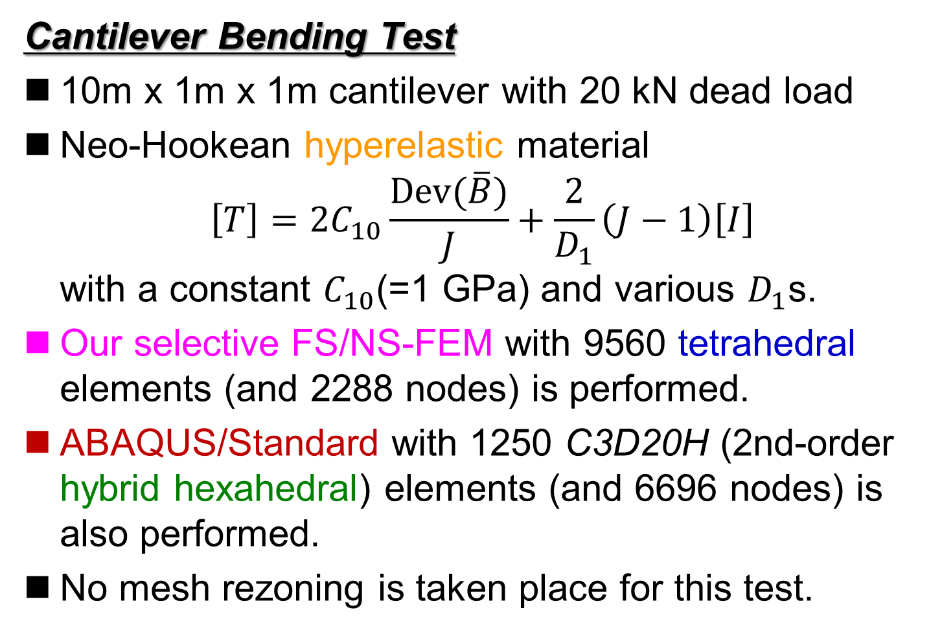
Verification of Our Selective S-FEM
Cantilever Bending Test
10m x 1m x 1m cantilever with 20 kN dead load
Neo-Hookean hyperelastic material
$\left[T\right]=2C_{10}\frac{Dev(\overline{B})}{J}+\frac{2}{D_{1}}\left(J−1\right)\left[I\right]$
with a constant $C_{10}$(=1 GPa) and various $D_{1}$s.
Our selective FS/NS-FEM with 9560 tetrahedral elements (and 2288 nodes) is performed.
ABAQUS/Standard with 1250 C3D20H (2nd-order hybrid hexahedral) elements (and 6696 nodes) is also performed.
No mesh rezoning is taken place for this test.

Slide 15
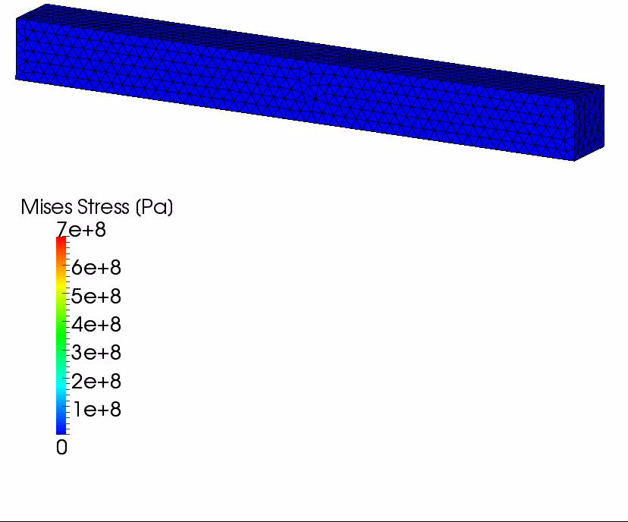

Verification of Our Selective S-FEM
Results with $D_{1}=2 PPa^{−1}$ ($ν_{0}$=0.499999)
The amount of
vertical deflection
is about
6.5 m.
If we use
constant strain
tetrahedral,
the amount of
vertical deflection
is about only
0.1 m.

Slide 16
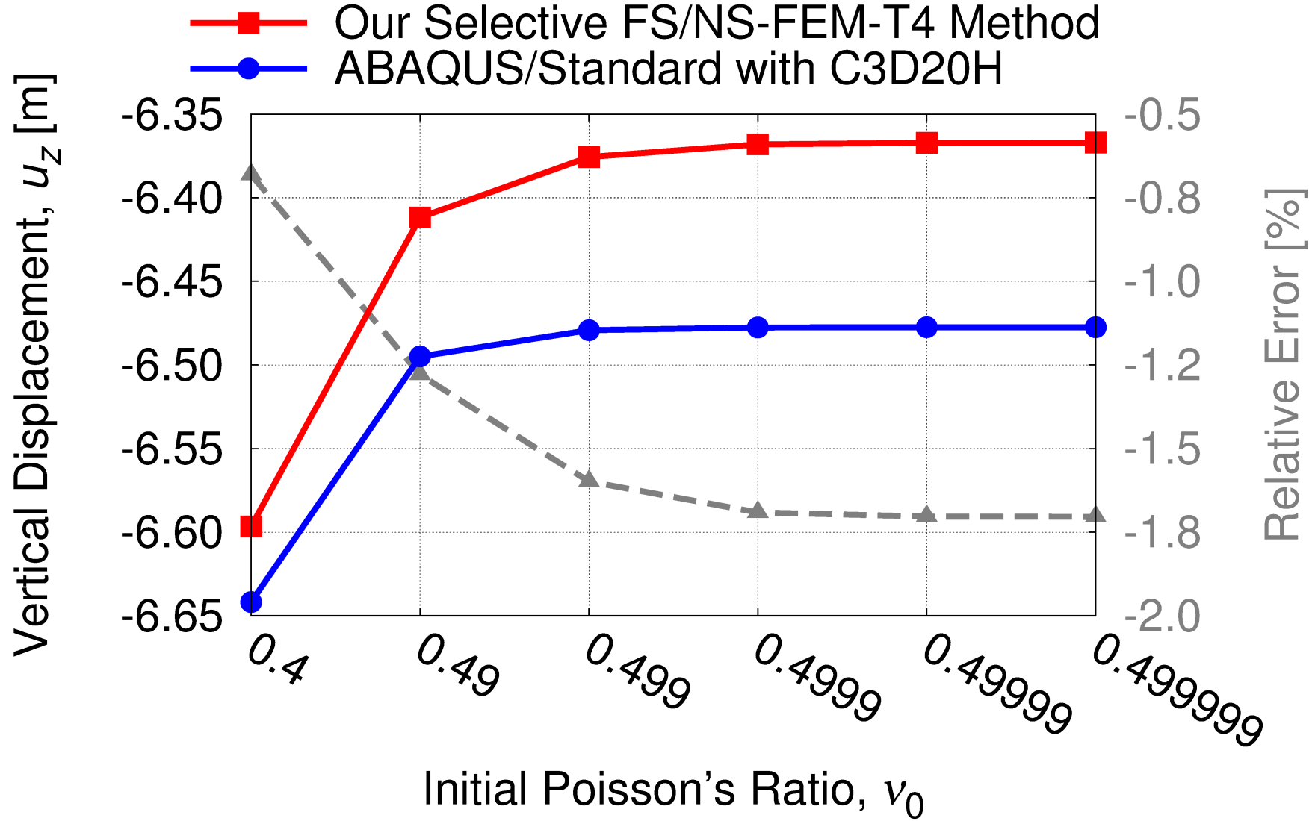
Verification of Our Selective S-FEM
Comparison to Hybrid Element Case
Our selective S-FEM can treat any material model
and is free from locking!!

Slide 17
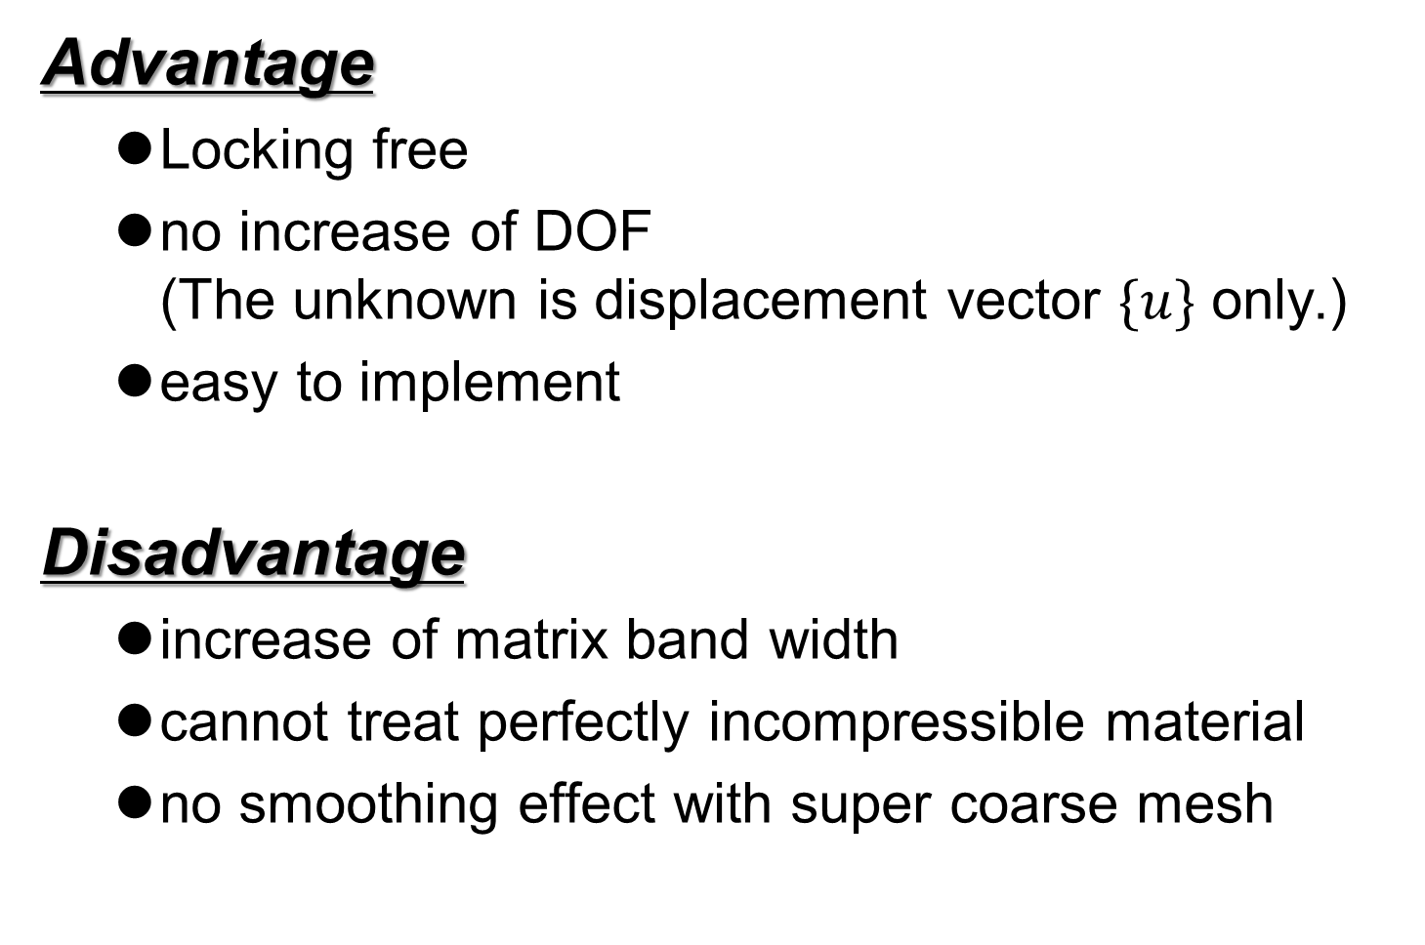
Characteristics of Our S-FEM
Advantage
  Locking free
  no increase of DOF
  (The unknown is displacement vector $\{u\}$ only.)
  easy to implement
Disadvantage
  increase of matrix band width
  cannot treat perfectly incompressible material
  no smoothing effect with super coarse mesh

Slide 18
Part 2:
Procedure of our mesh rezoning method

Slide 19



Procedure of Mesh Rezoning
Time:
t_{n-1}
Time:
t_{n}
Time:
t_{n+1}
Force
$$f^{\text{ext}}=f^{\text{int}}$$
$$f^{\text{ext}}≠f^{\text{int}}$$
$$f^{\text{ext}}=f^{\text{int}}$$
Solve
Equilibrium
Remesh
&
Map States
Resolve
Equilibrium
Solve
Equilibrium
The way of mapping varies with the material constitutive model.
(e.g. Elasto-plastic models necessitate some kind of correction.)

Slide 20
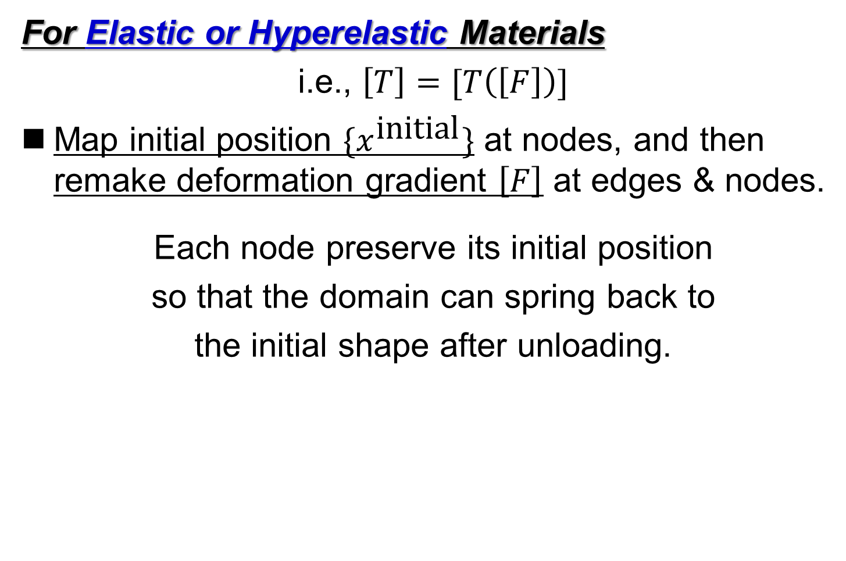
Mapping of Stress/Strain States
For Elastic or Hyperelastic Materials
i.e., $\left[T\right]=[T\left(\left[F\right]\right)]$
Map initial position $\{x^{\text{initial}}\}$ at nodes, and then remake deformation gradient $\left[F\right]$ at edges & nodes.
Each node preserve its initial position
so that the domain can spring back to
the initial shape after unloading.

Slide 21
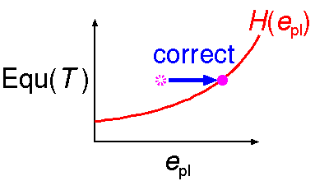
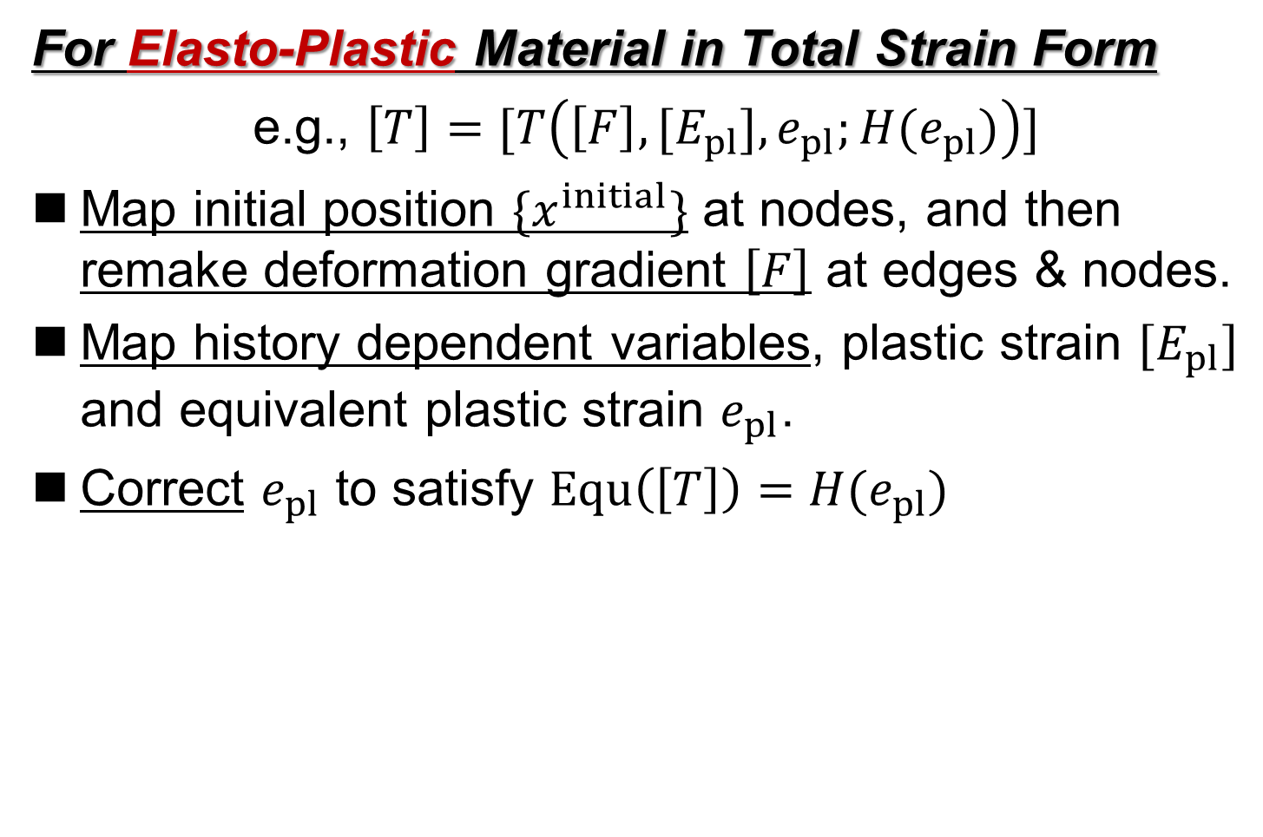
Mapping of Stress/Strain States
For Elasto-Plastic Material in Total Strain Form
e.g., $\left[T\right]=[T\left(\left[F\right],{[E}_{pl}], e_{pl};H(e_{pl})\right)]$
Map initial position $\{x^{initial}\}$ at nodes, and then
remake deformation gradient $\left[F\right]$ at edges & nodes.
Map history dependent variables, plastic strain $[E_{pl}]$ and equivalent plastic strain $e_{pl}$.
Correct $e_{pl}$ to satisfy $Equ\left(\left[T\right]\right)=H(e_{pl})$
= Mises Stress

Slide 22
Part 3:
Examples of Analysis

Slide 23
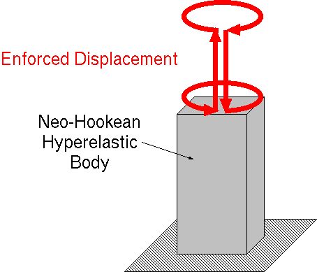
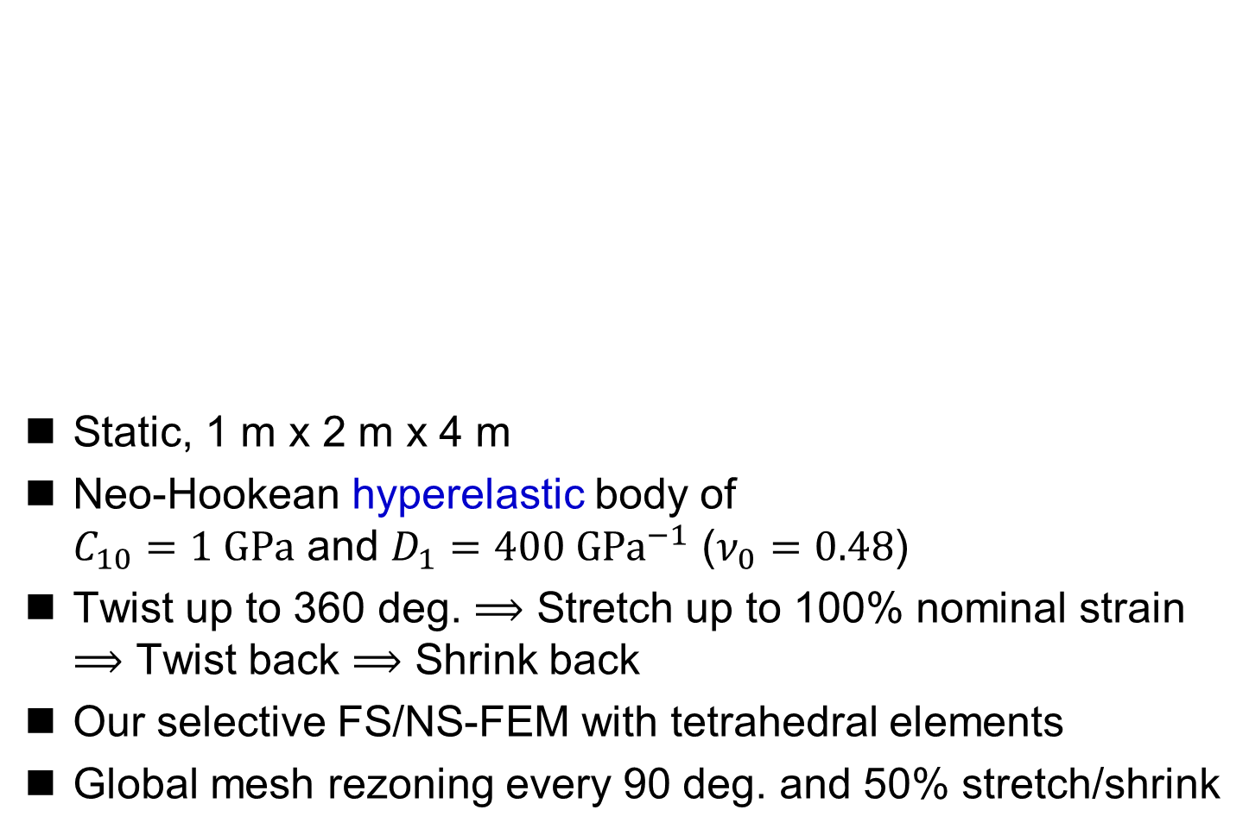
Twist and Stretch of Hyperelastic Body
Static, 1 m x 2 m x 4 m
Neo-Hookean hyperelastic body of
$C_{10}=1 GPa$ and $D_{1}=400 GPa^{−1}$ ($ν_{0}=0.48$)
Twist up to 360 deg. $⟹$ Stretch up to 100% nominal strain
$⟹$ Twist back $⟹$ Shrink back
Our selective FS/NS-FEM with tetrahedral elements
Global mesh rezoning every 90 deg. and 50% stretch/shrink

Slide 24
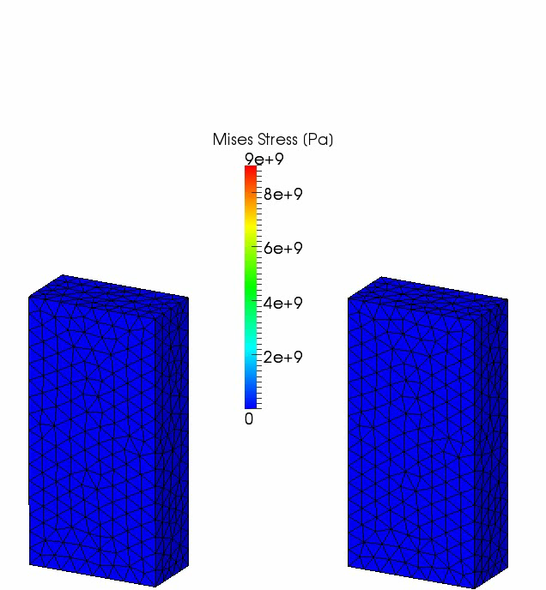
Twist and Stretch of Hyperelastic Body
Our selective
FS/NS-FEM
with
mesh rezoning
Our selective
FS/NS-FEM
without
mesh rezoning

Slide 25
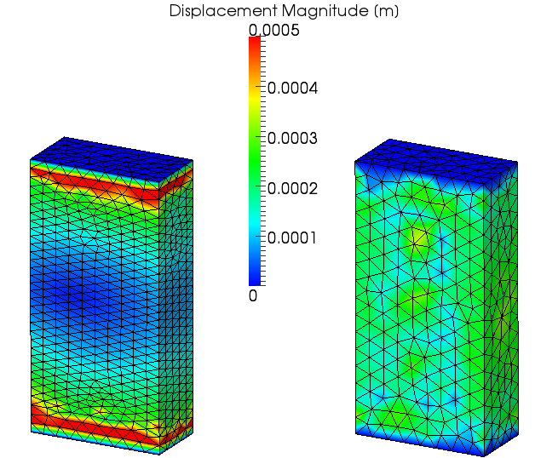
Twist and Stretch of Hyperelastic Body
Residual Displacement

Slide 26
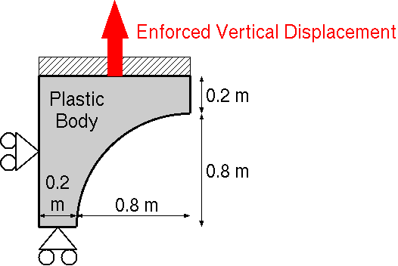
Necking of Elasto-Plastic Body
Outline
Static, Plane-strain
1/4 of test piece
horizontal constraint
on left edge
vertical constraint
on bottom edge
horizontal constraint and enforced displacement
on top edge
Mesh rezoning every 0.05 m displacement
Our selective ES/NS-FEM with triangular elements

Slide 27
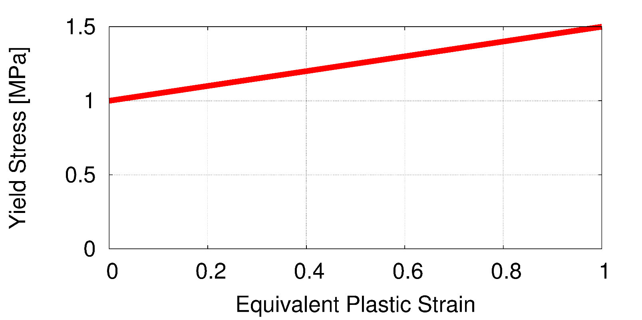

Necking of Elasto-Plastic Body
Material Constitutive Model
Hencky's elasto-plastic material, $T=C :h_{el}/J$,
with von Mises yield criterion and isotropic hardening.
Young's Modulus: 1 GPa, Poisson's Ratio: 0.3,
Yield Stress: 1 MPa, Hardening Coeff.: 0.5 MPa.
very close to
elastic-
perfect plastic
model

Slide 28
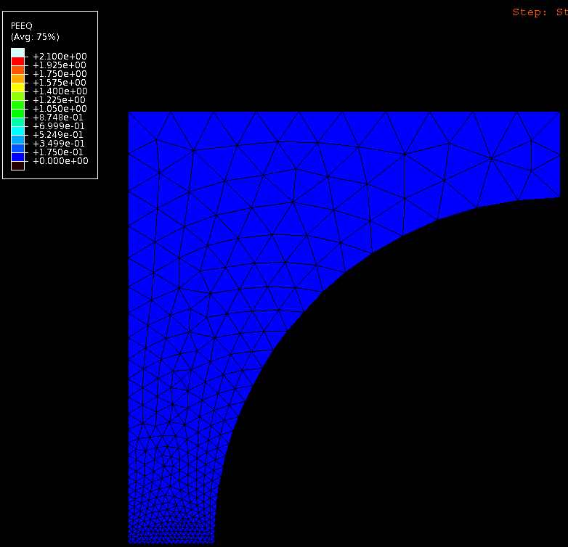
Necking of Elasto-Plastic Body
ABAQUS
/Standard
with
constant
strain
triangular
elements
Strange deformation
is obtained
due to:
locking of
triangular elements
absence of
mesh rezoning

Slide 29
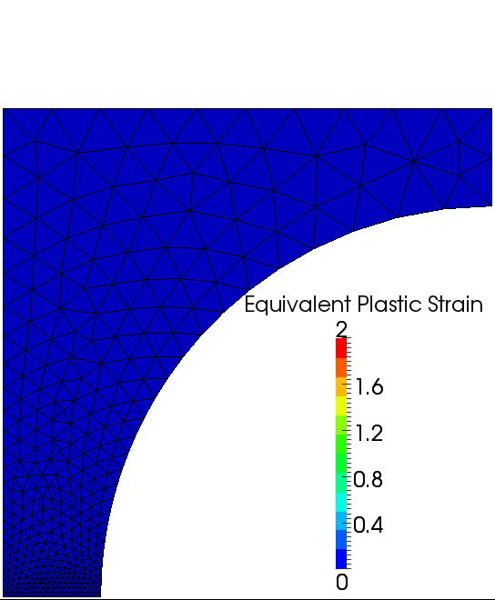
Necking of Elasto-Plastic Body
Our selective
ES/NS-FEM
with
mesh rezoning
Typical
deformation of necking test
is obtained.

Slide 30
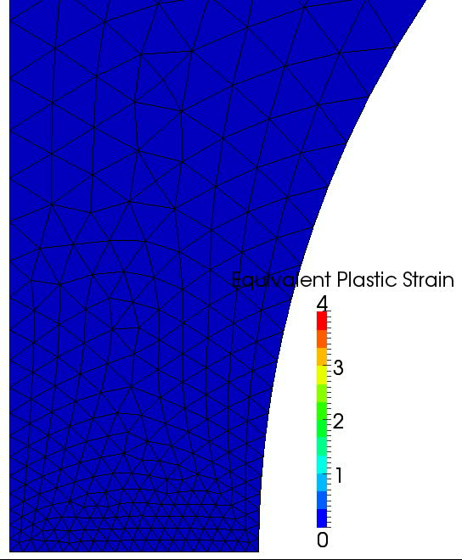
Necking of Elasto-Plastic Body
Zoom-in view
around the center

Slide 31
Summary

Slide 32
Take-Home Messages
Our modified selective S-FEM with triangular or tetrahedral elements is locking free and very easy to implement.
Our S-FEM goes well together with mesh rezoning.
Our S-FEM is worth using even without mesh rezoning.

Slide 33
Summary and Future Work
Summary
  A new static-implicit mesh rezoning method for severely large deformation analysis is proposed.
  It adopts our modified selective S-FEM, which separates stress into deviatoric part and hydrostatic part.
  Its accuracy are verified with hyperelastic material and elasto-plastic material.
Future Work
  More V&V
  Local mesh rezoning
  Apply to contact forming, crack propagation, etc.
Thank you for your kind attention.
I appreciate your question in slow and easy English!!

