Slide 1
Performance of
Smoothed Finite Element Methods with Tetrahedral Elements in Large Deformation Elasto-Plastic Analysis
Yuki ONISHI
Tokyo Institute of Technology, Japan

Slide 2
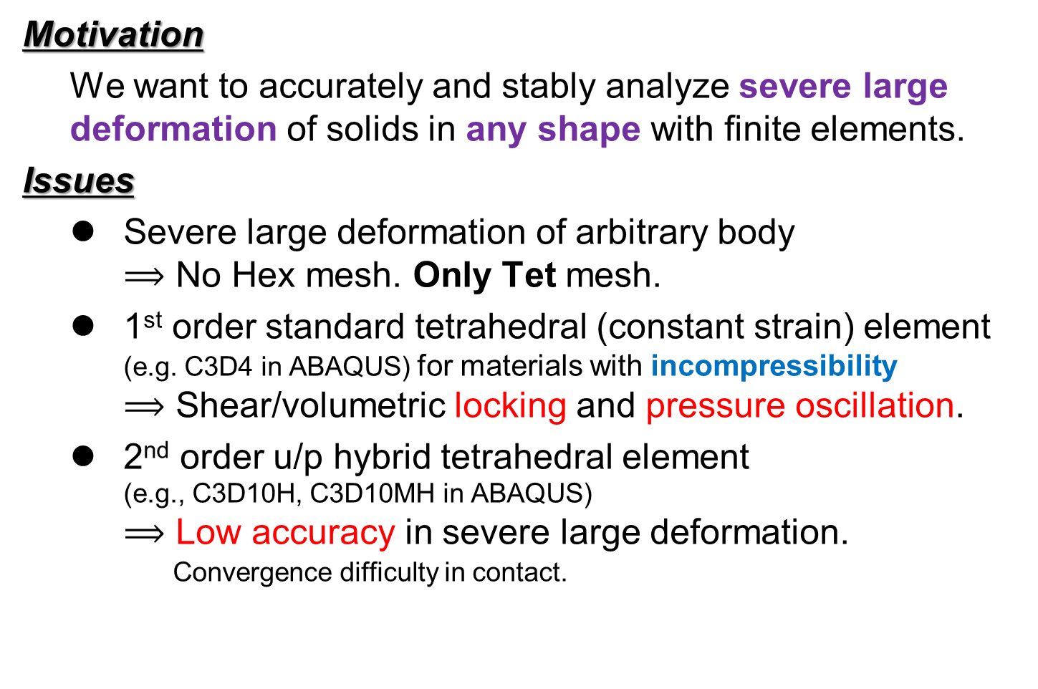
Motivation
Motivation
  We want to accurately and stably analyze severe large deformation of solids in any shape with finite elements.
Issues
  Severe large deformation of arbitrary body
  $⟹$ No Hex mesh. Only Tet mesh.
  1st order standard tetrahedral (constant strain) element
  (e.g. C3D4 in ABAQUS) for materials with incompressibility
  $⟹$ Shear/volumetric locking and pressure oscillation.
  2nd order u/p hybrid tetrahedral element
  (e.g., C3D10H, C3D10MH in ABAQUS)
  $⟹$ Low accuracy in severe large deformation.
  Convergence difficulty in contact.
  Researches on FE formulations for 1st order tetra (T4) are
  still active especially for rubber-like or elasto-plastic materials.

Slide 3
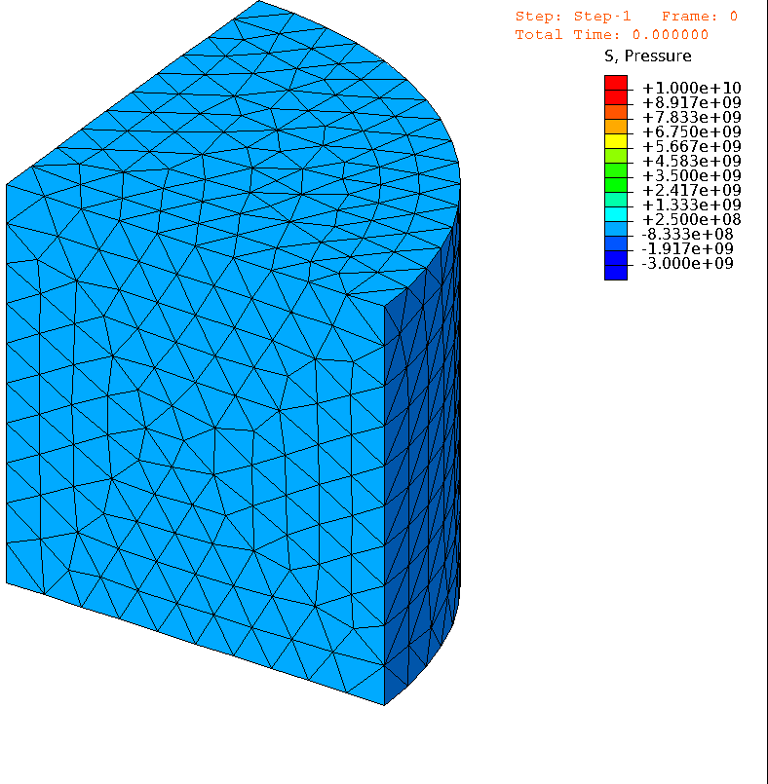


An Example for Rubber-like Material
Material: neo-Hookean hyperelastic, $ν_{ini}=0.49$
Pressure
Pressure
# of Nodes is
almost the same.
1st order hybrid T4 (C3D4H)
✓ No shear/volumetric locking
✗ Pressure oscillation
✗ Corner locking
2nd order modified hybrid T10 (C3D10MH)
✓ No shear/volumetric locking
✗ Decrease in interpolation accuracy
✗ Early convergence failure

Slide 4
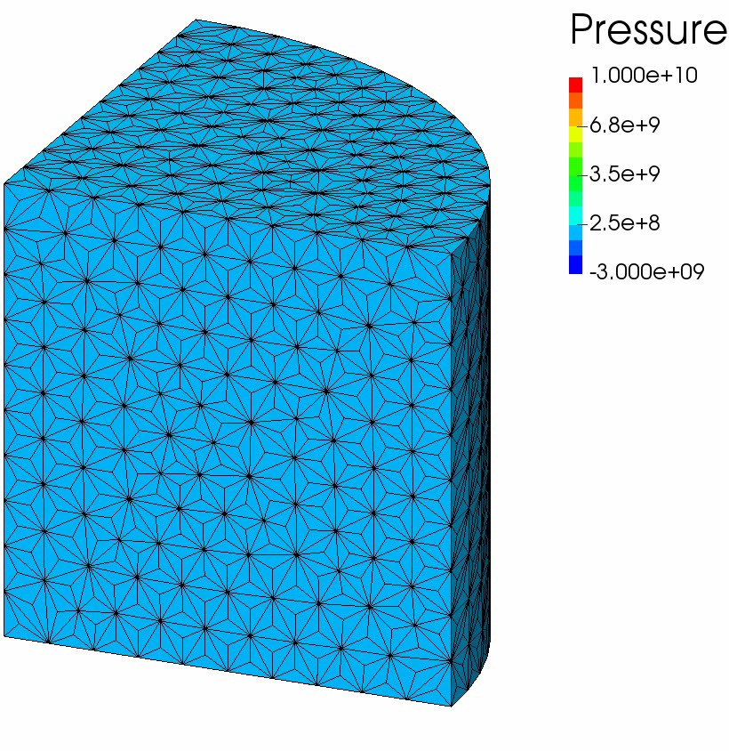
An Example for Rubber-like Material
Material: neo-Hookean hyperelastic, $ν_{ini}=0.49$
# of Nodes is
exactly the same
as the C3D4H case.
F-barES-FEM-T4 (a new type of smoothed finite element method (S-FEM))
✓ No shear/volumetric locking
✓ Less pressure oscillation
✓ Less corner locking
F-barES-FEM-T4 has excellent accuracy
on rubber-like materials.
How about it on elasto-plastic materials?

Slide 5
Objective
Apply the new type of S-FEM,
F-barES-FEM-T4,
to large deformation problems
of elasto-plastic materials.
Table of Body Contents
Methods: Quick introduction of F-barES-FEM-T4
Results: A few verification analyses
Summary

Slide 6
Methods
Quick introduction of F-barES-FEM-T4
(F-barES-FEM-T3 in 2D is explained for simplicity.)

Slide 7
What is S-FEM?
S-FEM: Smoothed Finite Element Method
A new sort of strain smoothing technique (since 2007).
Strain is smoothed across elements.
Various types of S-FEMs:
  Basic types
    Node-based S-FEM (NS-FEM)
    Face-based S-FEM (FS-FEM)
    Edge-based S-FEM (ES-FEM)
  Selective types (e.g. ES/NS-FEM)
  Bubble types (e.g. bES-FEM)
  F-bar type (e.g. F-barES-FEM)
✗ Spurious zero-energy mode
or Volumetric locking,
Pressure oscillation,
Corner locking.
NEW
✓ Good in hyperelastic case.
? Unknown in elasto-plastic case.

Slide 8

Quick Review of NS-FEM
Algorithm:
Calculate the deformation gradient $F$ at each element as usual.
Distribute the deformation gradient $F$ to the connecting nodes with area weights to make $^{Node}\tilde{F}$ at each node.
Use $^{Node}\tilde{F}$ to calculate the stress, nodal force and so on.
For triangular (T3)
or tetrahedral (T4)
elements.
NS-FEM avoids shear/volumetric locking in T3/T4 elements.
Yet, it suffers from zero-energy modes,
pressure oscillation and corner locking...

Slide 9

Quick Review of ES-FEM
Algorithm:
Calculate the deformation gradient $F$ at each element as usual.
Distribute the deformation gradient $F$ to the connecting edges with area weights to make $^{Edge}\tilde{F}$ at each edge.
Use $^{Edge}\tilde{F}$ to calculate the stress, nodal force and so on.
For triangular (T3)
or tetrahedral (T4)
elements.
ES-FEM avoids shear locking in T3/T4 elements.
Yet, it suffers from volumetric locking,
pressure oscillation and corner locking…

Slide 10
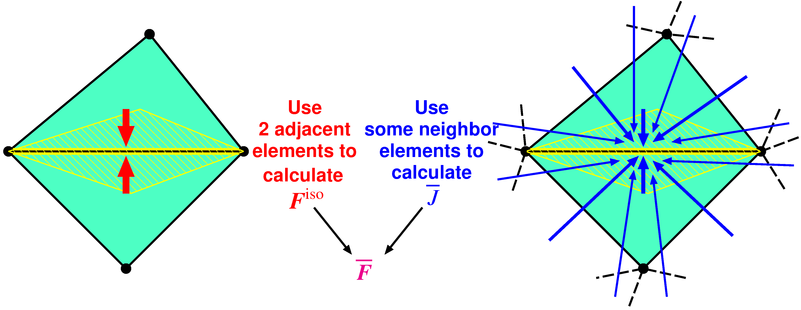

Quick Introduction of F-barES-FEM
$^{Edge}{\tilde{F}}^{iso}$ is given by ES-FEM.
$^{Edge}\overline{ J }$ is given by cyclic nodal smoothing.
$^{Edge}\overline{F }$ is calculated in the manner of F-bar method:
$^{Edge}\overline{F }=$ $^{Edge}{\overline{ J }}^{1/3}$ $^{Edge}{\tilde{F}}^{iso}$.
Concept: combination of F-bar method and ES-FEM

Slide 11
Results
A few verification analyses

Slide 12
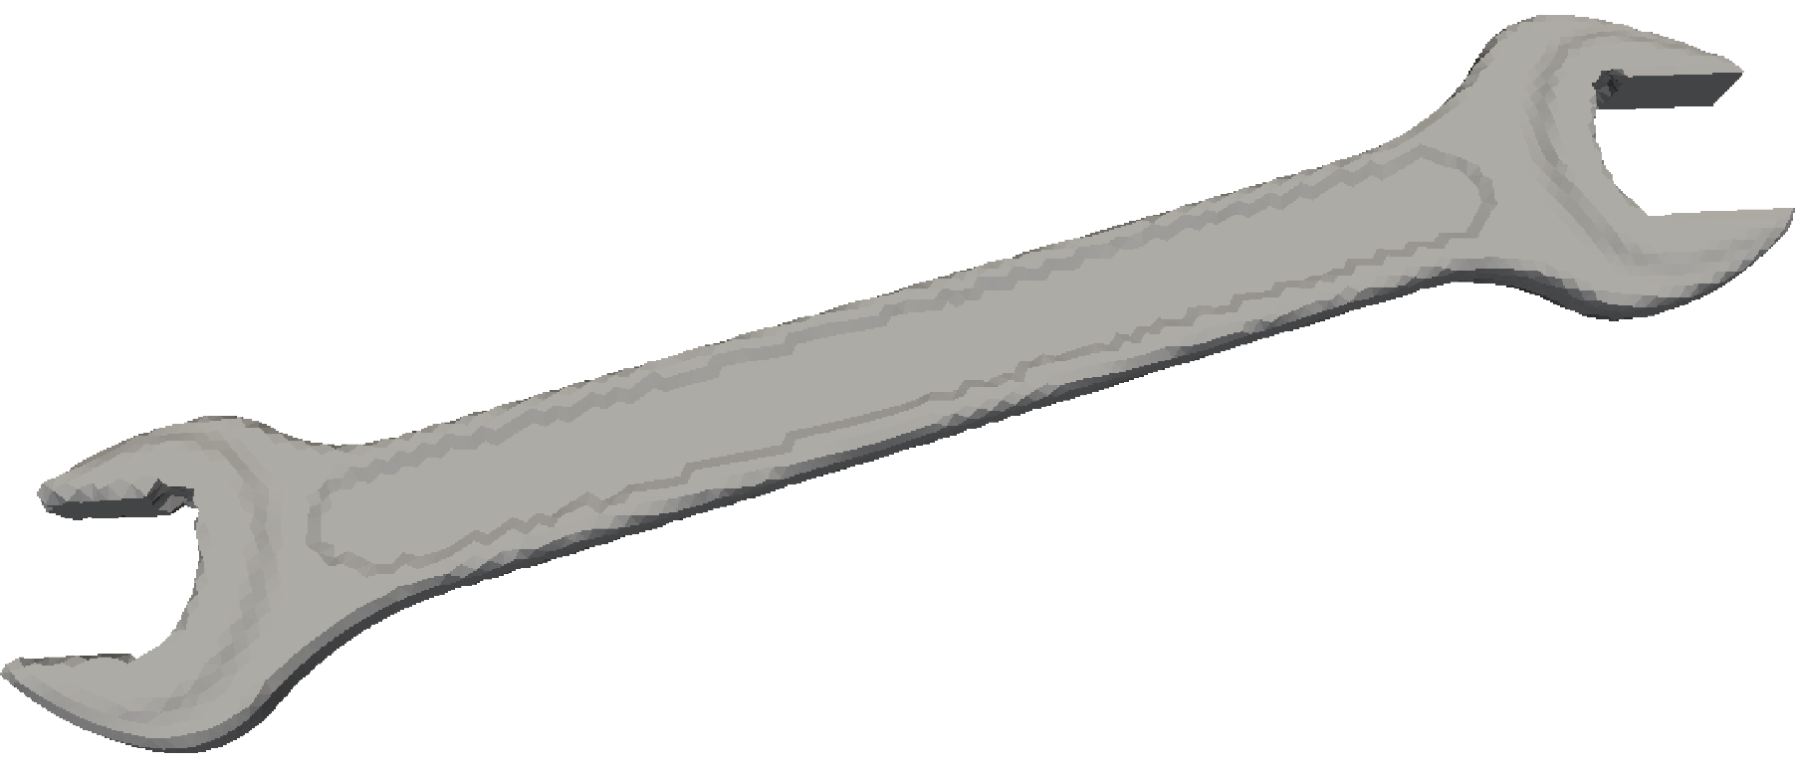
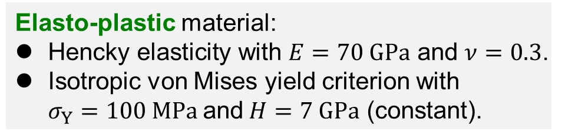
Bending of Elasto-Plastic Spanner
Outline
2 faces are perfectly constrained.
Pressure is applied to a side part of the spanner.
Compared to ABAQUS C3D4H with the same unstructured T4 mesh.
8.5 k nodes & 33 k elems.
Fixed
Elasto-plastic material:
Hencky elasticity with $E=70 GPa$ and $ν=0.3$.
Isotropic von Mises yield criterion with
$σ_{Y}=100 MPa$and$H=7 GPa$ (constant).
Pressure
P. 12

Slide 13
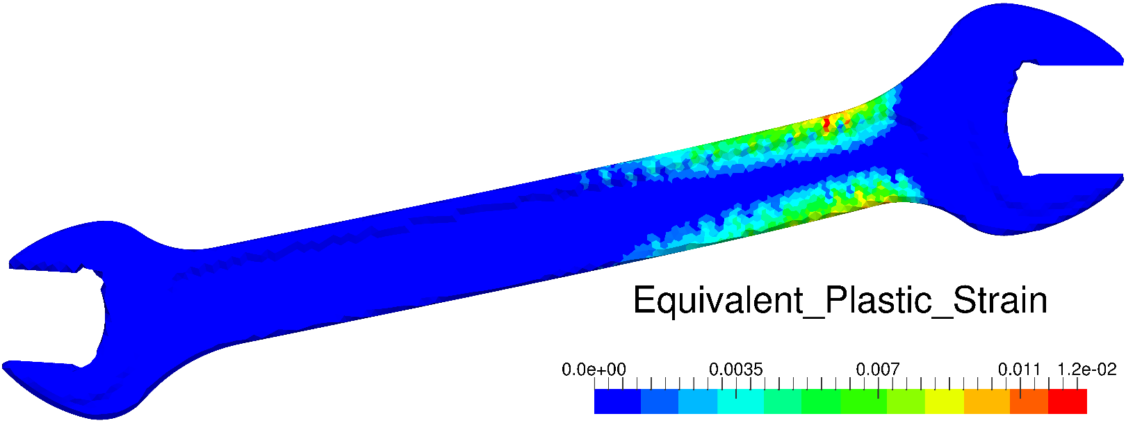
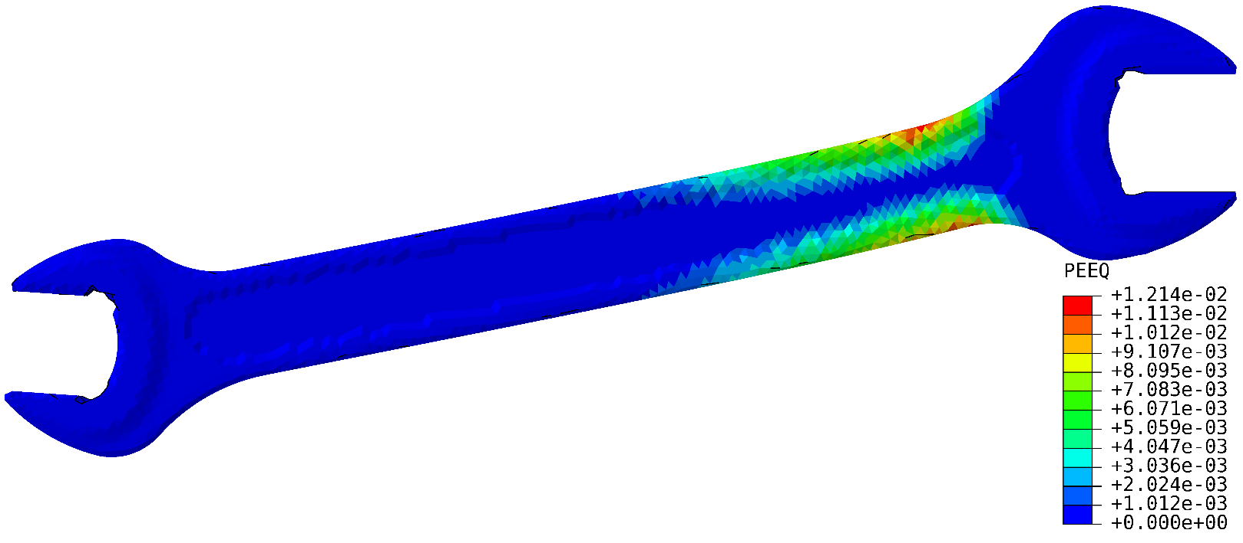
Bending of Elasto-Plastic Spanner
Equivalent Plastic Strain
F-barES-FEM-T4
ABAQUS C3D4H
Distributions of
equivalent plastic strain
are about the same.

Slide 14
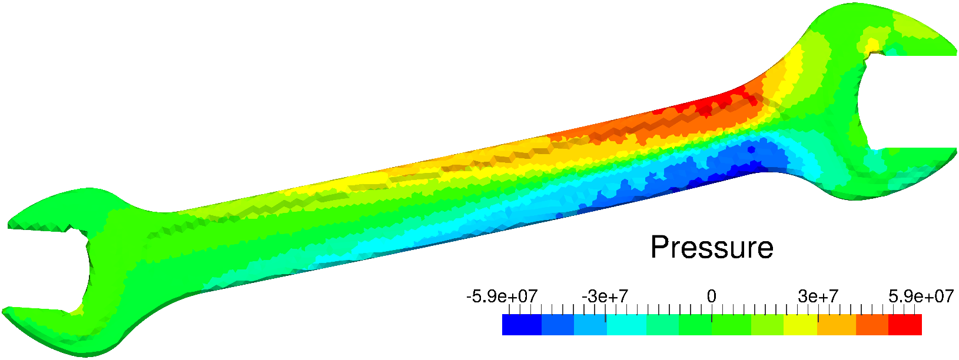
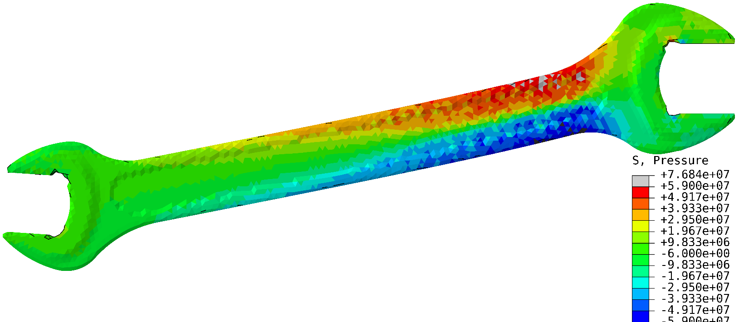
Bending of Elasto-Plastic Spanner
Pressure
Smooth distribution here.
F-barES-FEM-T4
Checkerboard patterns here.
ABAQUS C3D4H
ABAQUS C3D4H suffers from pressure oscillation
even in a small deformation elasto-plastic case.

Slide 15
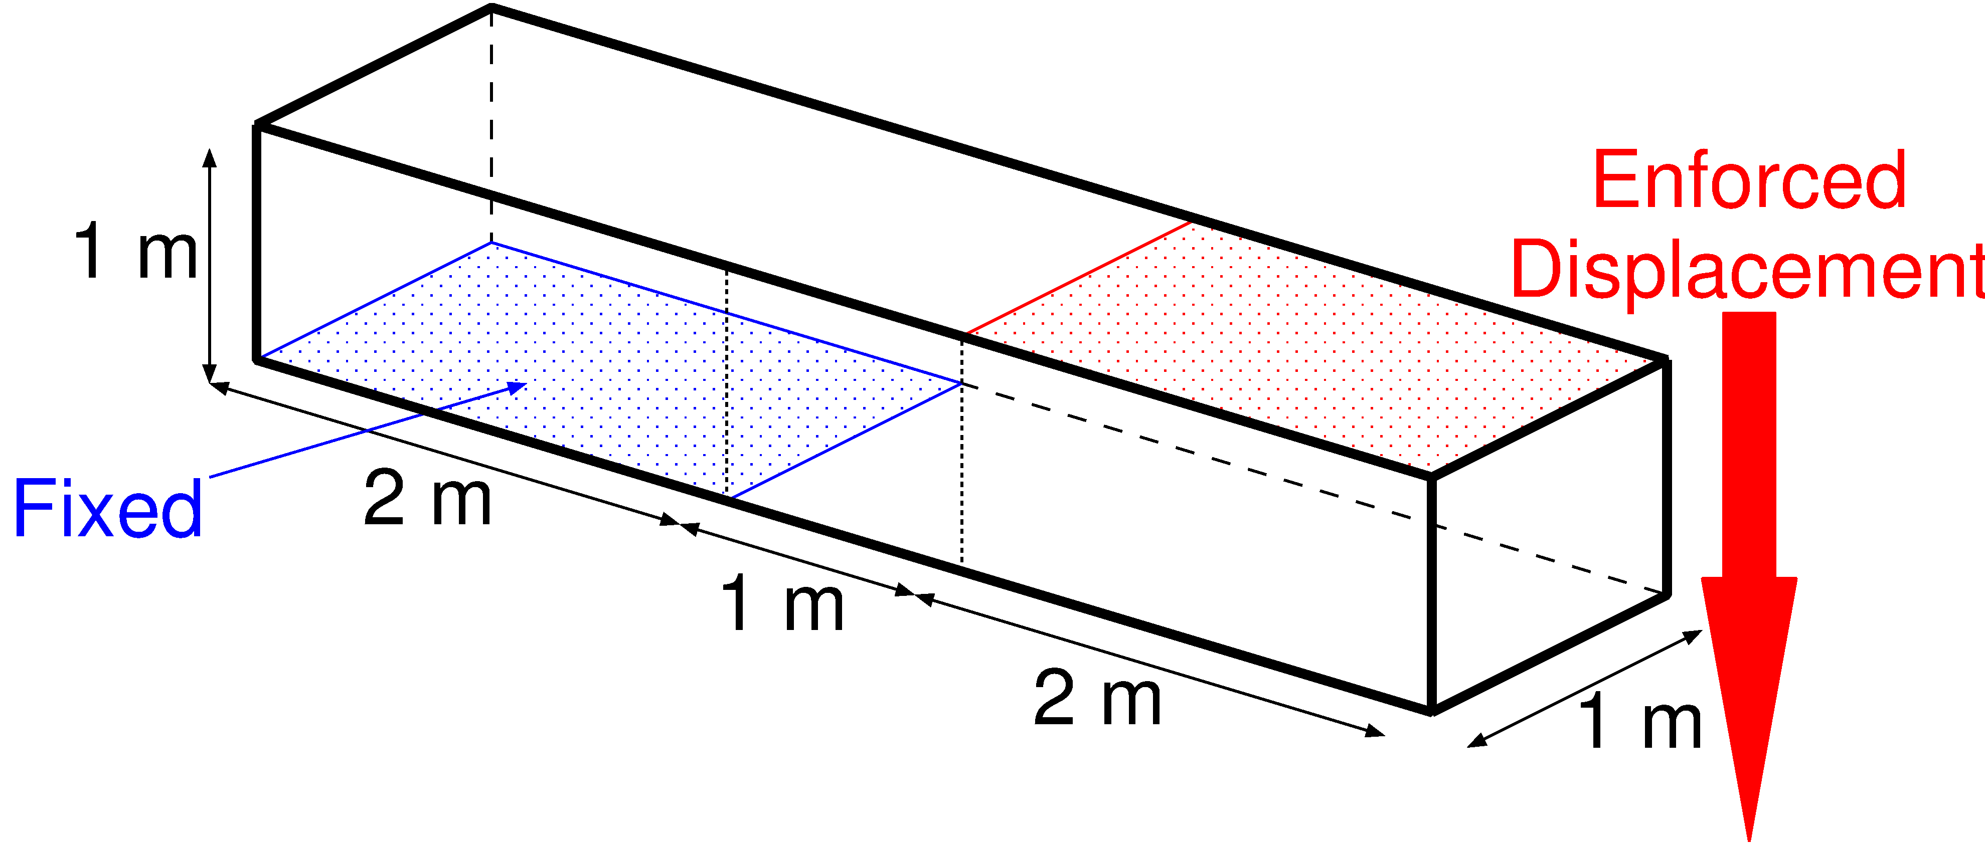
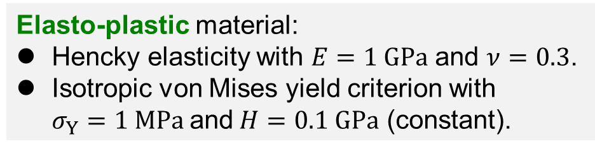
Shearing & Tensioning of Elasto-Plastic Bar
Outline
Blue face is perfectly constrained.
Red face is constrained in plane and pressed down.
Compared to ABAQUS C3D4H with the same unstructured T4 mesh.
1.2 k nodes & 4.8 k elems.
Elasto-plastic material:
Hencky elasticity with $E=1 GPa$ and $ν=0.3$.
Isotropic von Mises yield criterion with
$σ_{Y}=1 MPa$and$H=0.1 GPa$ (constant).
P. 15

Slide 16
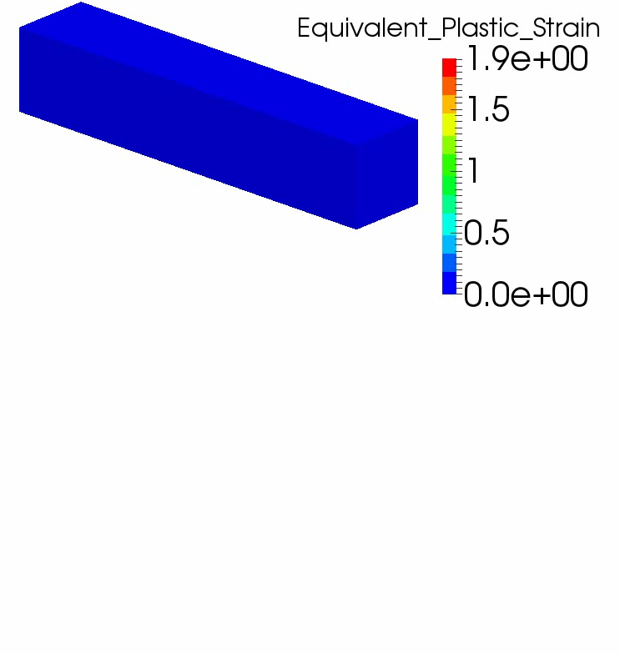
Shearing & Tensioning of Elasto-Plastic Bar
Result
of F-bar
ES-FEM
(Equiv.
Plastic
Strain)

Slide 17
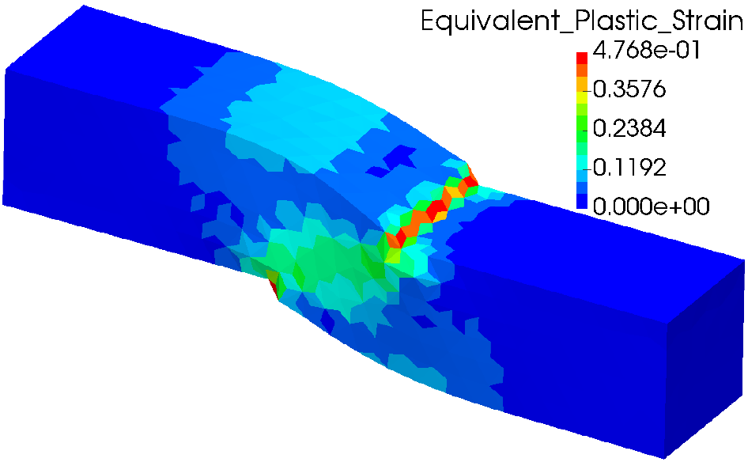
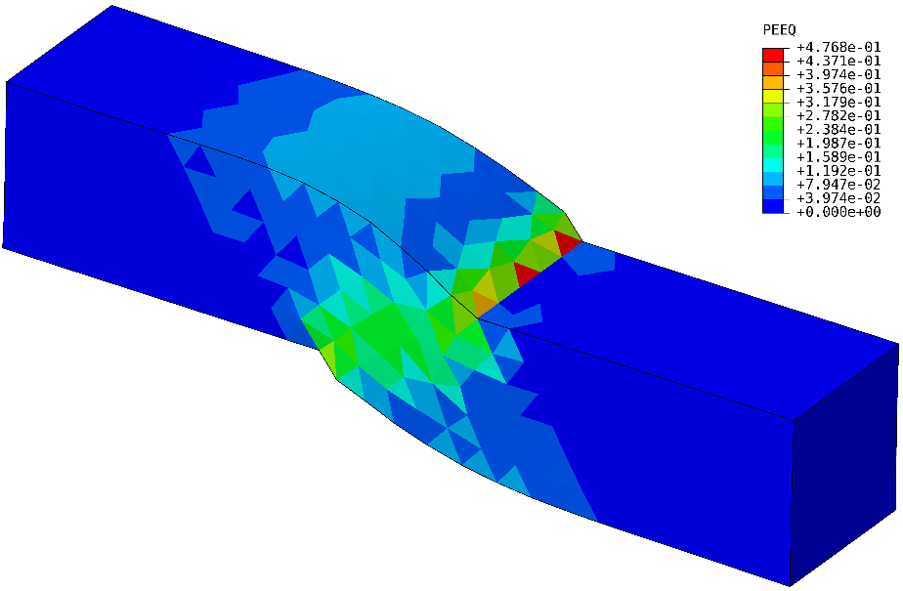
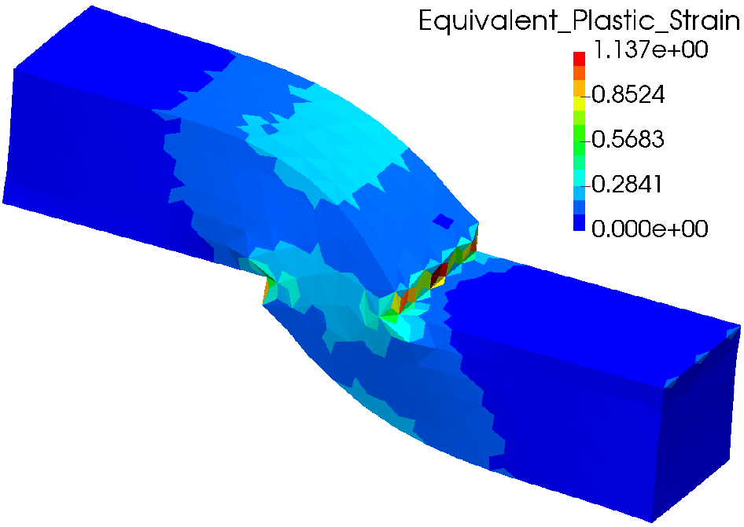
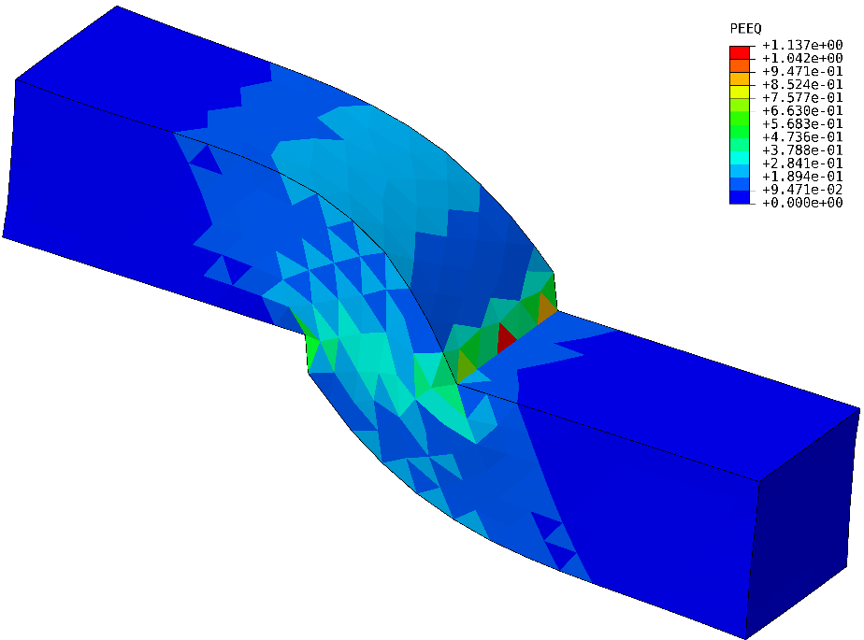


Shearing & Tensioning of Elasto-Plastic Bar
Equivalent Plastic Strain
$$u_{z}=0.5 m$$
Smooth distribution.
There is minor oscillation.
$$u_{z}=1.0 m$$
F-barES-FEM-T4
ABAQUS C3D4H
P. 17

Slide 18
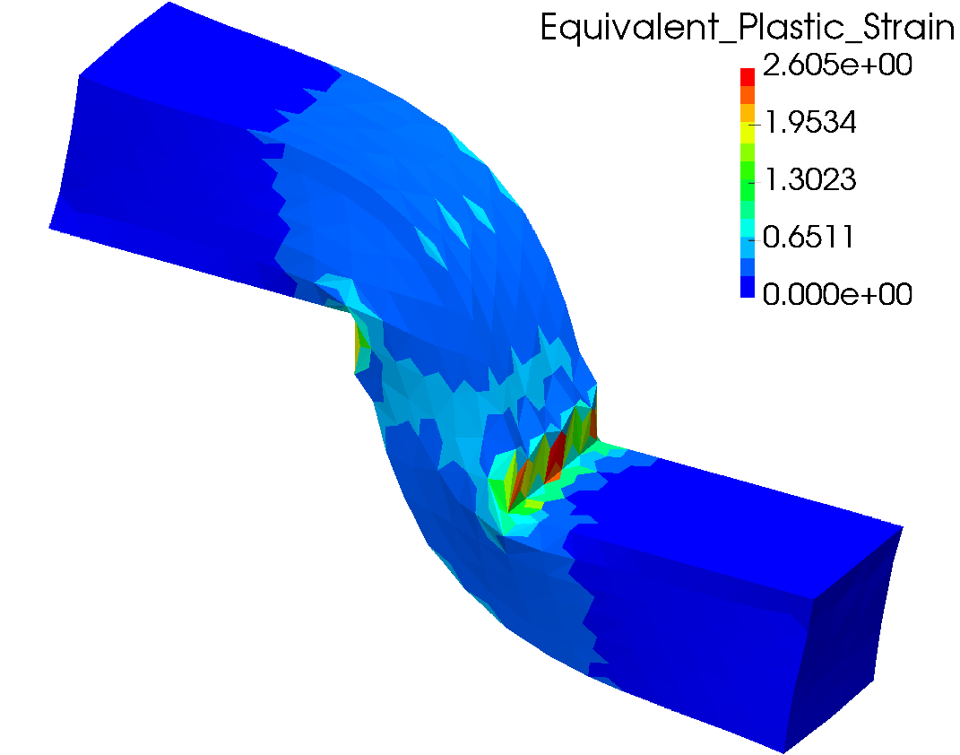
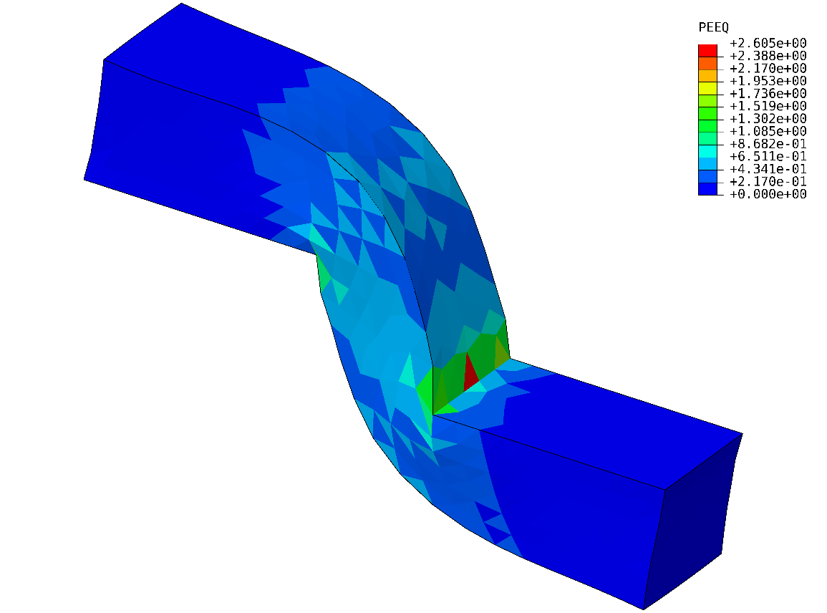

Shearing & Tensioning of Elasto-Plastic Bar
Equivalent Plastic Strain
$$u_{z}=2.0 m$$
F-barES-FEM-T4
ABAQUS C3D4H
Accuracy of equivalent plastic strain seems
no much different.
P. 18

Slide 19
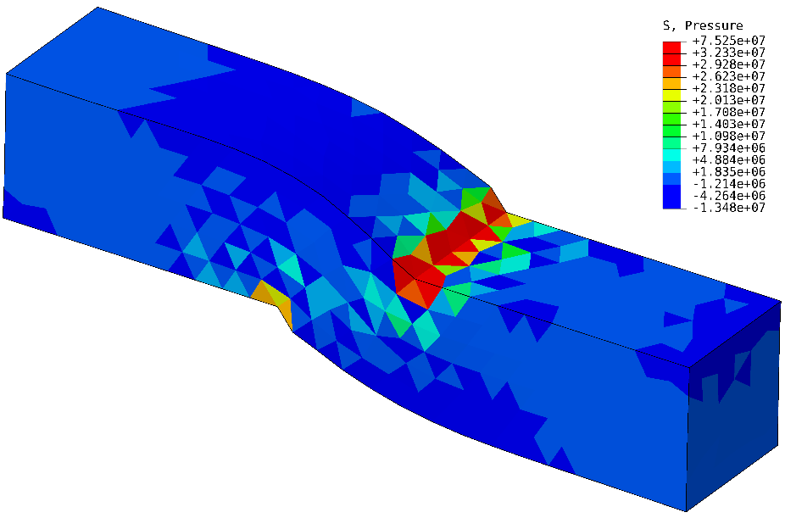
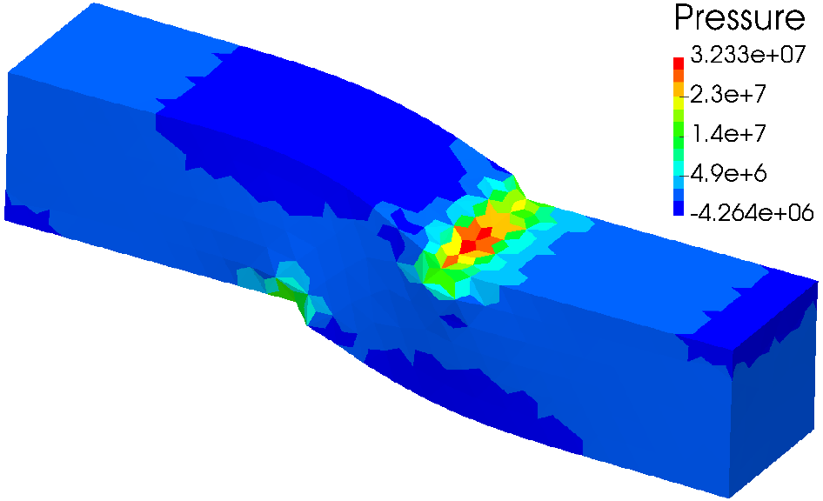
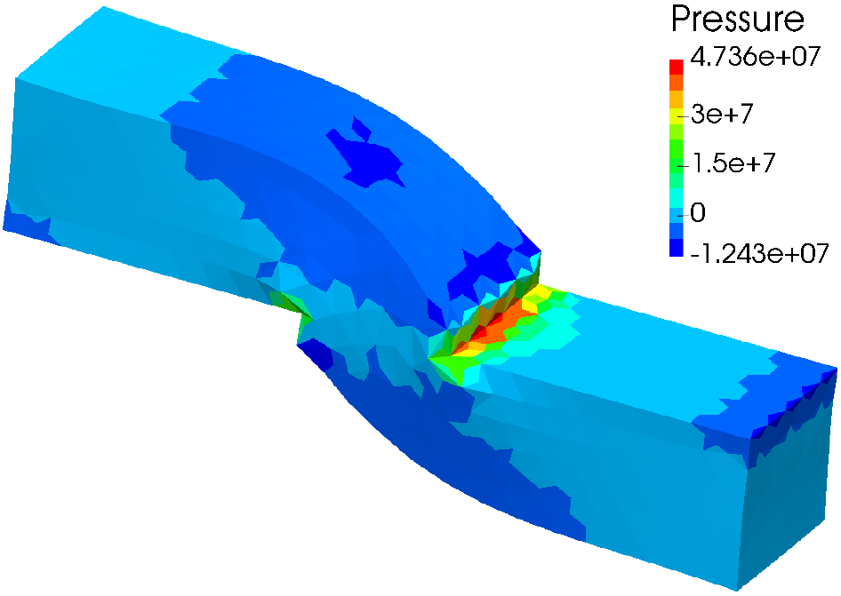
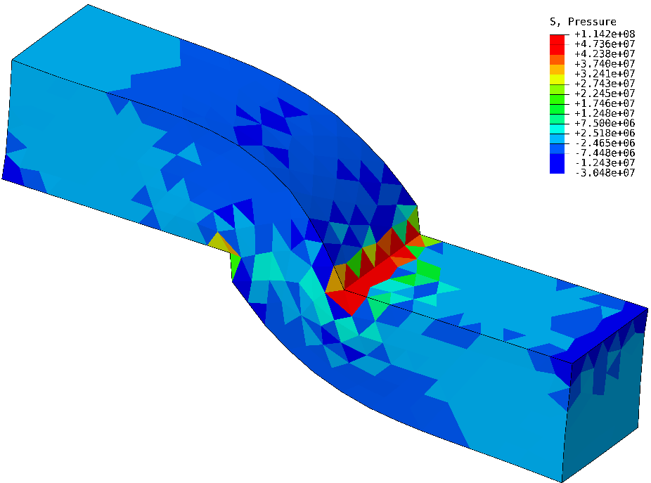

Shearing & Tensioning of Elasto-Plastic Bar
Pressure
$$u_{z}=0.5 m$$
Smooth distribution.
There is major oscillation.
$$u_{z}=1.0 m$$
F-barES-FEM-T4
ABAQUS C3D4H
P. 19

Slide 20
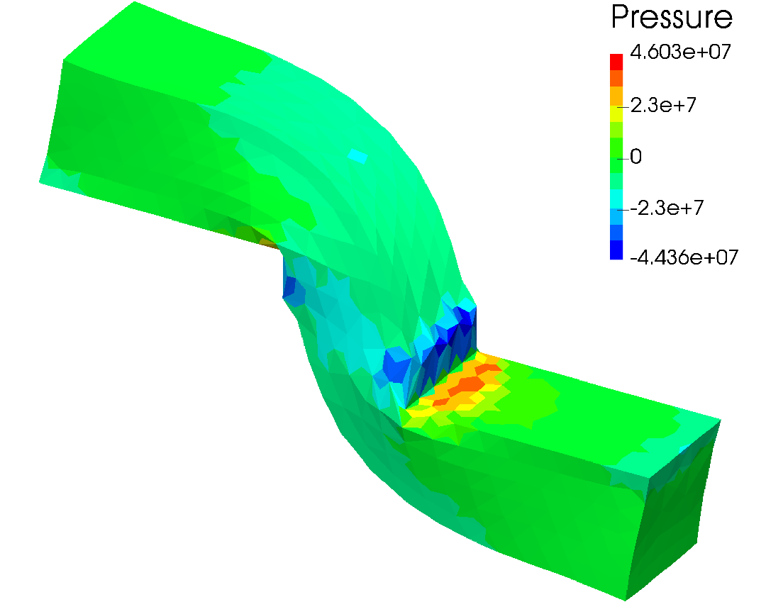
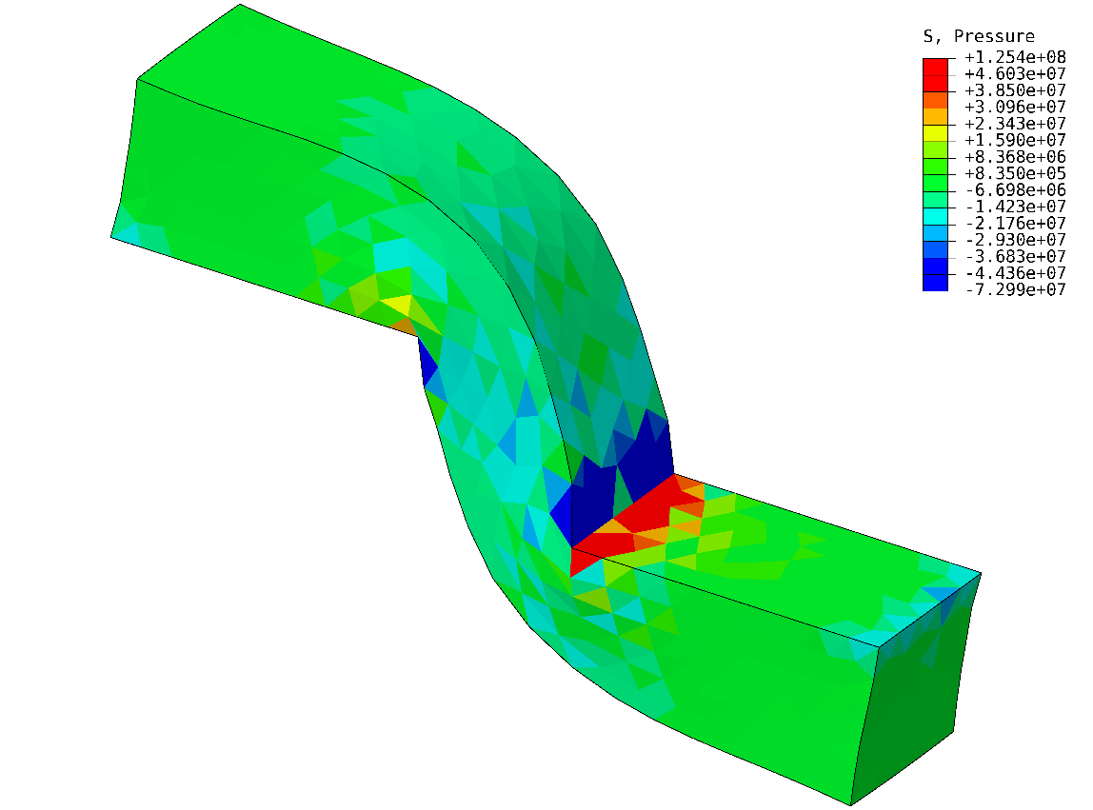
Shearing & Tensioning of Elasto-Plastic Bar
Pressure
$$u_{z}=2.0 m$$
F-barES-FEM-T4
ABAQUS C3D4H
Accuracy of pressure is quite different
due to the pressure oscillation of ABAQUS C3D4H.
P. 20

Slide 21
Summary

Slide 22
Benefits and Drawbacks of F-barES-FEM-T4
Benefits
  Locking-free with 1st -order tetra meshes.
  No difficulty in severe strain or contact analysis.
  No increase in DOF.
  No intermediate nodes. No need for static condensation.
  No restriction of material constitutive model.
  Pressure dependent models are acceptable.
  Less pressure oscillation and corner locking.
Drawbacks
✗ The more cyclic smoothing necessitates
the more CPU time.

Slide 23
The Take-Home Message
  If you are interested in elasto-plastic problems
  that have
    3D bulk complex shapes,
    severe large deformation or contact, and especially
    pressure dependent constitutive models,
  then, please consider using F-barES-FEM-T4.
Thank you for your kind attention!

