Slide 1
Numerical modeling method to reproduce UV imprint process using thermo-viscoelastic constitutive law
Ryunosuke YAMASHITA, Yuki ONISHI, Kenji AMAYA
Tokyo Institute of Technology, Japan

Slide 2
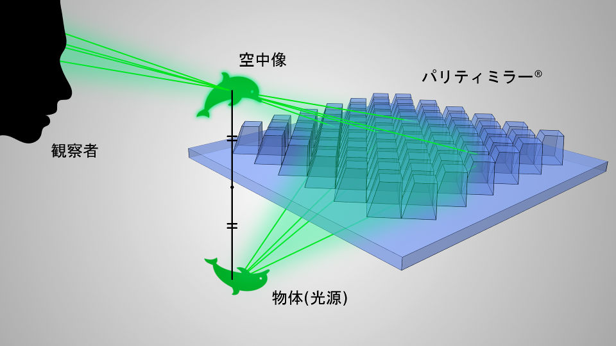
Background
UV imprinting is a low cost and high throughput production method.
It has been adopted to the production of various optical devices
requiring high surface accuracy such as micro mirror array.
Mold
PDMS Mold
Aerial image
Parity Mirror ®
UV Resin
Observer
UV Exposure
& Demolding
Light source
UV Resin
Example of optical product produced by
micro imprint. (Parity Innovations Co., Ltd.)

Slide 3
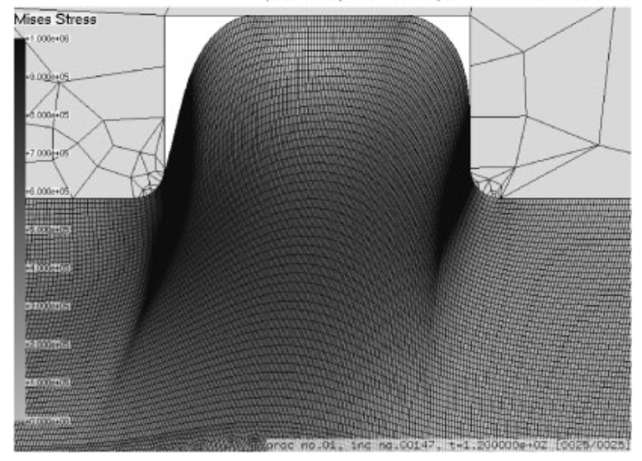
Issues
In the curing process, volume shrinkage of UV resin arises and
may cause unintended surface curvature when a soft mold such as PDMS is used.
There is no numerical modeling method to reproduce this type of error in UV imprint, although there are a few conventional methods for thermal imprint.
Unintended
Surface
Curvature
✘
Soft Mold
Soft Mold
UV
Exposure
Shrink
Demolding
UV Resin
UV Resin
UV Resin
Y. Onishi et al. Jpn. J. Appl. Phys. 47 5145 (2008)

Slide 4
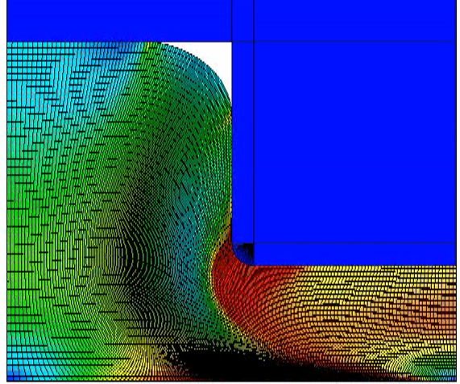
Brief of Conventional Method for Thermal Imprint Simulation
Thermo-viscoelastic constitutive model
  Thermal contraction is described with thermal
  expansion coefficient.
  Shear behavior is described with the time-
  temperature superposition principle and
  Prony series for the generalized Maxwell model.
  Volumetric behavior is assumed to be independent
  of strain rate and temperature.
Numerical simulation with the finite element
method (FEM)
τ₁
τ_{n}
G_{inf}
G₁
G_{n}
Our idea：
Similar numerical approach could be used for UV imprint simulation.

Slide 5
Objective
Propose a numerical method for UV curing process simulation.
Utilize the process simulation for
mold shape optimization.

Slide 6
Methods

Slide 7
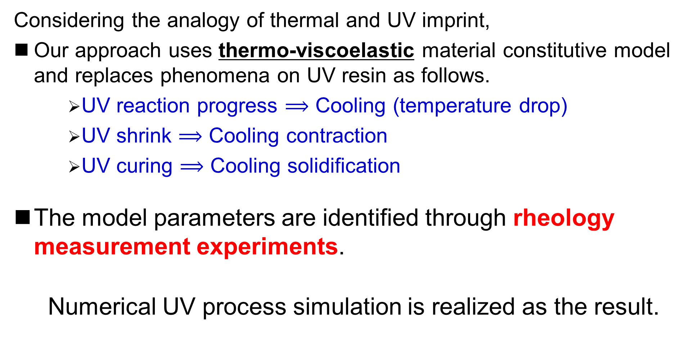
Overview of Our Method
Considering the analogy of thermal and UV imprint,
Our approach uses thermo-viscoelastic material constitutive model
and replaces phenomena on UV resin as follows.
    UV reaction progress $⟹$ Cooling (temperature drop)
    UV shrink $⟹$ Cooling contraction
    UV curing $⟹$ Cooling solidification
The model parameters are identified through rheology measurement experiments.
Numerical UV process simulation is realized as the result.
Becomes similar to
thermal imprint simulation

Slide 8
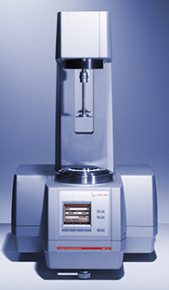
Experimental Conditions
Rotational oscillatory rheometer
(Anton Paar MCR301) is used.
The measurement object is
an UV resin from Daicel Co..
Room temperature is 25℃ (const.).
UV exposure condition is constant
(30 s exposure in a constant intensity).
The oscillation frequency is varied
from 0.1 to 10 Hz.
The gap between the cylinder rod
and the glass plate changes over time
due to UV shrink.
Long time measurement is conducted
to consider the dark curing.
Small
Rotational Oscillation
Cylinder
Rod
Follow
Gap
Change
UV Resin
Gap
Glass Plate
UV Light
Intensity
0 30 time (s)

Slide 9
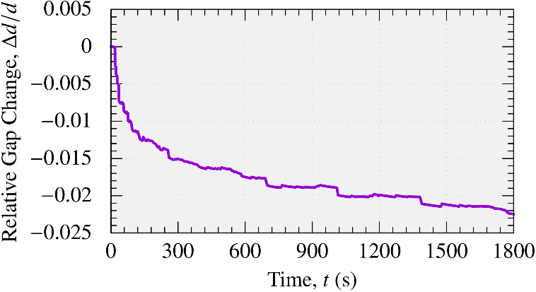
Relative Gap Change (Experimental Result)
Time History of Relative Gap Change
Note: the time history of the relative gap change is always the same in all cases
(∵ UV exposure condition is constant).
UV shrink progresses with time, but the shrink speed gradually decreases.

Slide 10
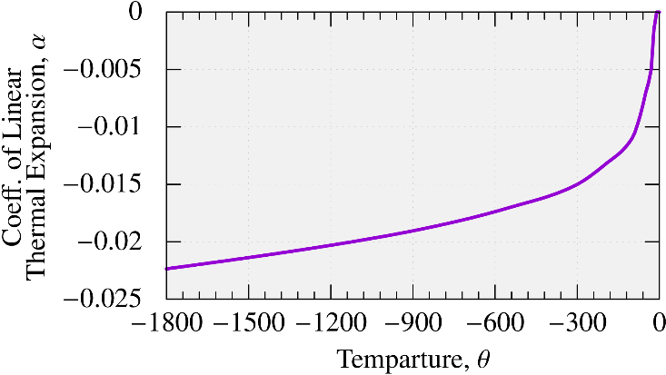

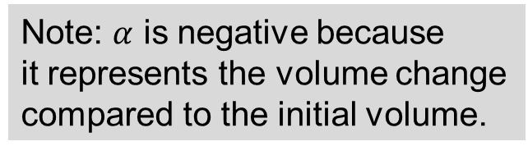
Relative Gap Change (Model Parameter Identification)
UV shrink is modeled as thermal (cooling) contraction.
For the UV reaction progress measure, the time history of temperature is given
as $θ\left(t\right)=−t$. (Note that $θ$ is not a real physical quantity but just a virtual value.)
The time history of relative gap change is converted into the temperature-dependent coefficient of thermal expansion.
Temperature-Dependent
Coefficient of
Thermal Expansion
Note: $α$ is negative because
it represents the volume change
compared to the initial volume.

Slide 11
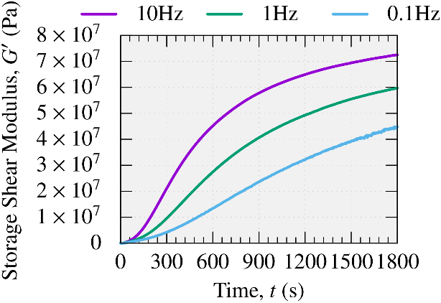
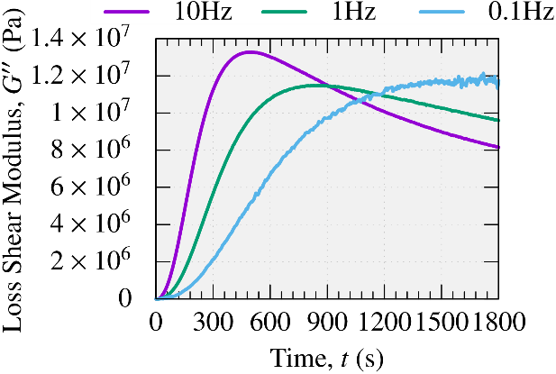

Viscoelasticity (Experimental Result)
Time History of Storage / Loss Shear Modulus ($G^{′}/G′′$)
Depending on the frequency, the time histories of $G′$ and $G′′$ are different
(harder at higher frequencies).
At any frequency, UV resin monotonically hardens with time.

Slide 12
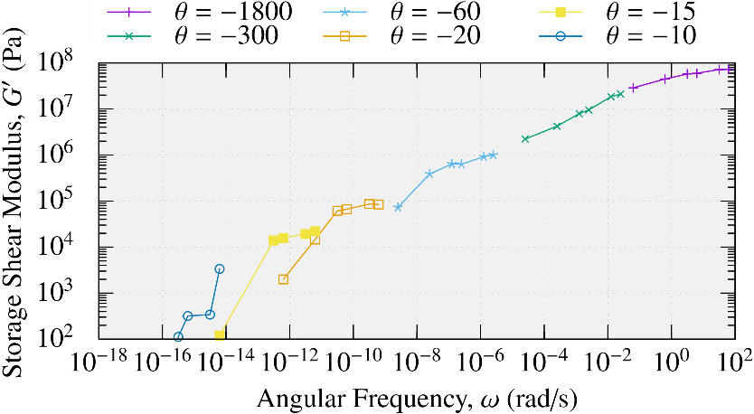

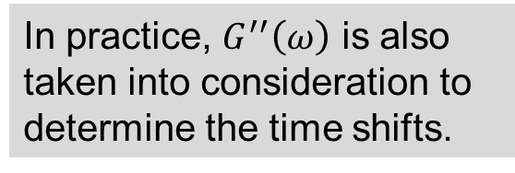






Viscoelasticity (Model Parameter Identification 1/3)
UV resin is modeled as viscoelastic material based on the time-temperature superposition principle and Prony series for the generalized Maxwell model.
A certain temperature is set as a reference temperature (e.g., $θ^{ref}=−1800$).
Pick $G′$s and $G′′$s at different temperatures and identify each time shift.
Time-Shifted
Storage Shear Modulus
$G^{′}\left(ω\right)$ at $θ^{ref}$
(Master Curve)
Measurement at $θ=θ^{ref}$
Shift for $θ=−300$
Shift for $θ=−60$
Shift for $θ=−20$
In practice, $G^{′′}\left(ω\right)$ is also taken into consideration to determine the time shifts.
Shift for $θ=−15$
Shift for $θ=−10$
P. 12

Slide 13
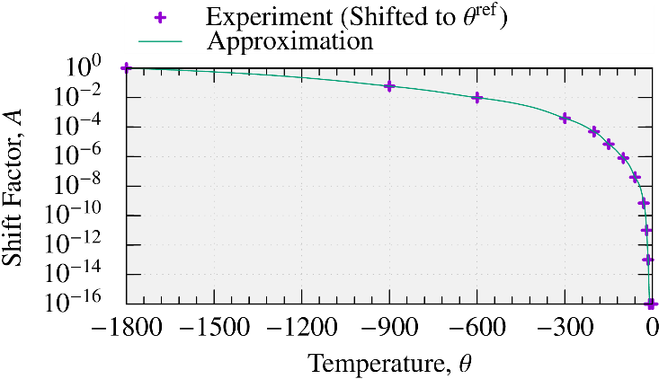

Viscoelasticity (Model Parameter Identification 2/3)
A temperature-dependent shift factor (i.e., time-temperature superposition) is obtained by fitting the time-shifts at various temperatures.
Temperature-
Dependent
Shift Factor $A(θ)$

Slide 14
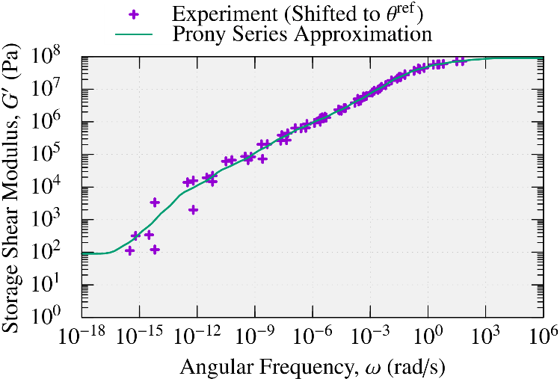
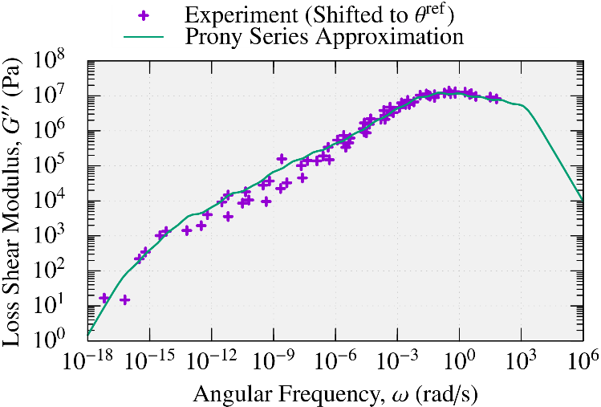
Viscoelasticity (Model Parameter Identification 3/3)
Find the Prony series coeffs by fitting the master curve at the reference temp.
Storage / Loss Shear Modulus at Reference Temp. Expressed by Prony Series
From the above, the constitutive model of thermo-viscoelasticity
to simulate UV shrink and curing were identified.

Slide 15
Result & Discussion

Slide 16



UV Curing Process Simulation (Outline)
Commercial finite element code, ABAQUS, is adopted.
Target pattern is a micro mirror array.
The mold pattern is periodic and thus
only one mirror is taken into account
with periodic boundary conditions.
Mold cavity is filled with UV resin at the initial state.
Temperature is given as $θ\left(t\right)=−t$.
UV exposure condition is exactly the same as
that of the rheology measurement experiments.
(30 s exposure in a constant intensity).
Demolding is conducted 70 s after the end of
UV exposure.
Mirror curvature is evaluated
enough after the demolding (6000 s).
3D View
Mirror
Surface
PDMS Mold
UV Resin
320 $μ$m
320 $μ$m

Slide 17
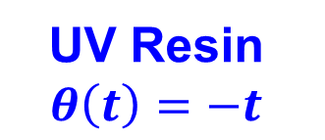
UV Curing Process Simulation (Outline)
Commercial finite element code, ABAQUS, is adopted.
Target pattern is a micro mirror array.
The mold pattern is periodic and thus
only one mirror is taken into account
with periodic boundary conditions.
Mold cavity is filled with UV resin at the initial state.
Temperature is given as $θ\left(t\right)=−t$.
UV exposure condition is exactly the same as
that of the rheology measurement experiments.
(30 s exposure in a constant intensity).
Demolding is conducted 70 s after the end of
UV exposure.
Mirror curvature is evaluated
enough after the demolding (6000 s).
Demolding
2D View
No-slip &
No-separation
Contact
PDMS Mold
UV Resin
$$θ\left(t\right)=−t$$
Periodic Boundary Condition

Slide 18
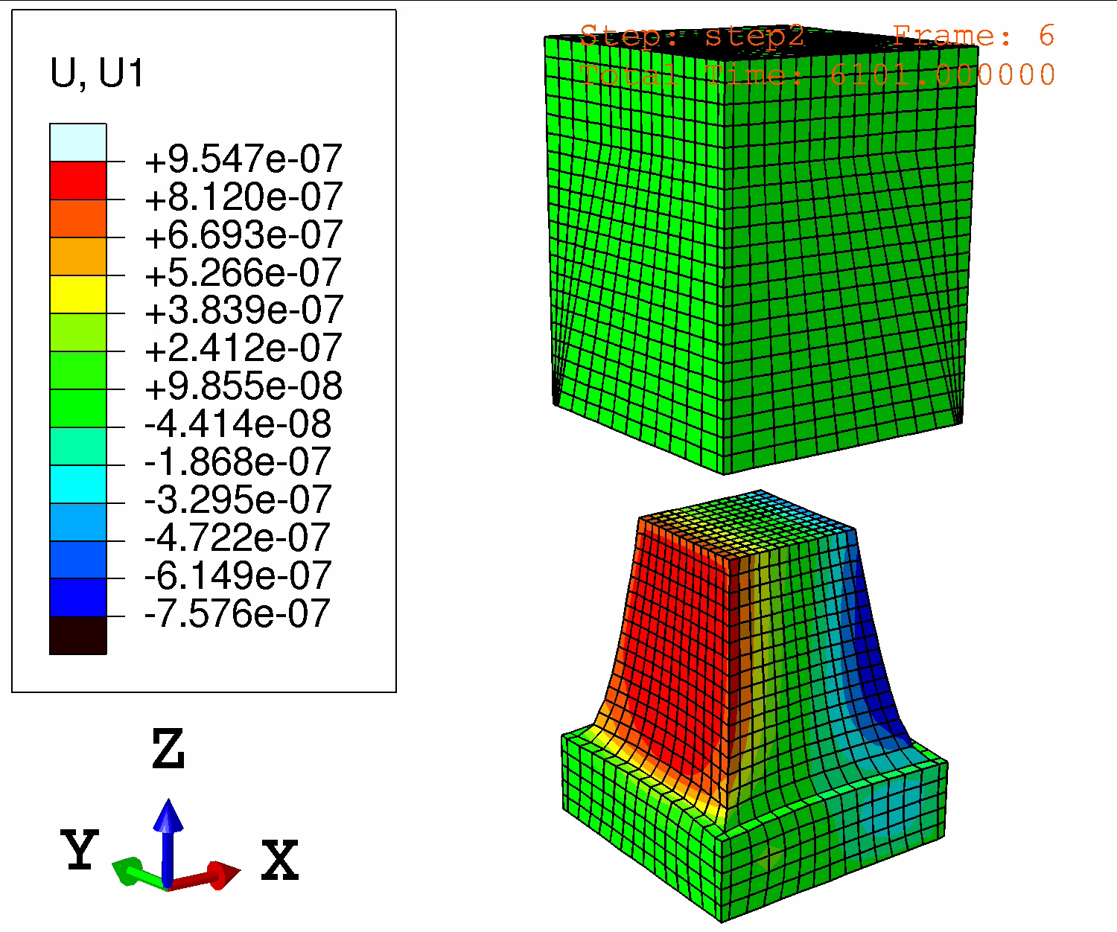
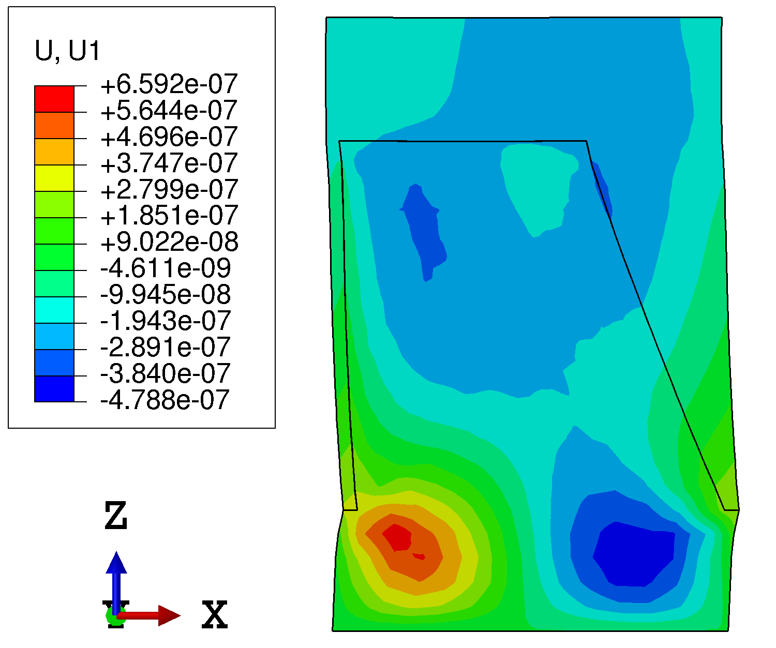
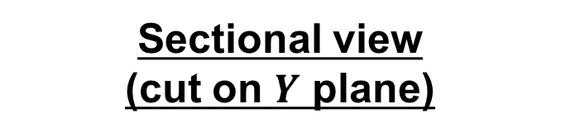
UV Curing Process Simulation (Simulation Result)
Displacement Dist. in X Direction
Deformation Scale Factor: 30 x 30 x 1 in XYZ
Sectional view
(cut on $Y$ plane)
3D view
Surface curvature due to the mold deformation
is observed.
Flow of UV resin due to the
UV shrink is observed.

Slide 19
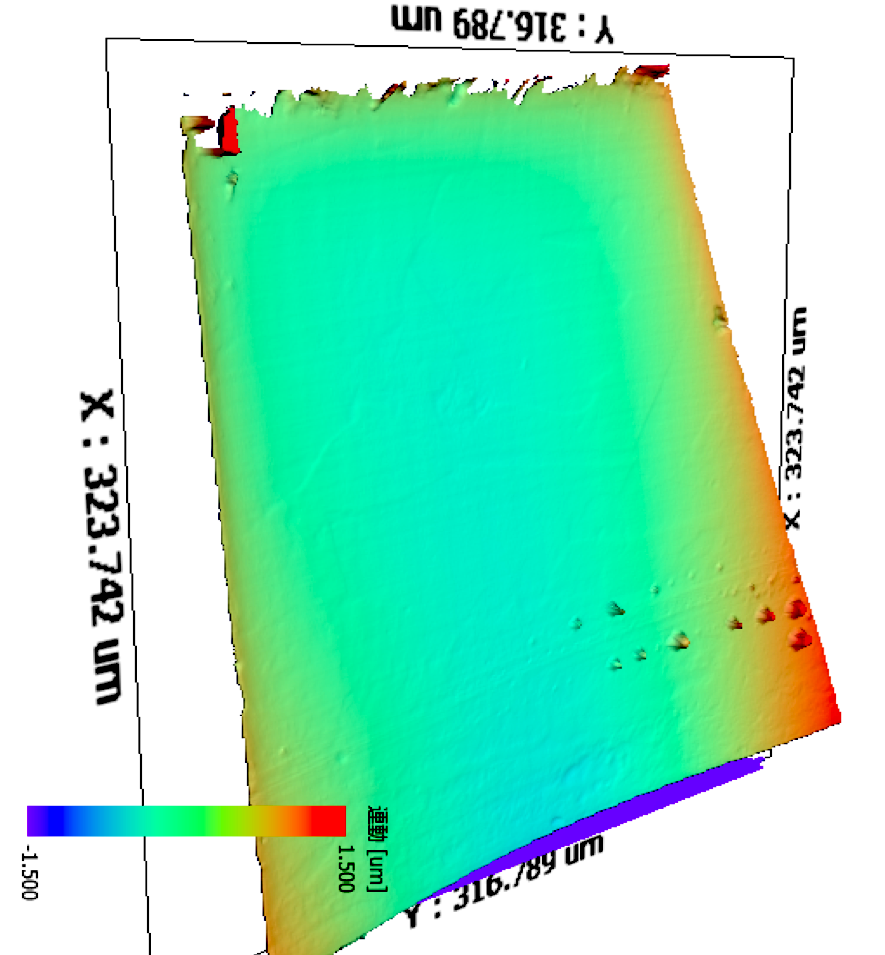
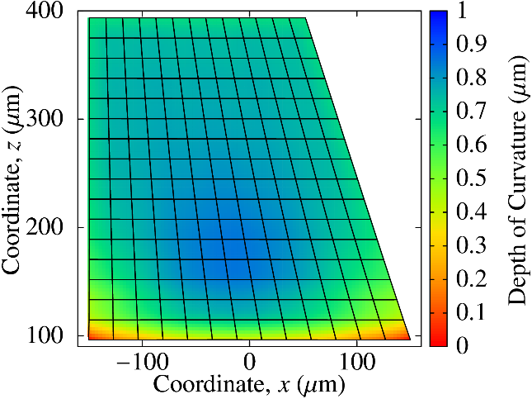

UV Curing Process Simulation (Validation)
Curvature Depth Dist. on Mirror Surface
The maximum
curvature depth
is about 1 $μ$m
located at
lower center
of the surface.
Experimental Result
(Measured with scanning probe microscope)
Simulation Result
(For ease of comparison, the contour color scheme uses “reversed rainbow”.)
✔ Simulation result agreed with the experimental measurement data qualitatively.

Slide 20
Mold Shape Optimization (Outline)
Unoptimized Mold Shape
✘ Curvature!
Before Mold Optimization
UV Exposure
Optimized Mold Shape
✔ Lesser Curvature!
After Mold
Optimization
UV Exposure

Slide 21
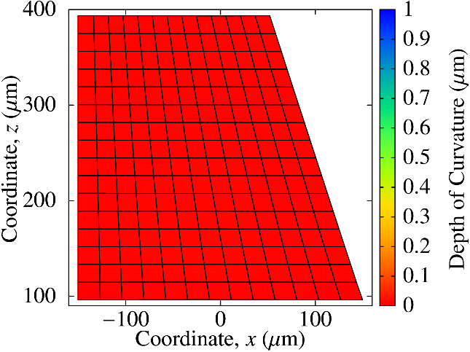
Mold Shape Optimization (Simulation Result)
Curvature Depth Dist. on Mirror Surface
Simulation Result with Unoptimized Mold
✘ Maximum curvature depth: 1 µm
Simulation Result with Optimized Mold
✔ Maximum curvature depth: 0.01 µm
The optimized mold greatly suppressed the curvature and achieved a super-flat mirror surface!

Slide 22
Summary

Slide 23
Summary
A numerical modeling method for UV shrink & curing simulation
using thermo-viscoelastic model was proposed.
The model parameters were identified through the rheology measurement experiments.
A process simulation for micro mirror array using PDMS mold
validated the qualitative accuracy on mirror surface curvature.
A demonstration of mold shape optimization successfully suggested
an optimal mold shape to achieve a flat mirror surface.
Quantitative validation and application to other patterns (such as
lens arrays) are our future work.

Slide 24
Acknowledgement
This is a joint work with Daicel Co. and Osaka Prefecture Univ.
(Prof. Hirai’s group).
Another joint work is scheduled for oral presentation tomorrow:
  Yoshihiko Hirai et al., “3-Dimensional mold profile correction for resin shrinkage in micro-nano molding process”
  Sep. 26 (Wed.), 16:25 -16:40, Auditorium 11 (06-11: Metrology)
Thank you for your kind attention.

Slide 25
Appendix

Slide 26
Limitation of Our Method
UV exposure condition to simulate must be exactly the same as that on the rheology measurement experiments.
The pattern size must be large enough to apply continuum approximation.

Slide 27

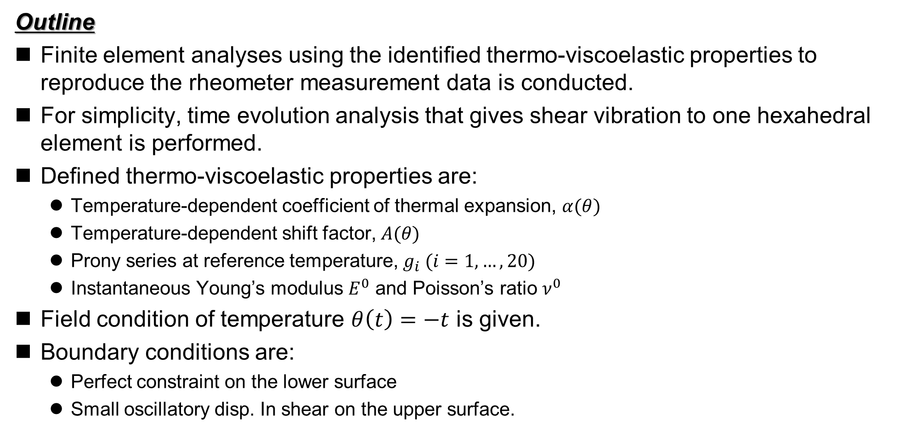
Validation of Material Constitutive Model
Outline
Finite element analyses using the identified thermo-viscoelastic properties to reproduce the rheometer measurement data is conducted.
For simplicity, time evolution analysis that gives shear vibration to one hexahedral element is performed.
Defined thermo-viscoelastic properties are:
  Temperature-dependent coefficient of thermal expansion, $α(θ)$
  Temperature-dependent shift factor, $A(θ)$
  Prony series at reference temperature, $g_{i} (i=1,…,20)$
  Instantaneous Young’s modulus $E^{0}$ and Poisson’s ratio $ν^{0}$
Field condition of temperature $θ\left(t\right)=−t$ is given.
Boundary conditions are:
  Perfect constraint on the lower surface
  Small oscillatory disp. In shear on the upper surface.
Small shear oscillation
$$θ\left(t\right)=−t$$

Slide 28
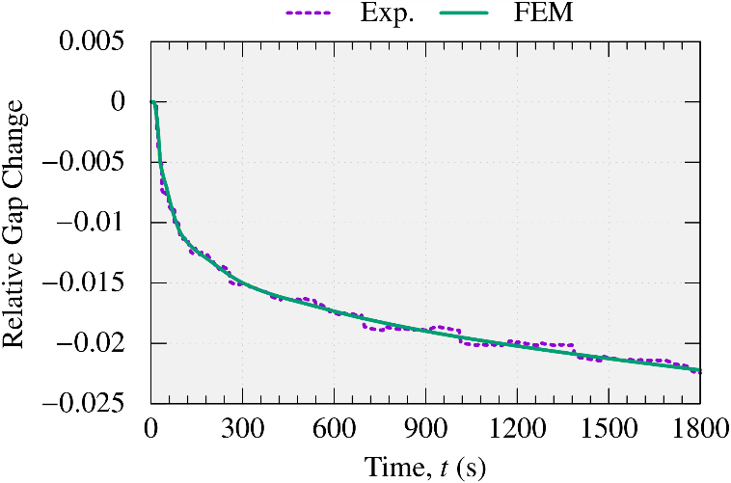
Validation of Material Constitutive Model
Time History of Relative Gap Change
The relative gap change is accurately simulated.

Slide 29
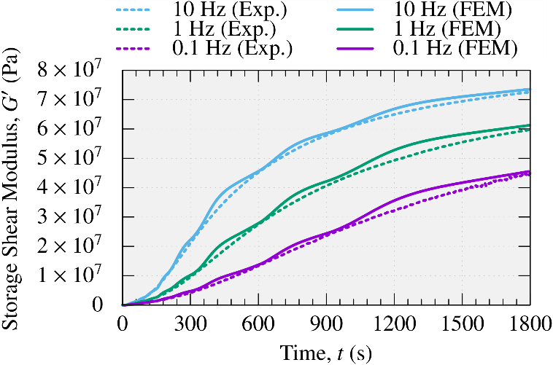
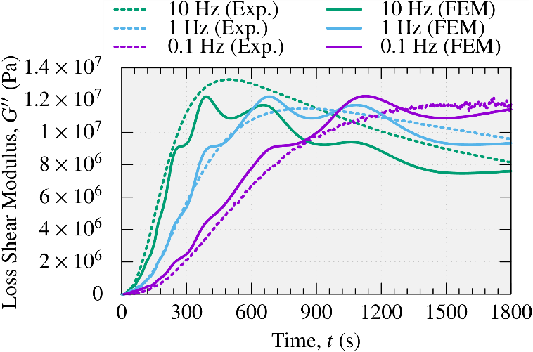
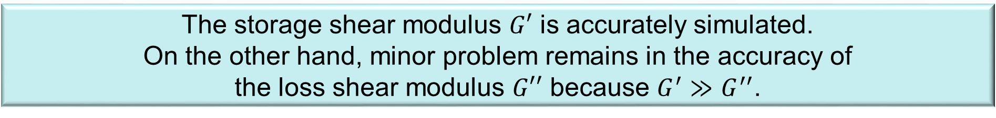
Validation of Material Constitutive Model
Time History of Storage / Loss Shear Modulus
The storage shear modulus $G′$ is accurately simulated.
On the other hand, minor problem remains in the accuracy of
the loss shear modulus $G′′$ because $G^{′}≫G^{′′}$.

Slide 30

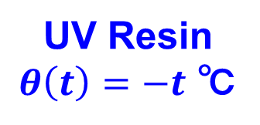
Outline of UV Process Simulation
Step 1: Stationary (1 sec.)
  Static analysis
  Start no-slip & no-separation contact
Step 2: UV curing (100 sec.)
  Quasi-static analysis
  Lower UV resin temperature: $θ\left(t\right)=−t$
Step 3: Demolding & Dark curing (6000 sec.)
  Quasi-static analysis
  Remove no-slip & no-separation contact
  Lift mold upward
  Continue lowering UV resin temperature: $θ\left(t\right)=−t$
Displacement 400µm
No-slip &
No-separation
contact
PDMS Mold
UV Resin
$θ\left(t\right)=−t$ ℃
Periodic boundary condition
ABAQUS/Standard C3D8 is used for FE analysis.

Slide 31
Search Flow of Optimized Mold Shape
Cost function： Squared sum of curvature depth
Optimization method: Quasi-Newton method
Initial mold shape
Get curvature data
Modify mold shape
①
②
UV process simulation
Modify mold shape according to the curvature
Forced
Displacement
③ Mold shape update
This optimization loop continues
until the curvature after UV shrink becomes flat within tolerance.

Slide 32
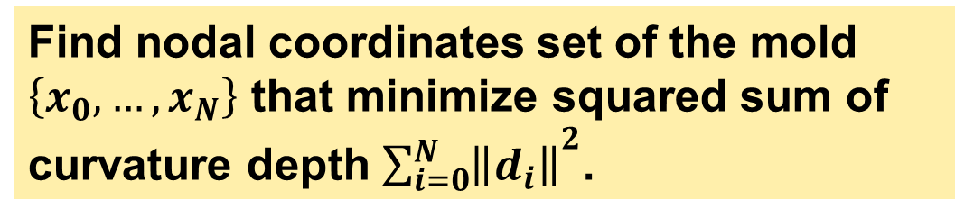
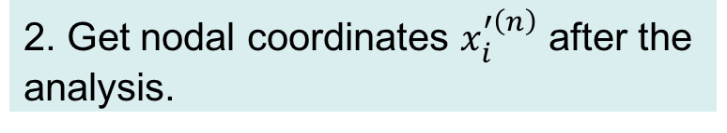
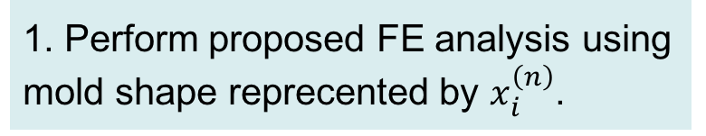
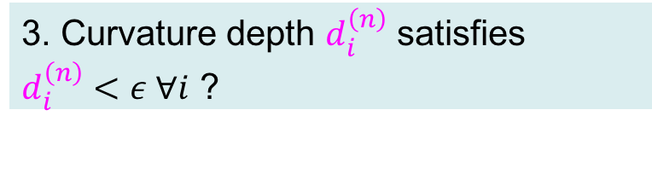
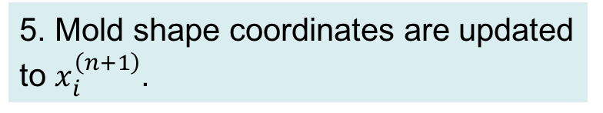
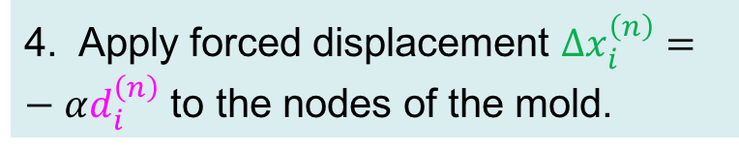
How to Find Optimal Mold Shape?
Find nodal coordinates set of the mold $\left\{x_{0},…,x_{N}\right\}$ that minimize squared sum of curvature depth ${\sum_{i=0}^{N}{\left\|d_{i}\right\|}}^{2}$.
1. Perform proposed FE analysis using mold shape reprecented by $x_{i}^{\left(n\right)}$.
2. Get nodal coordinates $x_{i}^{′\left(n\right)}$ after the analysis.
3. Curvature depth $d_{i}^{\left(n\right)}$ satisfies
$d_{i}^{\left(n\right)}<ε ∀i$ ?
YES
3.
4.
1.
NO
4. Apply forced displacement $Δx_{i}^{\left(n\right)}=−αd_{i}^{\left(n\right)}$ to the nodes of the mold.
5.
2.
5. Mold shape coordinates are updated to $x_{i}^{\left(n+1\right)}$.
Break
loop

Slide 33
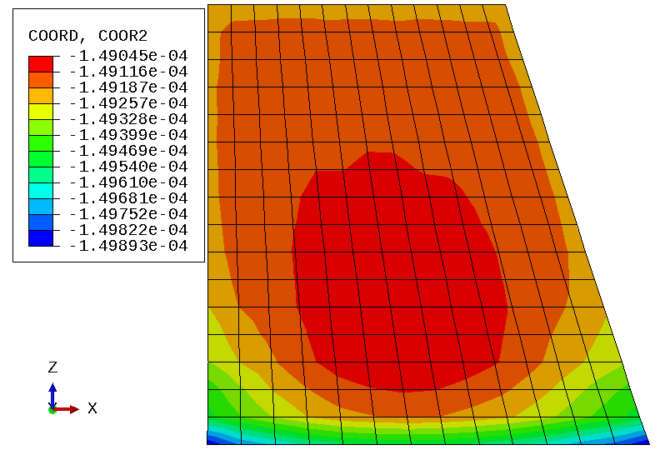
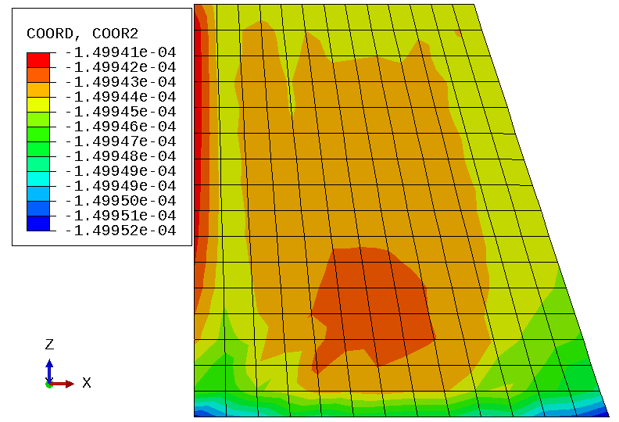
Mold Shape Optimization (Simulation Result)
Curvature Depth Dist. on Mirror Surface
Simulation Result with Unoptimized Mold
✘ Maximum curvature depth: 1 µm
Simulation Result with Optimized Mold
✔ Maximum curvature depth: 0.01 µm
The optimized mold greatly suppressed the curvature and achieved a super-flat mirror surface!

