Slide 1
F-bar aided Edge-based
Smoothed Finite Element Method with Tetrahedral Elements for Large Deformation Analysis of Nearly Incompressible Materials
Yuki ONISHI
Tokyo Institute of Technology (Japan)

Slide 2
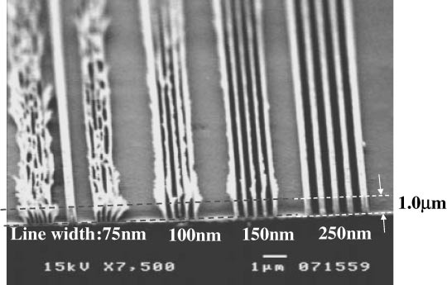
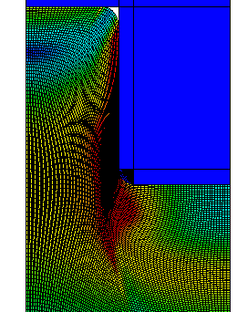

Motivation & Background
Motivation
  We want to analyze severe large
  deformation of nearly incompressible
  solids accurately and stably!
  (Target: automobile tire, thermal nanoimprint, etc.)
Background
  Finite elements are distorted
  in a short time, thereby resulting
  in convergence failure.
Mesh rezoning method (h-adaptive
mesh-to-mesh solution mapping)
is indispensable.
1$μ$m
Mold
Polymer

Slide 3
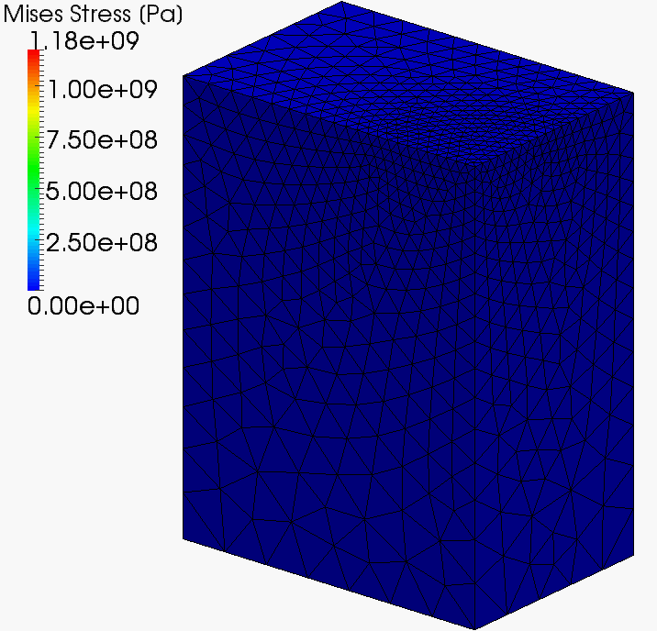
Our First Result in Advance
What we want to do:
Static
Implicit
Large deformation
Mesh rezoning

Slide 4
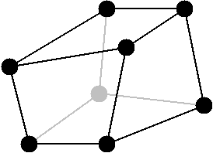
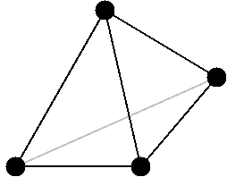
Issues
The biggest issue
in large deformation mesh rezoning
It is impossible to remesh arbitrary deformed 3D shapes with hexahedral (H8) elements.
However, the standard (constant strain) T4 elements easily induce shear and volumetric locking, which leads to inaccurate results.
✗
✓
We have to use tetrahedral (T4) elements...

Slide 5
Conventional Methods
Higher order elements:
✗ Not volumetric locking free; Unstable in contact analysis;
No good in large deformation due to intermediate nodes.
EAS method:
✗ Unstable due to spurious zero-energy modes.
B-bar, F-bar and selective integration method:
✗ Not applicable to T4 mesh directly.
F-bar patch method:
✗ Difficult to construct good patches. Not shear locking free.
u/p hybrid (mixed) elements:
✗ No sufficient formulation for T4 mesh so far.
(There are almost acceptable hybrid elements
such as C3D4H of ABAQUS.)
Smoothed finite element method (S-FEM):
? Unknown potential (since 2009~). It’s worth trying!!

Slide 6
Various Types of S-FEMs
Basic type
  Node-based S-FEM (NS-FEM)
  Face-based S-FEM (FS-FEM)
  Edge-based S-FEM (ES-FEM)
Selective type
  Selective FS/NS-FEM
  Selective ES/NS-FEM
Bubble-enhanced or Hat-enhanced type
  bFS-FEM, hFS-FEM
  bES-FEM, hES-FEM
F-bar type
  F-barES-FEM
✗ Spurious zero-energy
✗ Volumetric Locking
✗ Limitation of constitutive model,
Pressure oscillation,
Corner locking
✗ Pressure oscillation,
Short-lasting
NEW
? Unknown potential

Slide 7
Objective
Develop a new S-FEM, F-barES-FEM-T4,
by combining F-bar method and ES-FEM-T4
for large deformation problems
of nearly incompressible solids
Table of Body Contents
Method: Formulation of F-barES-FEM-T4
Result: Verification of F-barES-FEM-T4
Summary

Slide 8
Method
Formulation of F-barES-FEM-T4
(F-barES-FEM-T3 in 2D is explained for simplicity.)

Slide 9
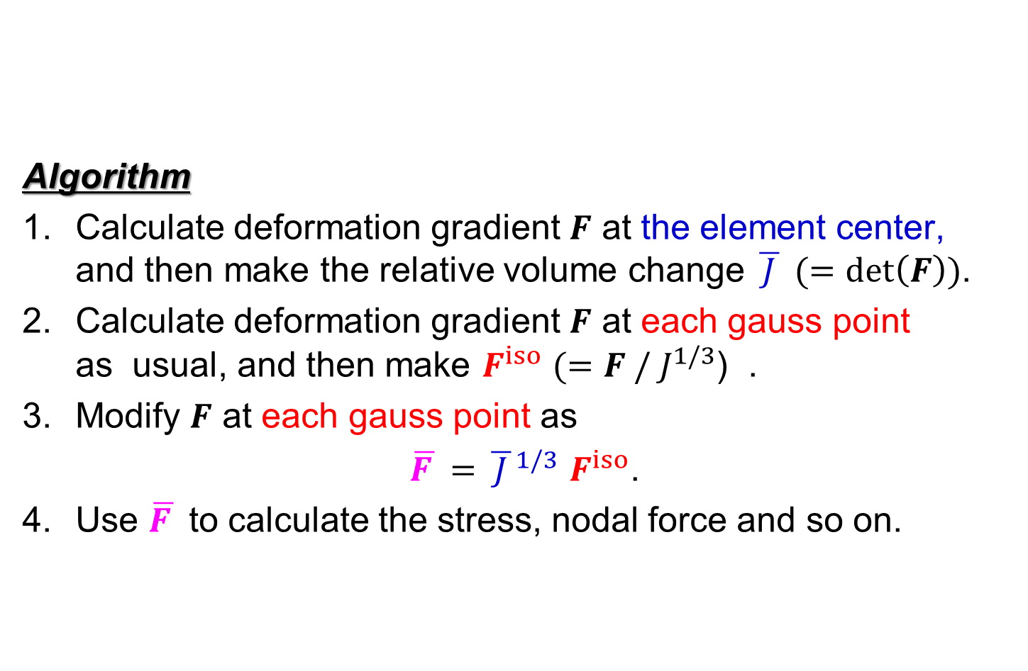
Quick Review of F-bar Method
Algorithm
Calculate deformation gradient $F$ at the element center,
and then make the relative volume change $\overline{ J }$ $(=det\left(F\right))$.
Calculate deformation gradient $F$ at each gauss point
as usual, and then make $F^{iso}$ $(=F / J^{1/3}$) .
Modify $F$ at each gauss point as
$\overline{F }=$ ${\overline{ J }}^{1/3}$ $F^{iso}$.
Use $\overline{F }$ to calculate the stress, nodal force and so on.
For quadrilateral (Q4)
or hexahedral (H8)
elements
F-bar method is used to avoid volumetric locking in Q4 or H8
elements. Yet, it cannot avoid shear locking.

Slide 10
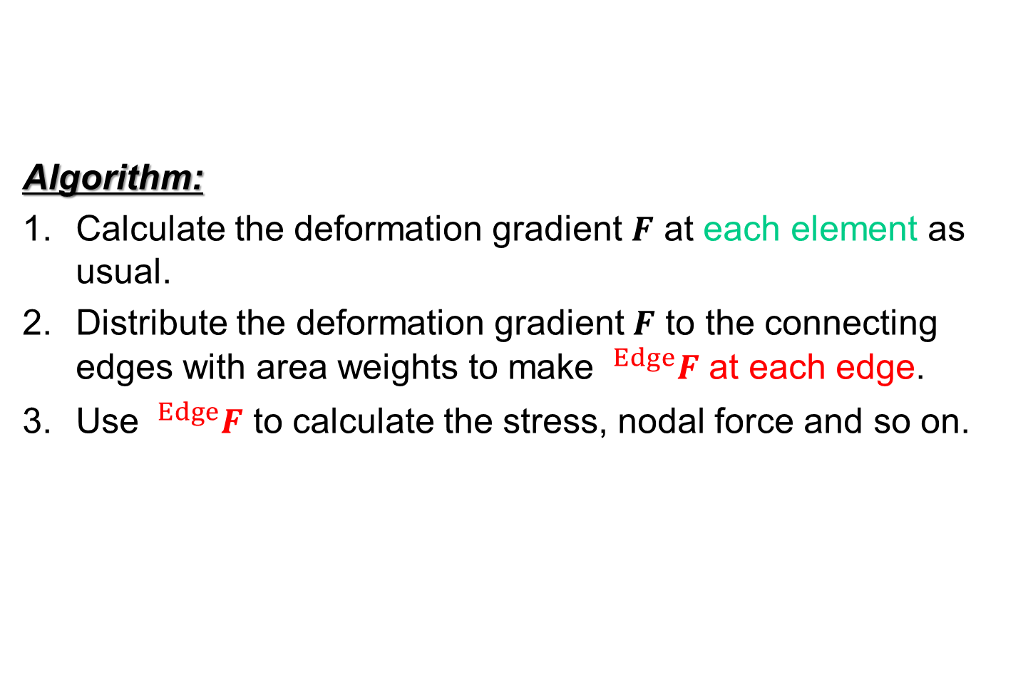
Quick Review of ES-FEM
Algorithm:
Calculate the deformation gradient $F$ at each element as usual.
Distribute the deformation gradient $F$ to the connecting edges with area weights to make $^{Edge}F$ at each edge.
Use $^{Edge}F$ to calculate the stress, nodal force and so on.
For triangular (T3)
or tetrahedral (T4)
elements.
ES-FEM is used to avoid shear locking in T3 or T4
elements. Yet, it cannot avoid volumetric locking.

Slide 11
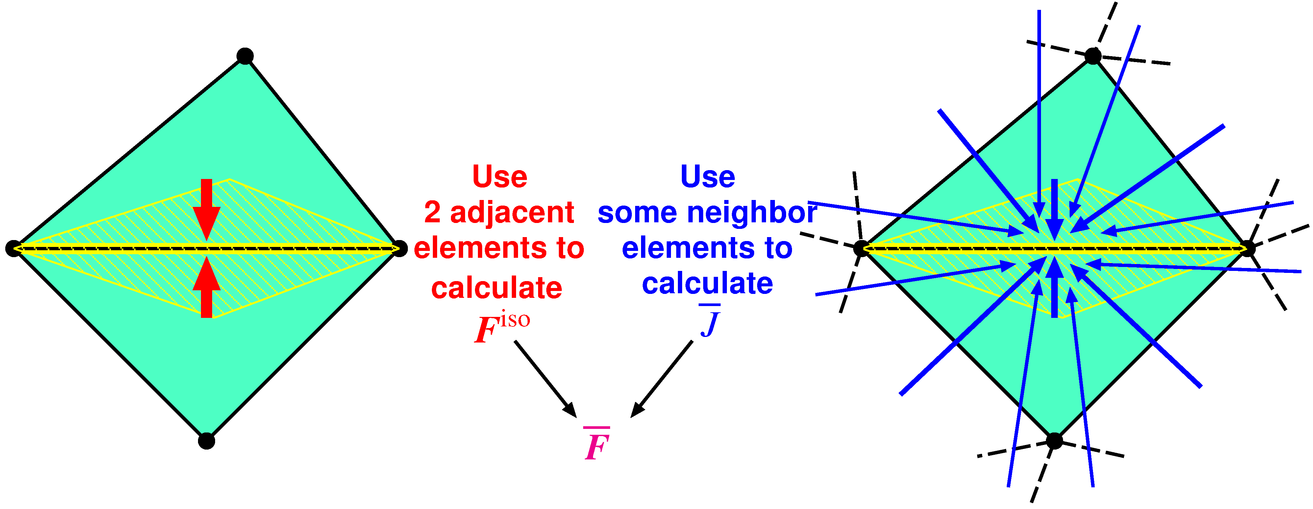

Outline of F-barES-FEM
Concept
$^{Edge}F^{iso}$ is given by ES-FEM.
$^{Edge}\overline{ J }$ is given by Cyclic Smoothing (detailed later).
$^{Edge}\overline{F }$ is calculated in the manner of F-bar method:
$^{Edge}\overline{F }=$ $^{Edge}{\overline{ J }}^{1/3}$ $^{Edge}F^{iso}$.
Combination of F-bar method and ES-FEM

Slide 12
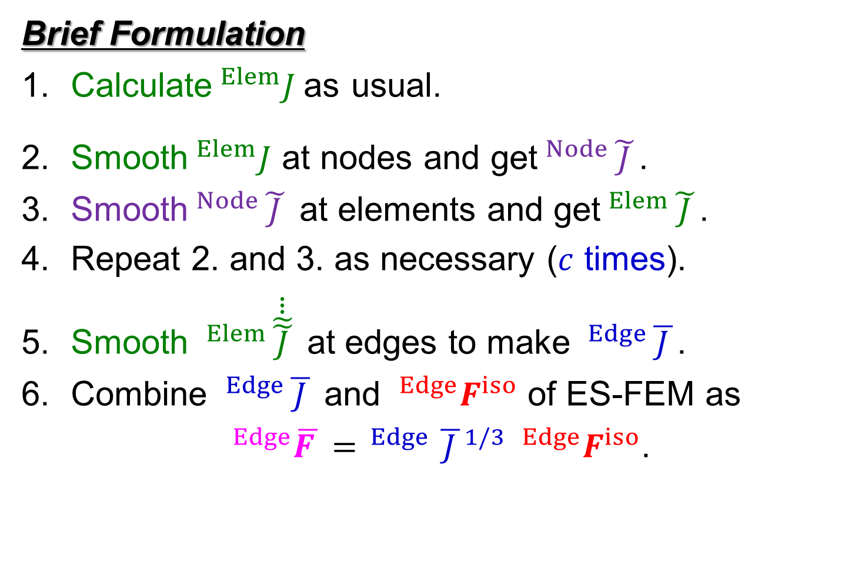


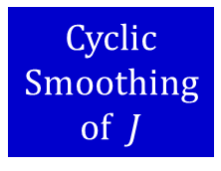
Outline of F-barES-FEM
Brief Formulation
Calculate$^{Elem}J$as usual.
Smooth$^{Elem}J$ at nodes and get$^{Node}\tilde{ J }$.
Smooth$^{Node}\tilde{ J }$ at elements and get$^{Elem}\tilde{ J }$.
Repeat 2. and 3. as necessary ($c$ times).
Smooth $^{Elem}\dot{\dot{\dot{\tilde{\tilde{ J }}}}}$ at edges to make $^{Edge}\overline{ J }$.
Combine $^{Edge}\overline{ J }$ and $^{Edge}F^{iso}$ of ES-FEM as
$^{Edge}\overline{F }= ^{Edge}{\overline{ J }}^{1/3} ^{Edge}F^{iso}$.
Cyclic
Smoothing
of $J$
($c$ layers of ~)
Hereafter, F-barES-FEM-T4 with $c$-time cyclic smoothing
is called “F-barES-FEM-T4($c$)”.

Slide 13
Result
Verification of F-barES-FEM-T4
(Analyses without mesh rezoning are presented
for pure verification.)

Slide 14
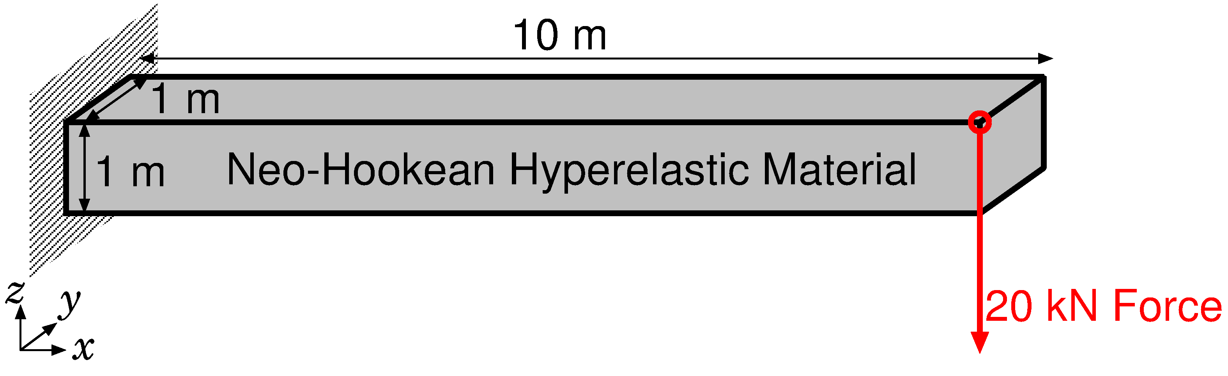
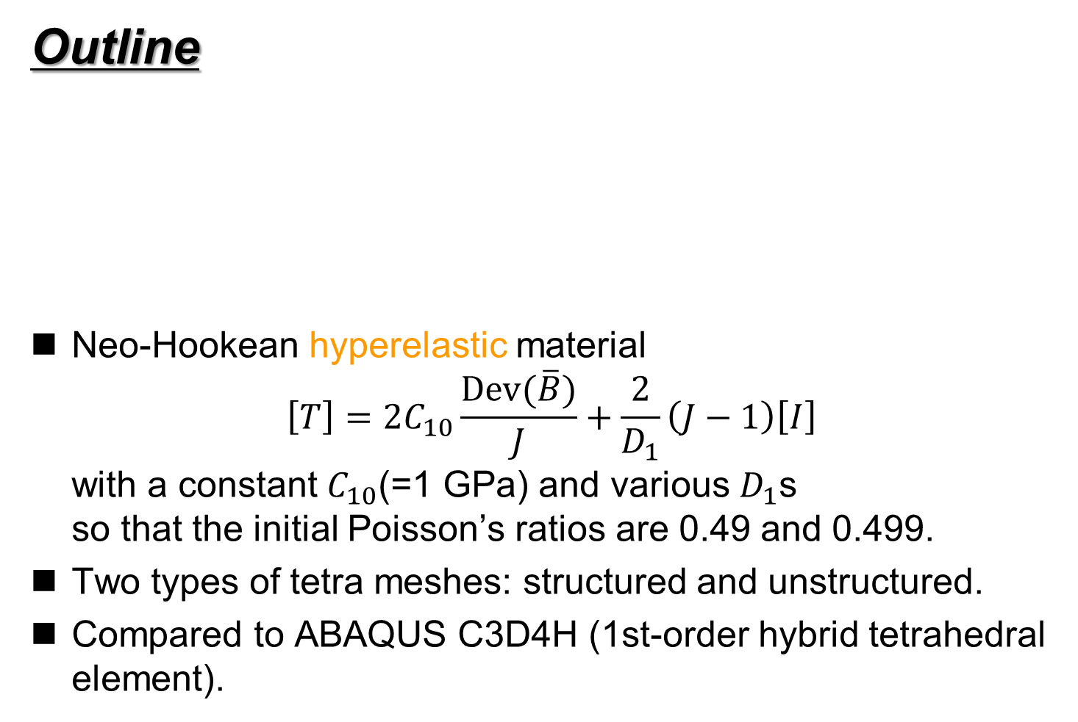
#1: Bending of a Cantilever
Outline
Neo-Hookean hyperelastic material
$\left[T\right]=2C_{10}\frac{Dev(\overline{B})}{J}+\frac{2}{D_{1}}\left(J−1\right)\left[I\right]$
with a constant $C_{10}$(=1 GPa) and various $D_{1}$s
so that the initial Poisson’s ratios are 0.49 and 0.499.
Two types of tetra meshes: structured and unstructured.
Compared to ABAQUS C3D4H (1st-order hybrid tetrahedral element).
Dead Load

Slide 15
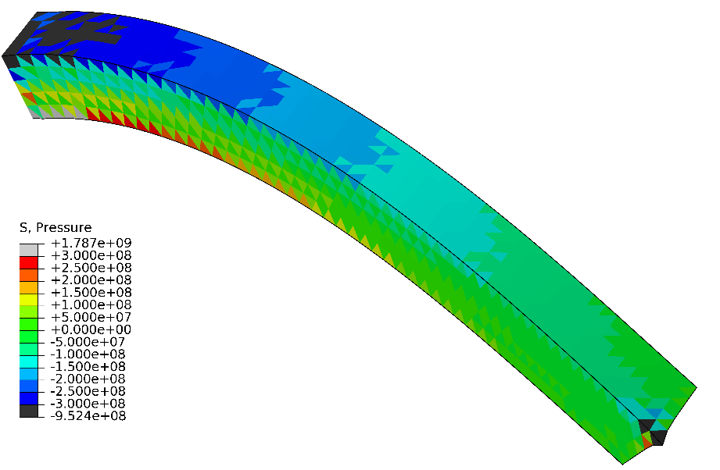
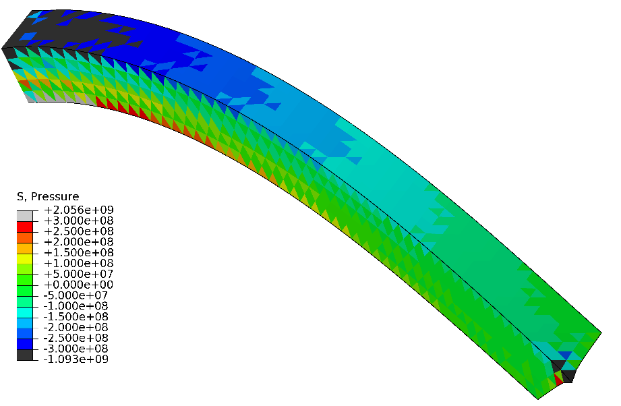
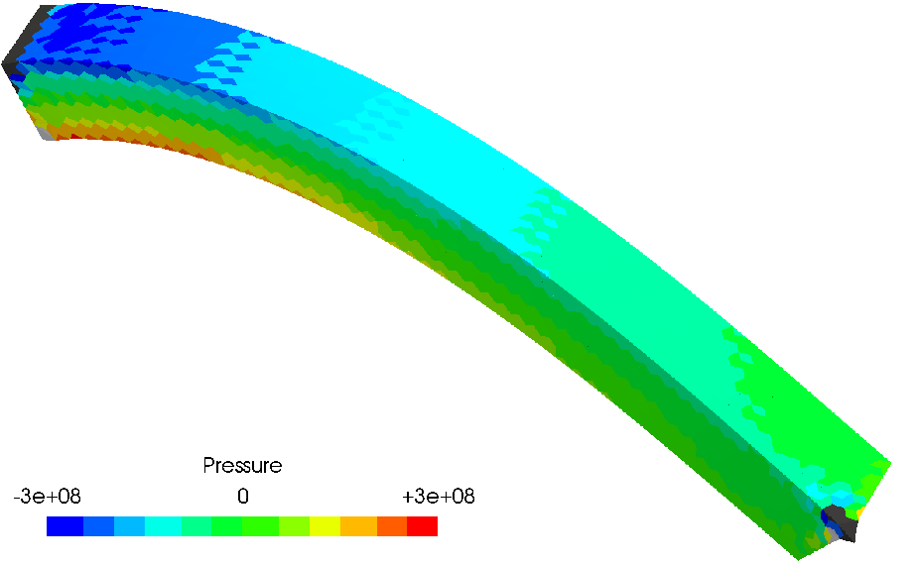
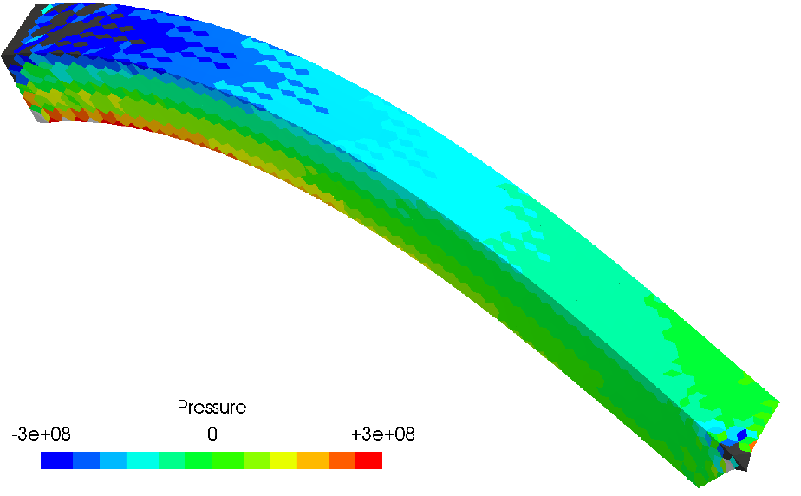


#1: Bending of a Cantilever
Pressure
Distributions
$$ν^{ini}=0.49$$
Structured
Mesh
$$ν^{ini}=0.499$$
ABAQUS
C3D4H
F-bar
ES-FEM-
T4(1)

Slide 16
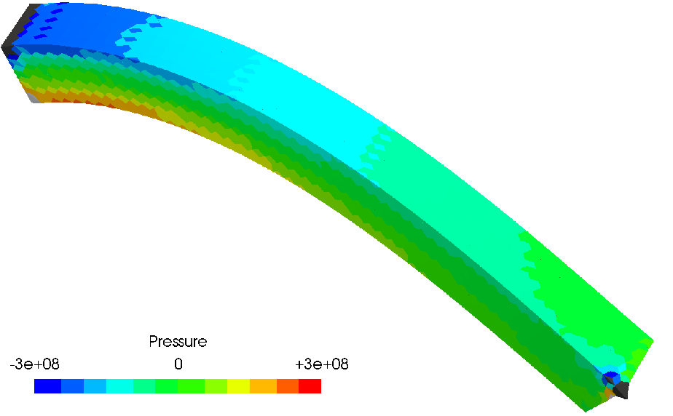
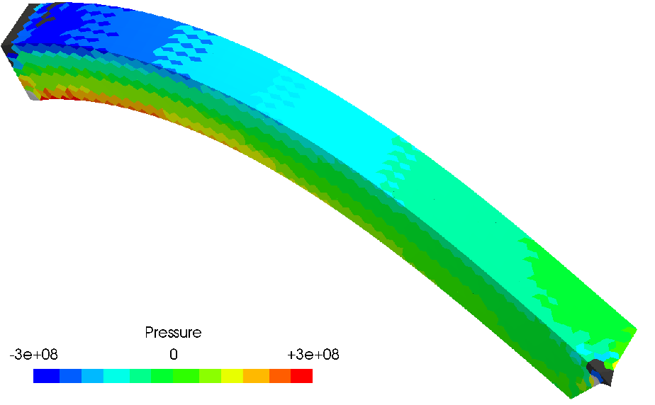


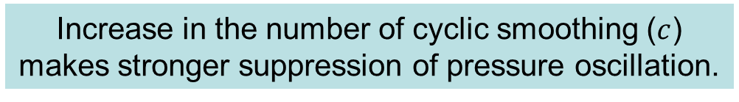
#1: Bending of a Cantilever
Pressure
Distributions
$$ν^{ini}=0.49$$
Structured
Mesh
$$ν^{ini}=0.499$$
F-bar
ES-FEM-
T4(2)
Increase in the number of cyclic smoothing ($c$)
makes stronger suppression of pressure oscillation.
F-bar
ES-FEM-
T4(3)

Slide 17
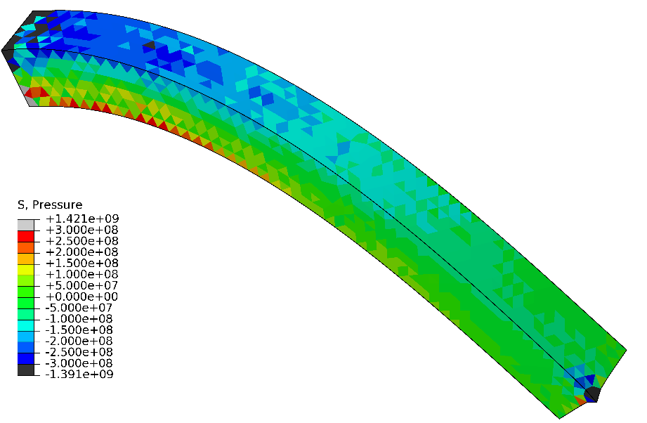
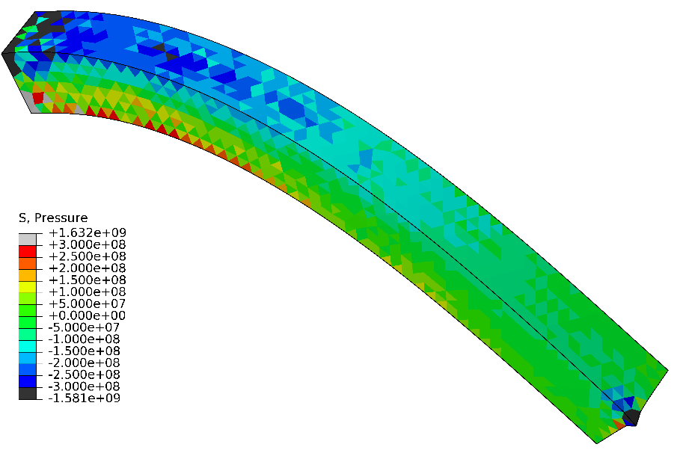


#1: Bending of a Cantilever
Pressure
Distributions
$$ν^{ini}=0.49$$
Unstructured
Mesh
$$ν^{ini}=0.499$$
ABAQUS
C3D4H
F-bar
ES-FEM-
T4(1)

Slide 18




#1: Bending of a Cantilever
Pressure
Distributions
$$ν^{ini}=0.49$$
Unstructured
Mesh
$$ν^{ini}=0.499$$
F-bar
ES-FEM-
T4(2)
F-bar
ES-FEM-
T4(3)
No mesh
dependency
is observed.

Slide 19
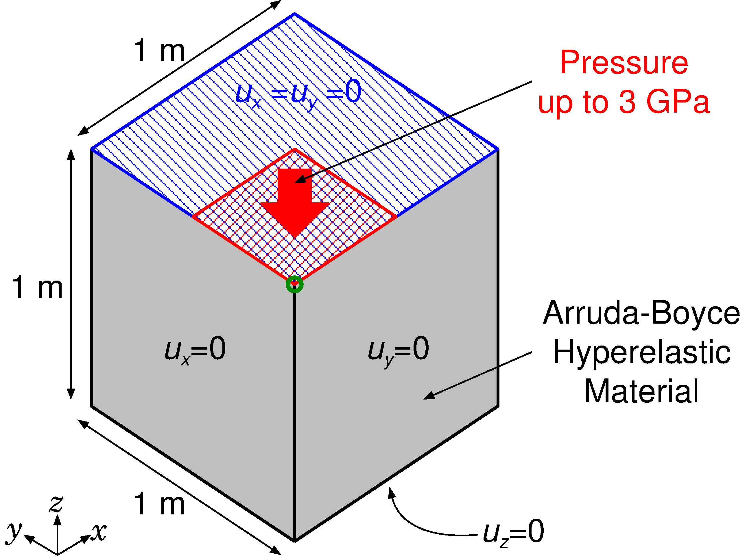
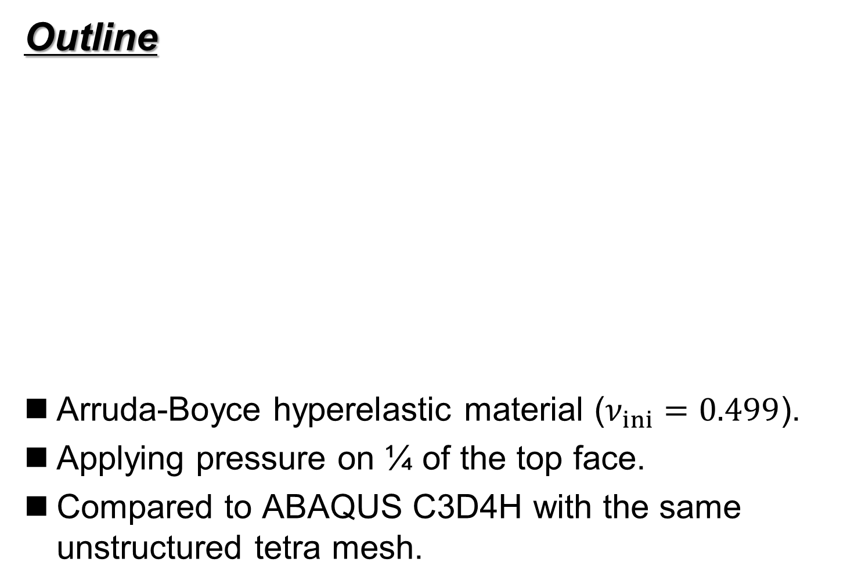
#2: Compression of a Block
Outline
Arruda-Boyce hyperelastic material ($ν_{ini}=0.499$).
Applying pressure on ¼ of the top face.
Compared to ABAQUS C3D4H with the same unstructured tetra mesh.
Load

Slide 20
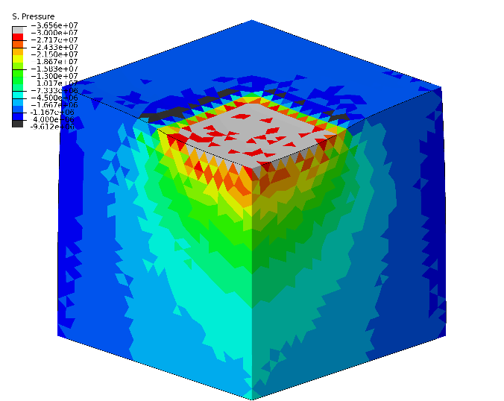
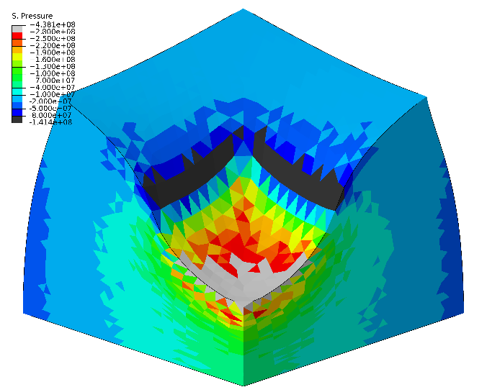
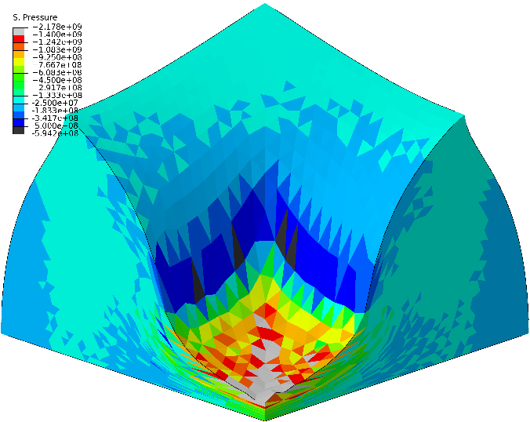
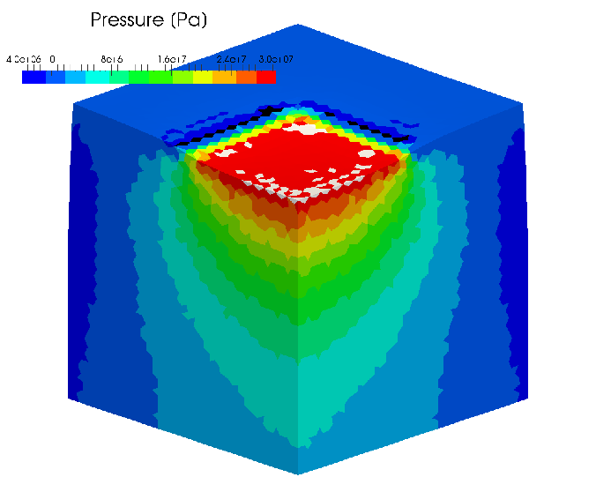
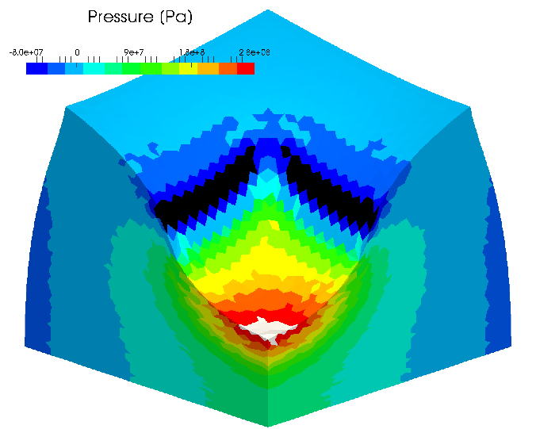
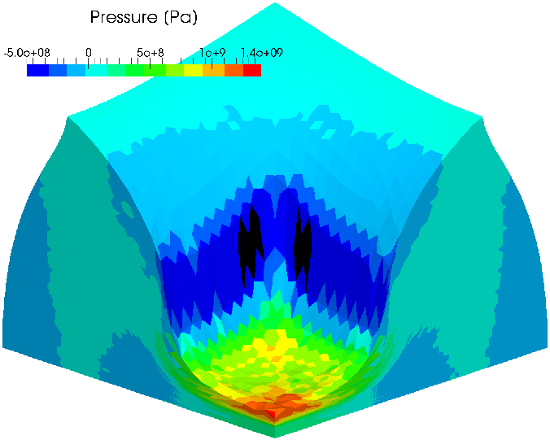
#2: Compression of a Block
Pressure Distribution
Early stage Middle stage Later stage
ABAQUS
C3D4H
F-bar
ES-FEM-
T4(2)

Slide 21
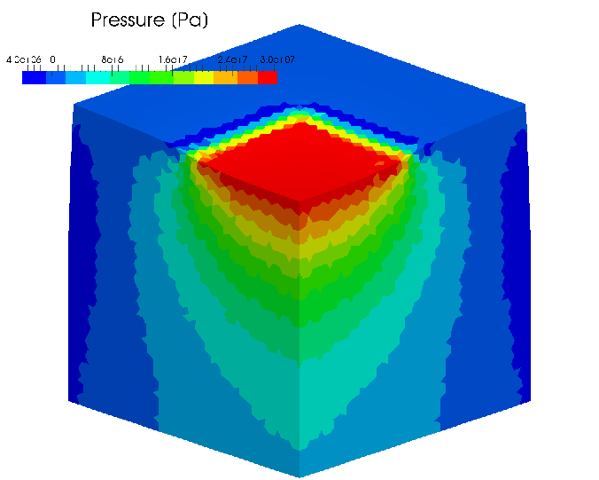
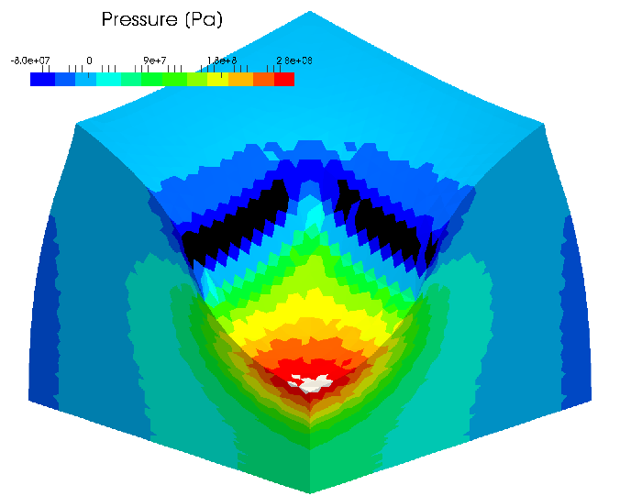
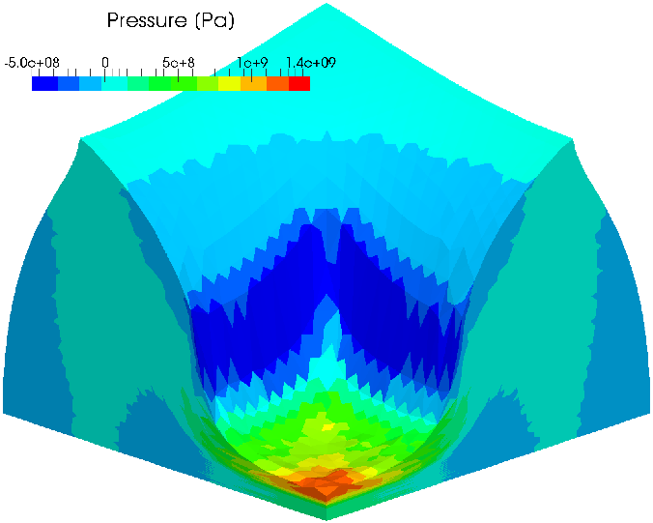

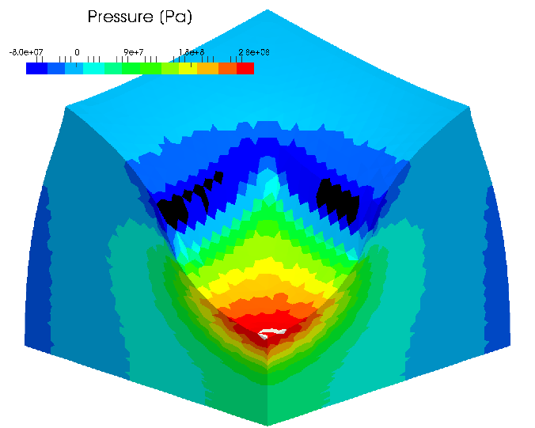
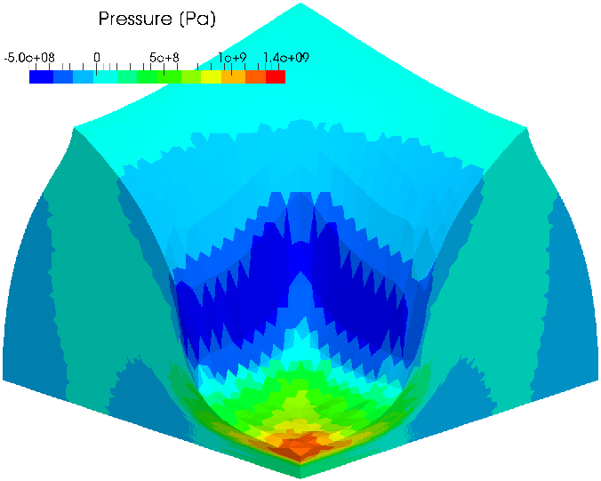
#2: Compression of a Block
Pressure Distribution
Early stage Middle stage Later stage
F-bar
ES-FEM-
T4(3)
In case the Poisson’s ratio is 0.499,
F-barES-FEM-T4(2) or later can suppress pressure oscillation
successfully in large strain analysis.
F-bar
ES-FEM-
T4(4)

Slide 22
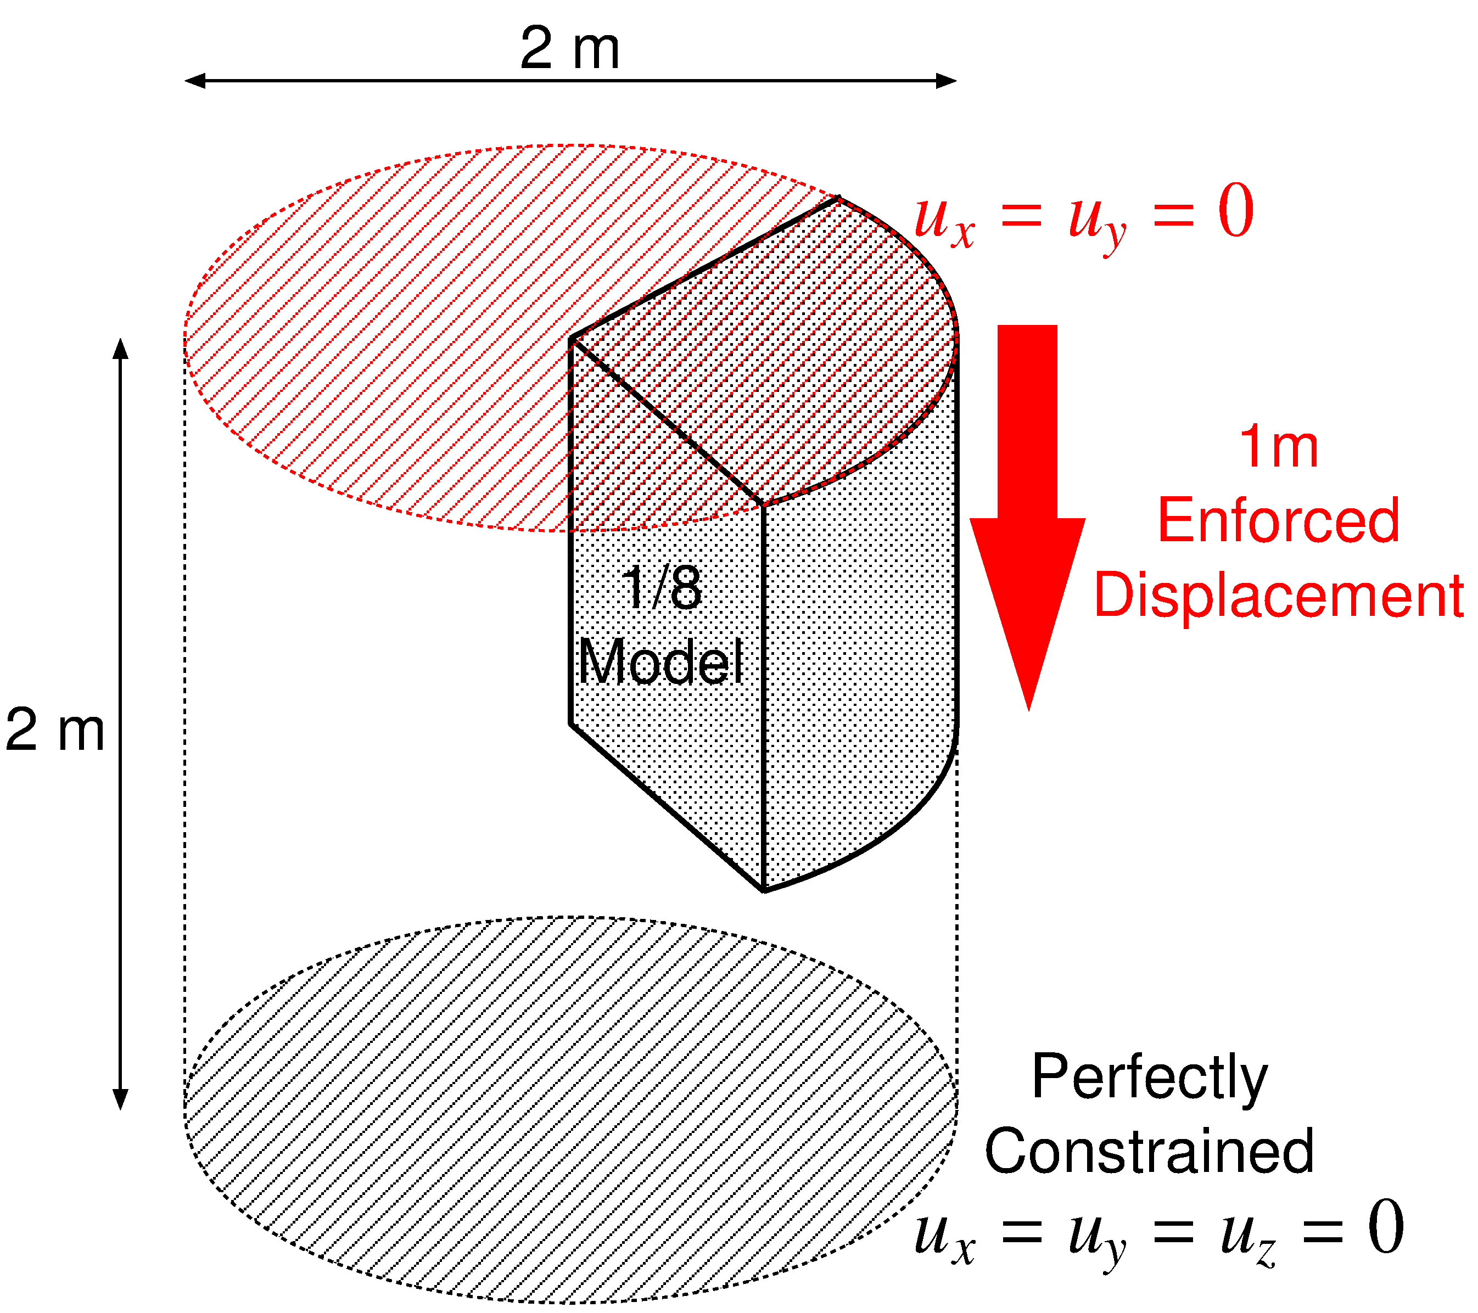
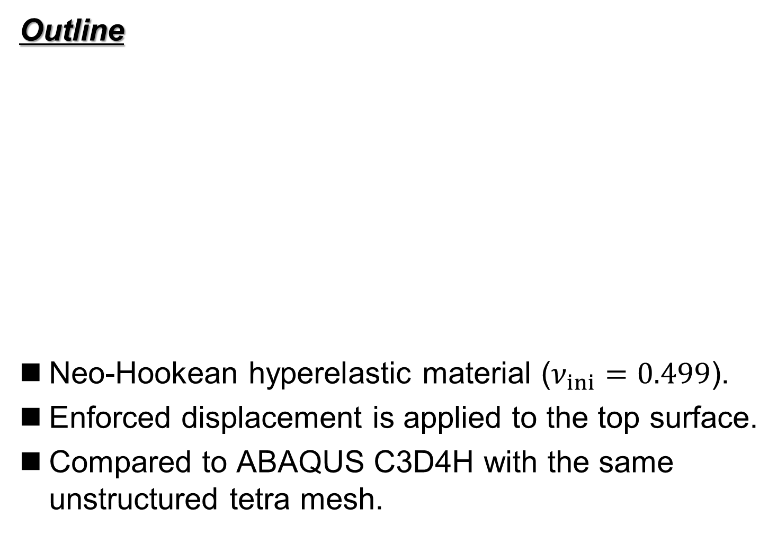
#3: Compression of 1/8 Cylinder
Outline
Neo-Hookean hyperelastic material ($ν_{ini}=0.499$).
Enforced displacement is applied to the top surface.
Compared to ABAQUS C3D4H with the same unstructured tetra mesh.

Slide 23
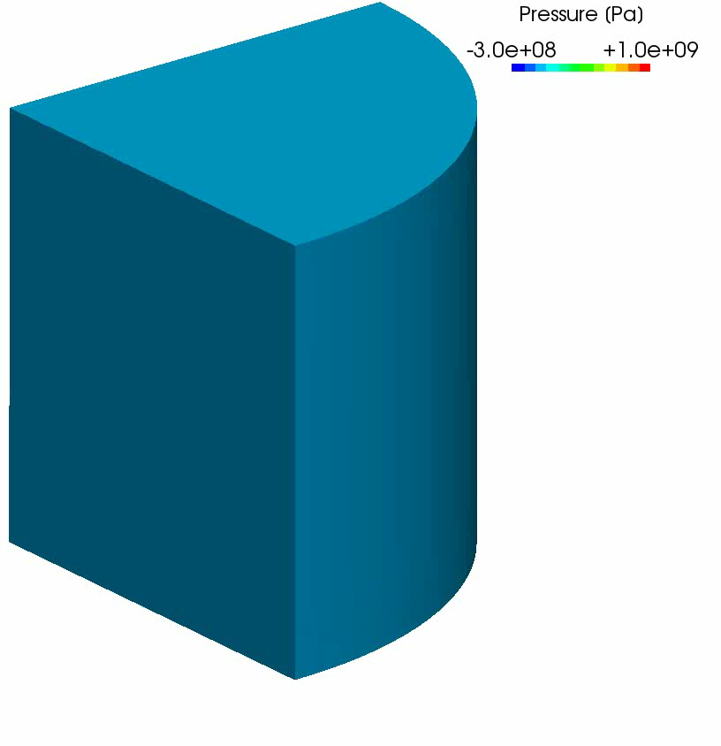
#3: Compression of 1/8 Cylinder
Result
of F-bar
ES-FEM(2)
50% nominal
compression
Almost smooth
pressure
distribution
is obtained
except just
around the rim.

Slide 24
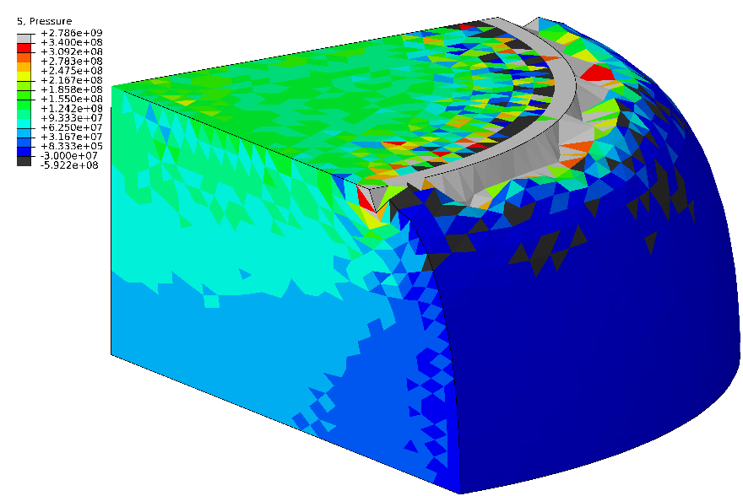
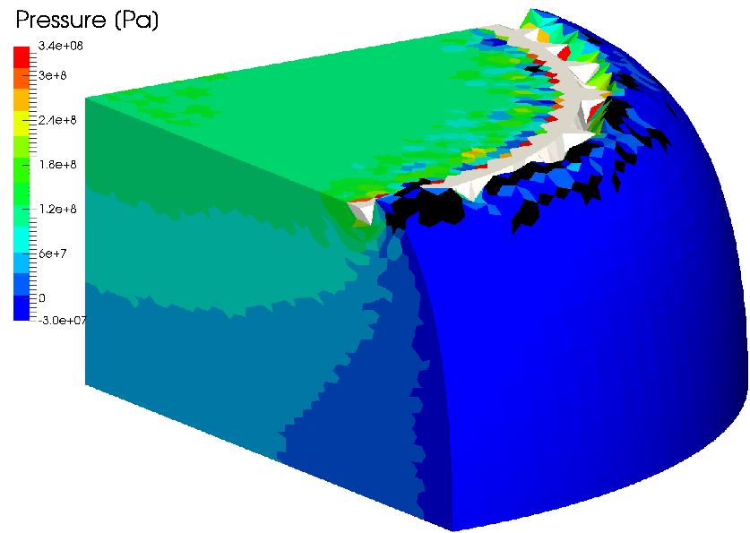
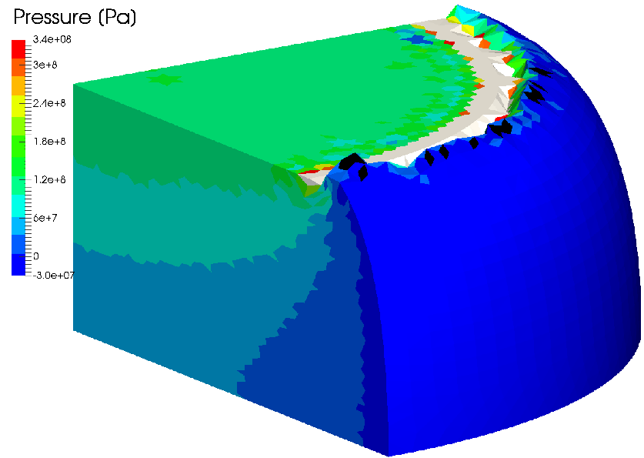

#3: Compression of 1/8 Cylinder
Pressure Distribution
F-bar
ES-FEM-
T4(2)
ABAQUS
C3D4H
F-barES-FEM-T4 with a sufficient cyclic smoothing
also resolves the corner locking issue.
F-bar
ES-FEM-
T4(3)
F-bar
ES-FEM-
T4(4)

Slide 25
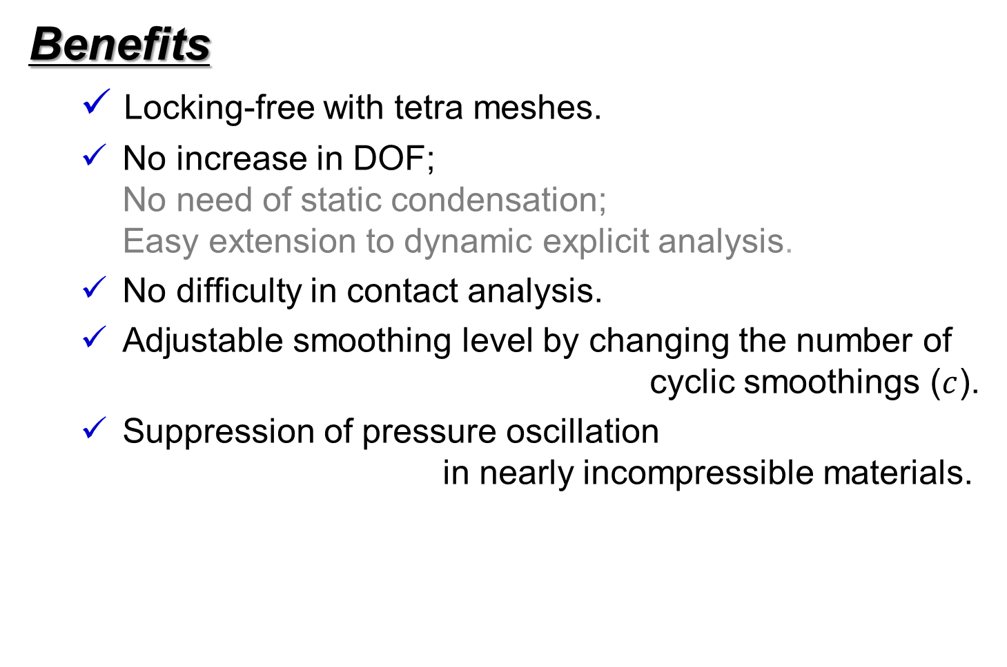
Characteristics of F-barES-FEM-T4
Benefits
  Locking-free with tetra meshes.
  No increase in DOF;
  No need of static condensation;
  Easy extension to dynamic explicit analysis.
  No difficulty in contact analysis.
  Adjustable smoothing level by changing the number of
  cyclic smoothings ($c$).
  Suppression of pressure oscillation
  in nearly incompressible materials.
  In point of accuracy, F-barES-FEM-T4 is excellent!!

Slide 26

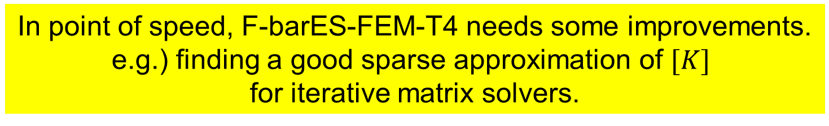
Characteristics of F-barES-FEM-T4
Drawbacks
  ✗ Blur of high-frequency pressure distribution.
  (The impact of blur seem to be not significant.)
  ✗ Increase in bandwidth of the exact tangent stiffness $[K]$.
  In case of standard unstructured T4 meshes,
Method | Approx. Bandwidth | Approx. Ratio
Standard FEM-T4 | 40 | 1
F-barES-FEM(1) | 390 | x10
F-barES-FEM(2) | 860 | x20
F-barES-FEM(3) | 1580 | x40
F-barES-FEM(4) | 2600 | x65
  In point of speed, F-barES-FEM-T4 needs some improvements.
  e.g.) finding a good sparse approximation of $[K]$
  for iterative matrix solvers.

Slide 27
Summary

Slide 28
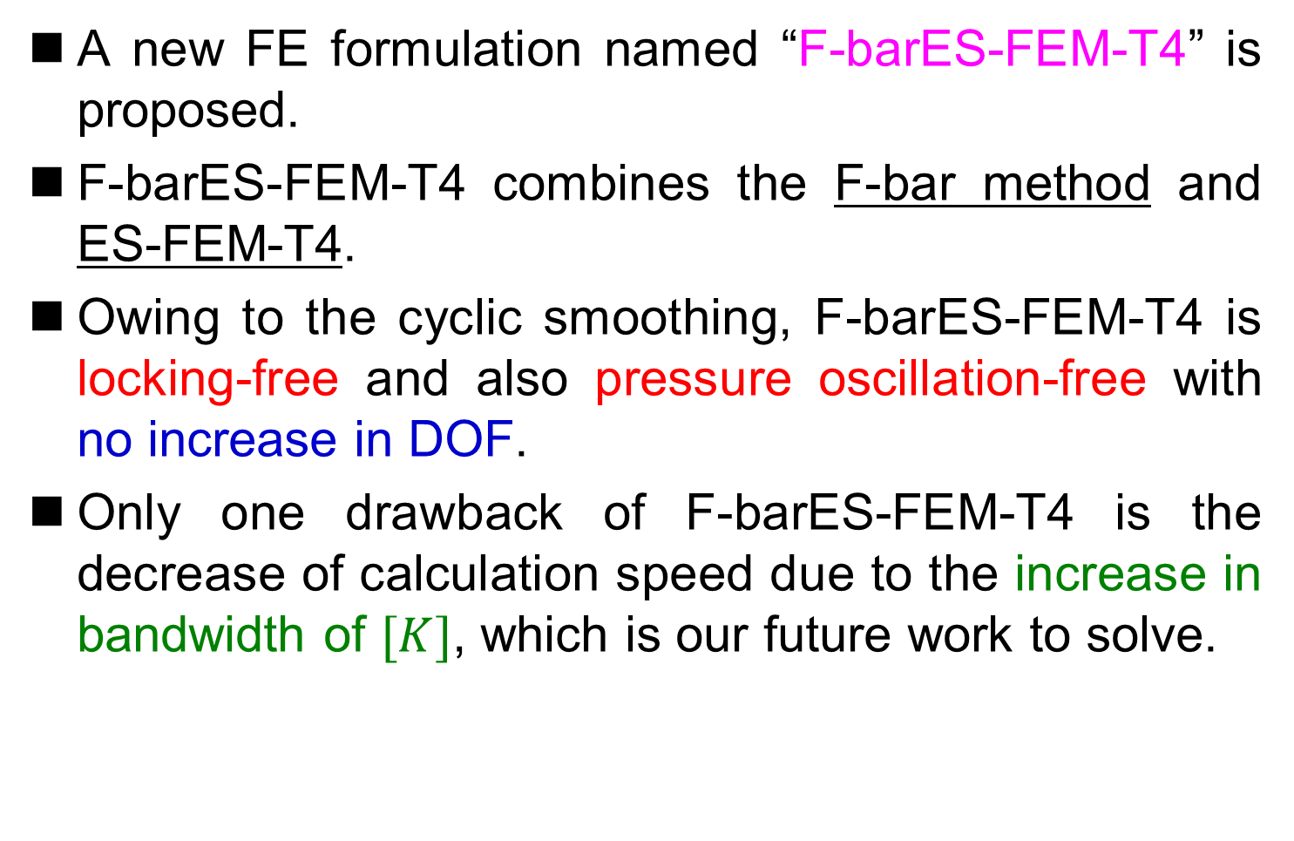
Summary
A new FE formulation named “F-barES-FEM-T4” is proposed.
F-barES-FEM-T4 combines the F-bar method and ES-FEM-T4.
Owing to the cyclic smoothing, F-barES-FEM-T4 is locking-free and also pressure oscillation-free with no increase in DOF.
Only one drawback of F-barES-FEM-T4 is the decrease of calculation speed due to the increase in bandwidth of $[K]$, which is our future work to solve.
Thank you for your kind attention!

Slide 29
Appendix

Slide 30
Characteristics of FEM-T4s
 | Shear & Volumetric Locking | Zero- Energy Mode | Dev/Vol Coupled Material | Pressure Oscillation | Corner Locking | Severe Strain
Standard FEM-T4 | ✗ | ✓ | ✓ | ✗ | ✗ | ✓
ABAQUS C3D4H | ✓ | ✓ | ✓ | ✗ | ✗ | ✓
Selective S-FEM-T4 | ✓ | ✓ | ✗ | ✗ | ✗ | ✓
bES-FEM-T4 hES-FEM-T4 | ✓ | ✓ | ✓ | ✗ | ✗ | ✗
F-bar ES-FEM-T4 | ✓ | ✓ | ✓ | ✓* | ✓* | ✓
*
) when the num. of cyclic smoothings is sufficiently large.

Slide 31
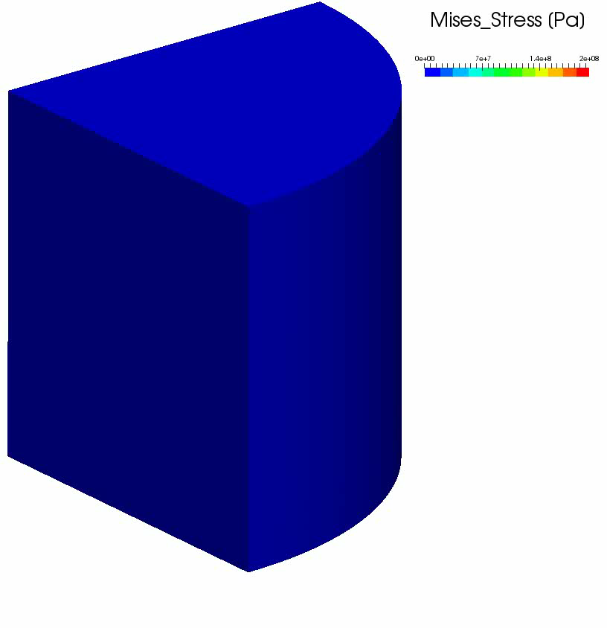
#3: Compression of 1/8 Cylinder
Result
of F-bar
ES-FEM(2)
50% nominal
compression
Smooth
Mises stress
distribution
is obtained
except just
around the rim.

