Slide 1
Smoothed Finite Element Method
Based on Incremental
Implicit Equilibrium Equation for Large Deformation
Mesh Rezoning Analysis
Yuki ONISHI, Kenji AMAYA
Tokyo Institute of Technology (Japan)

Slide 2
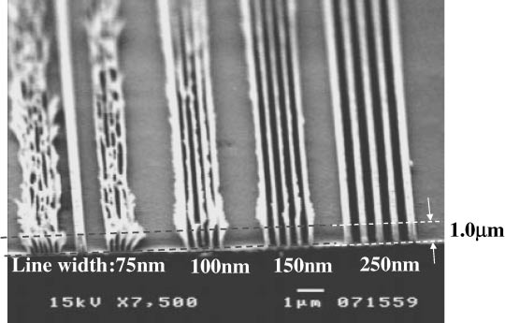
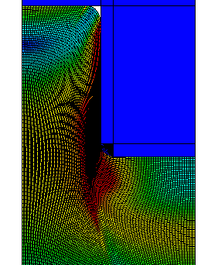
Motivation and Background
Motivation
  We want to solve severely large deformation problems
  accurately and stably!
  (Final target: thermal nanoimprinting)
Background
  Finite elements are distorted
  in a short time, thereby resulting
  in convergence failure.
Mesh rezoning method (h-adaptive
mesh-to-mesh solution mapping)
is indispensable.
Mold
Polymer

Slide 3
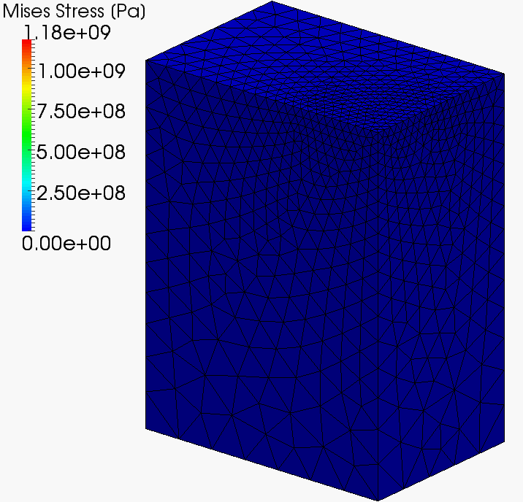
Our First Result in Advance
static-implicit
large deformation
analysis
with
mesh rezoning

Slide 4
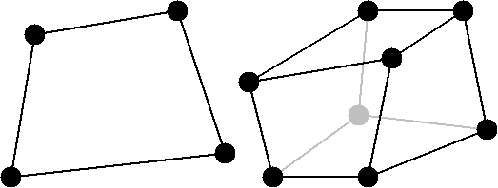
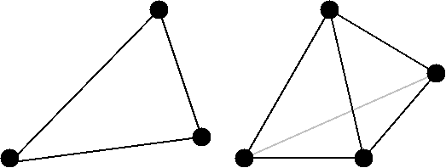
Issues
The biggest issue
in large deformation mesh rezoning
It is impossible to remesh arbitrary deformed 2D or 3D domains with quadrilateral or hexahedral elements.
However, the standard (constant strain) triangular or tetrahedral elements induce shear and volumetric locking easily, which leads to inaccurate results.
NO
YES
We have to use triangular or tetrahedral elements...

Slide 5
Conventional Methods
Higher order elements:
✗ Not volumetric-locking-free; Not effective
in large deformation due to intermediate nodes.
EAS elements:
✗ Unstable.
B-bar, F-bar and selective integration elements:
✗ Not applicable to triangular/tetrahedral.
F-bar patch elements:
✗ Difficult to construct patches
u/p hybrid elements:
✗ No sufficient formulation for triangular/tetrahedral
is presented so far.
Can selective S-FEMs really be a solution?
My answer is “Let’s try”.

Slide 6
Objective
Develop a locking-free
modified selective S-FEM
for large deformation problems
with mesh rezoning
Table of Body Contents
- Part 1: Introduction of our modified selective S-FEM
formulation
- Part 2: Procedure of our mesh rezoning method
- Part 3: Examples of demonstrative analysis
- Summary

Slide 7
Part 1:
Introduction of Our Modified selective S-FEM Formulation

Slide 8
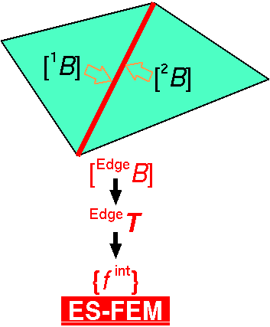

Review of Edge-based S-FEM (ES-FEM)
Calculate $[B]$ at element as usual.
Distribute $[B]$ to the connecting edges and make $[ ^{Edge}B]$.
F, T etc and {f ^{int}} are calculated on smoothed edge domains.
Generally accurate but induces volumetric locking.
Substituting "face" for "edge"
gives FS-FEM for 3D

Slide 9
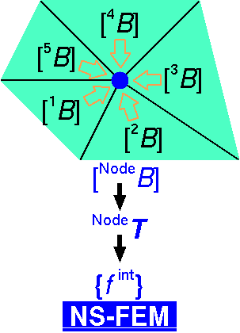

Review of Node-based S-FEM (NS-FEM)
Calculate $[B]$ at element as usual.
Distribute $[B]$ to the connecting nodes and make $[ ^{Node}B]$
F, T etc and {f ^{int}} are calculated on smoothed node domains.
Generally not accurate but volumetric locking free.
(due to zero-energy modes,
which are arisen in
reduced integration
finite elements as
hour-glass modes)
close to FVM with
vertex-based control volume

Slide 10
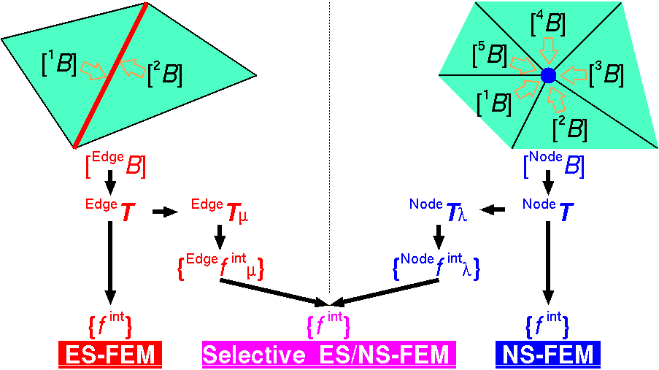

Review of Selective ES/NS-FEM
Separate stress into "$μ$ part" and "$λ$ part", where $μ$ and $λ$ are the Lame's parameters.
F, T etc and {f ^{int}} are calculated on both smoothed domains.
Only applicable to elastic constitutive models.
Substituting
"face"
for
"edge"
gives
FS/NS-FEM
for 3D

Slide 11


Our Modified Selective ES/NS-FEM
Separate stress into "deviatoric part" and "hydrostatic part"
instead of "$μ$ part" and "$λ$ part".
F, T etc and {f ^{int}} are calculated on both smoothed domains.
Applicable to any kind of material constitutive models.
Substituting
"face"
for
"edge"
gives
FS/NS-FEM
for 3D

Slide 12
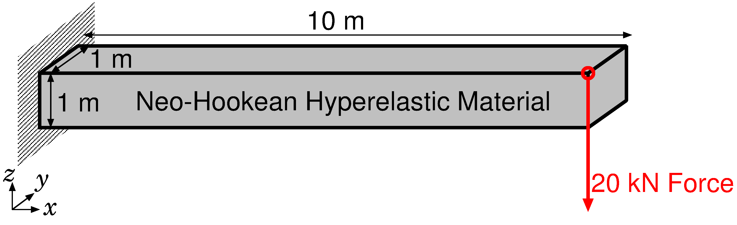
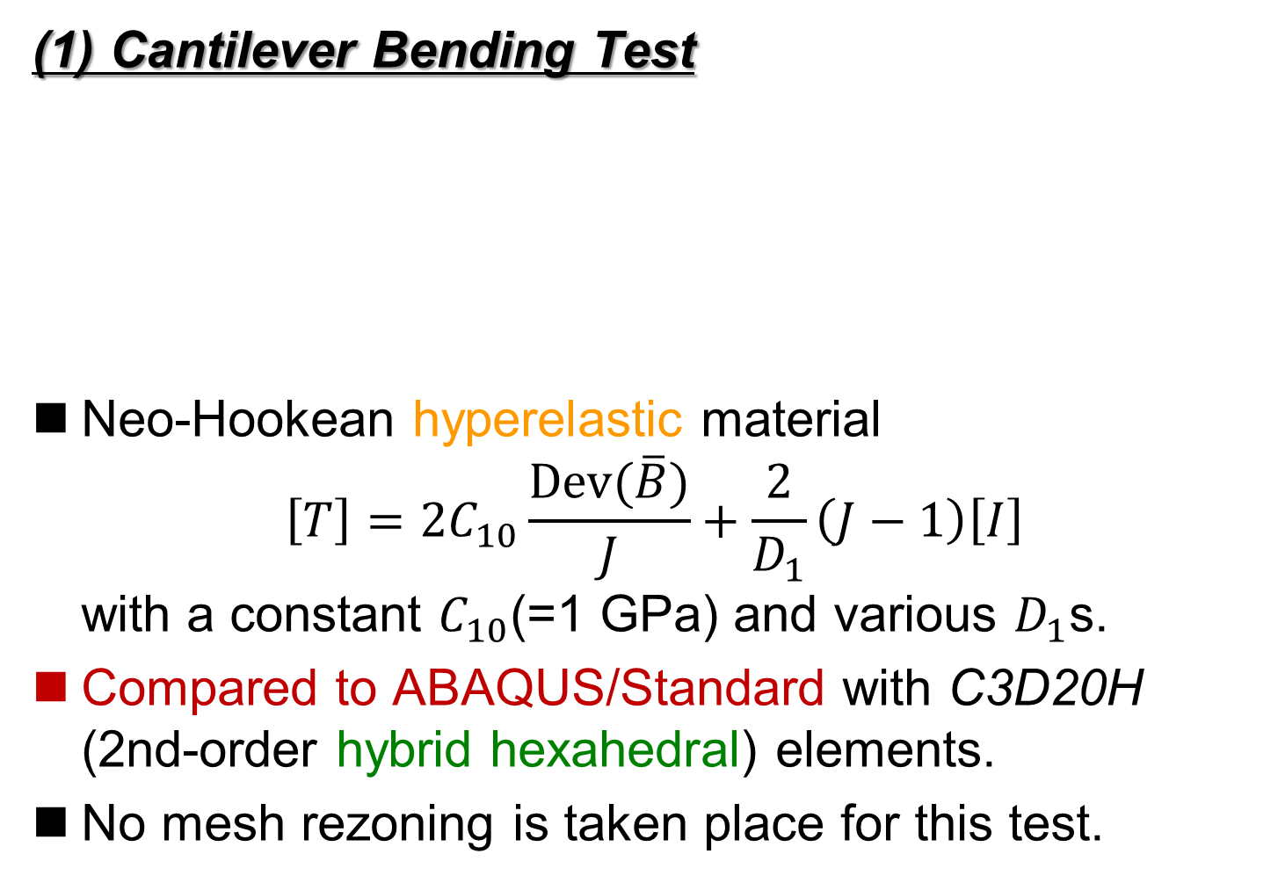
Verification of Our Selective S-FEM
(1) Cantilever Bending Test
Neo-Hookean hyperelastic material
$\left[T\right]=2C_{10}\frac{Dev(\overline{B})}{J}+\frac{2}{D_{1}}\left(J−1\right)\left[I\right]$
with a constant $C_{10}$(=1 GPa) and various $D_{1}$s.
Compared to ABAQUS/Standard with C3D20H (2nd-order hybrid hexahedral) elements.
No mesh rezoning is taken place for this test.

Slide 13
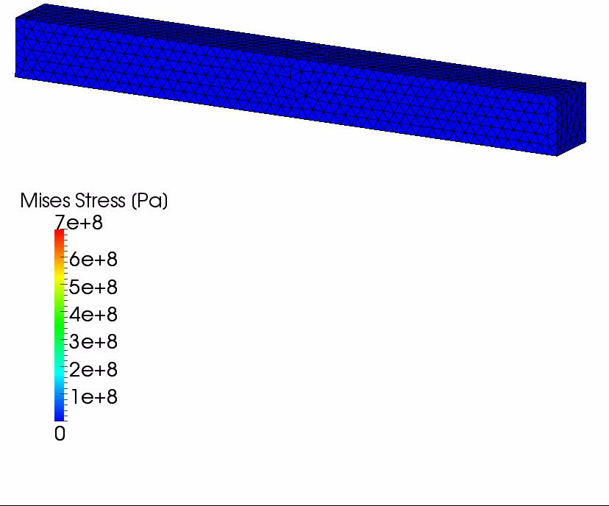

Verification of Our Selective S-FEM
Results with $D_{1}=2×10^{−15} [Pa^{−1}]$ ($ν_{ini}$=0.499999)
The amount of
vertical deflection
is about
6.5 m.
If we use
constant strain
tetrahedral,
the amount of
vertical deflection
is about only
0.1 m.

Slide 14
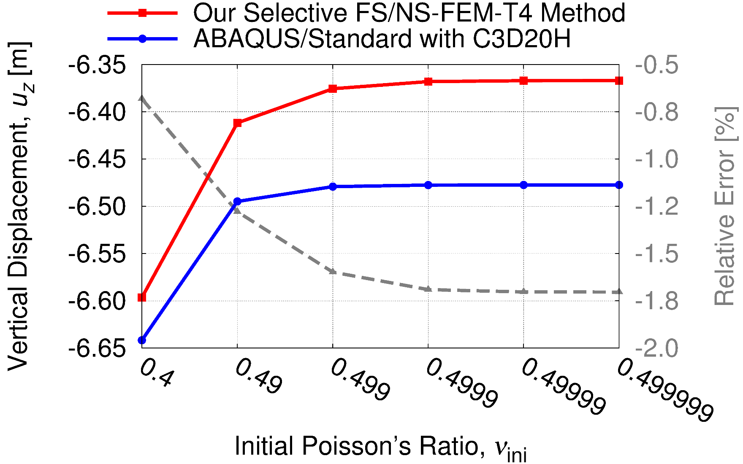
Verification of Our Selective S-FEM
Comparison to ABAQUS Hybrid Element
Our selective S-FEM is free from shear locking!!

Slide 15
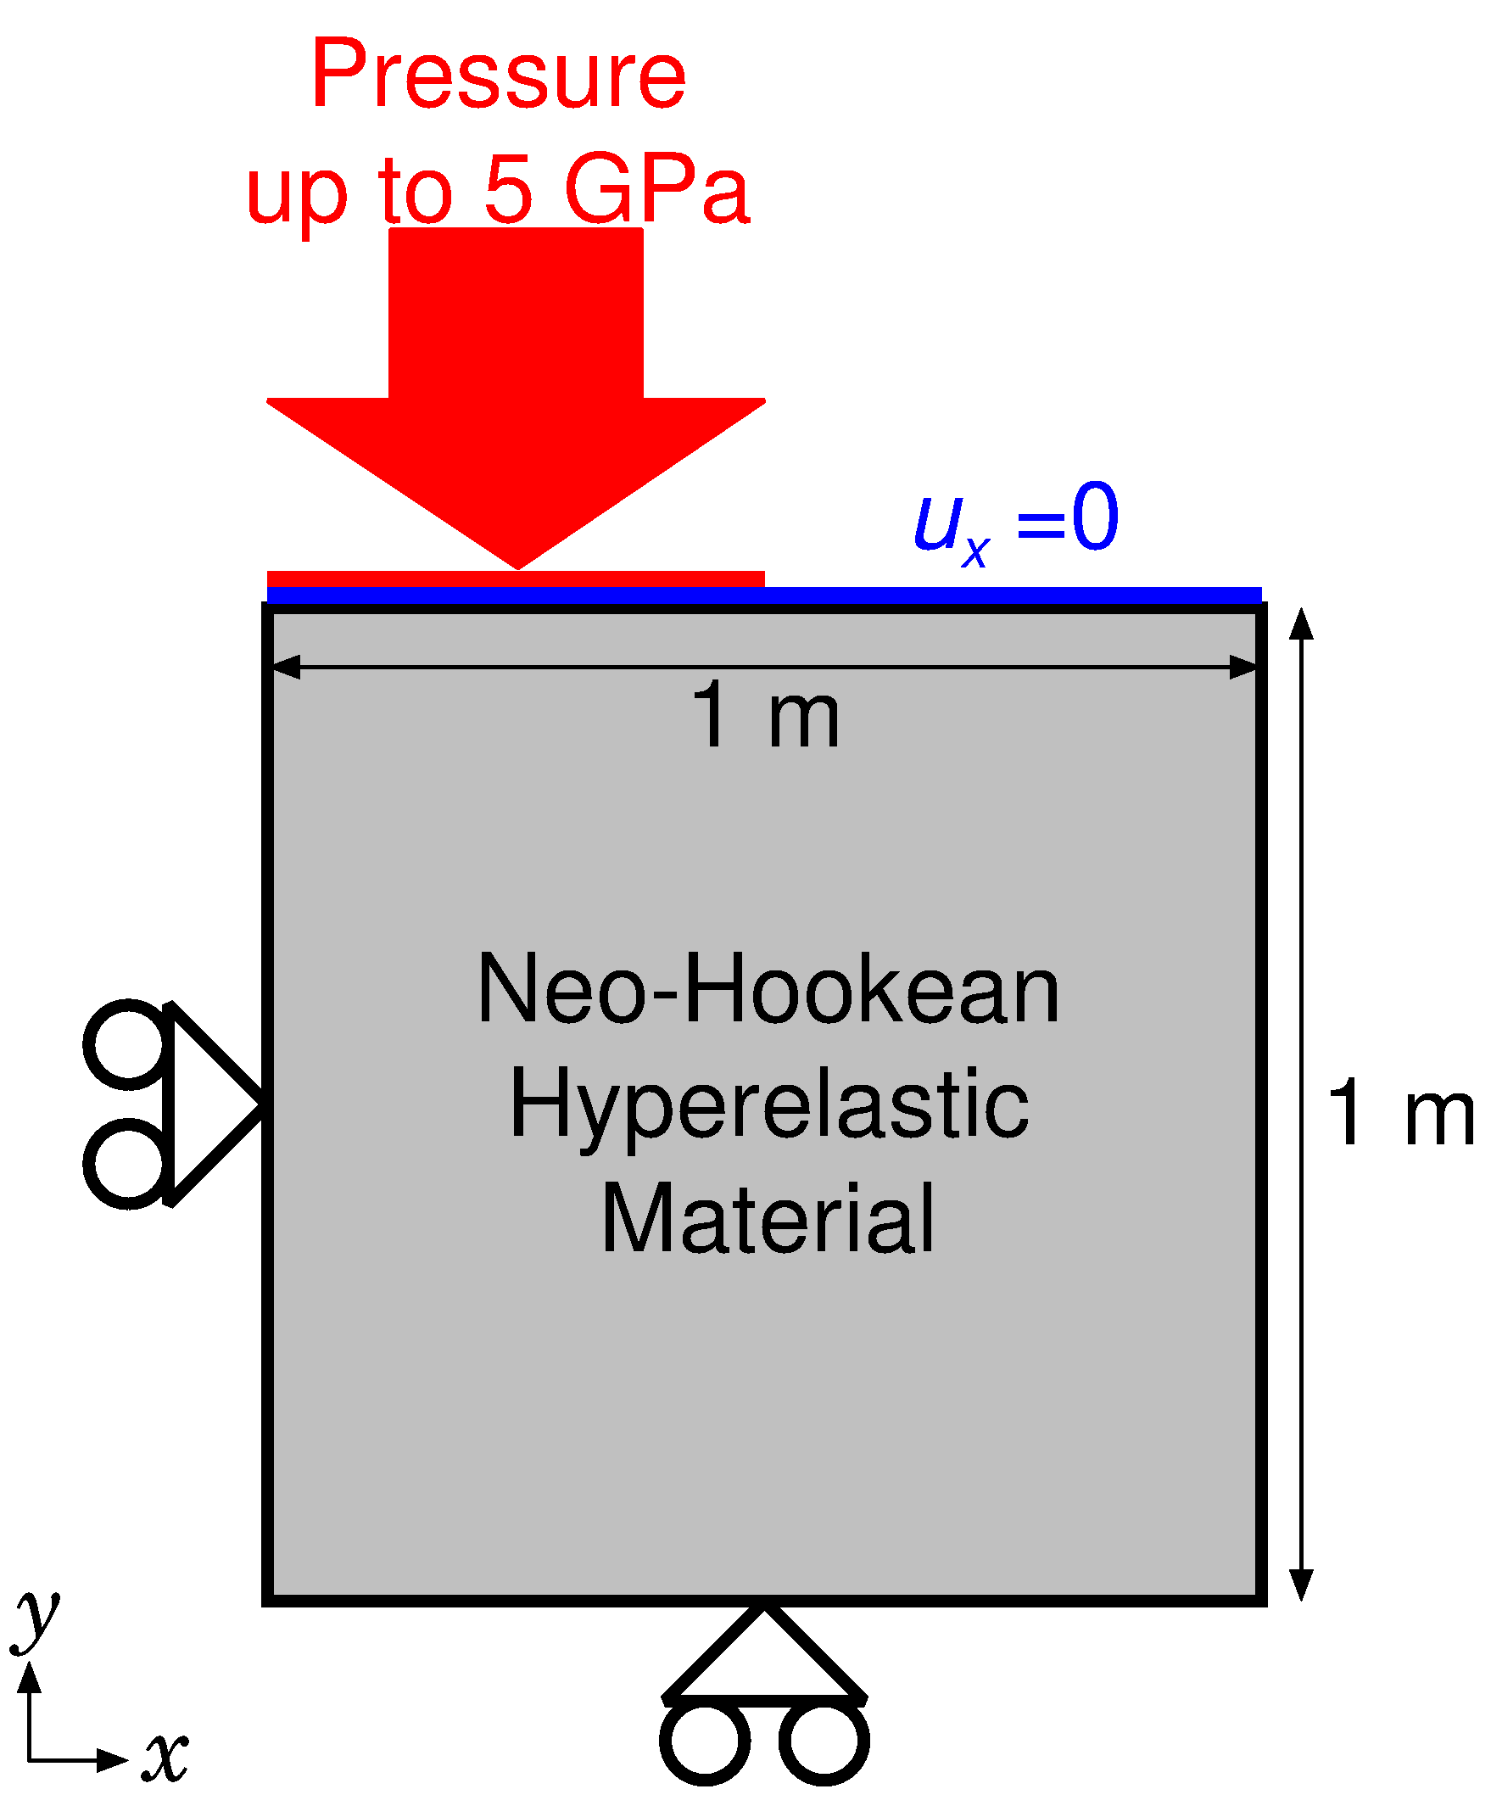

Verification of Our Selective S-FEM
(2) Block Pressing Test
Plane-strain condition
Neo-Hookean
hyperelastic
material with
$C_{10}=40×{10}^{6}Pa,$
$D_{1}=5×{10}^{−12} Pa^{−1}$
($ν_{ini}=0.4999$)
Pressure is applied
to the top-left part
up to 5 GPa

Slide 16
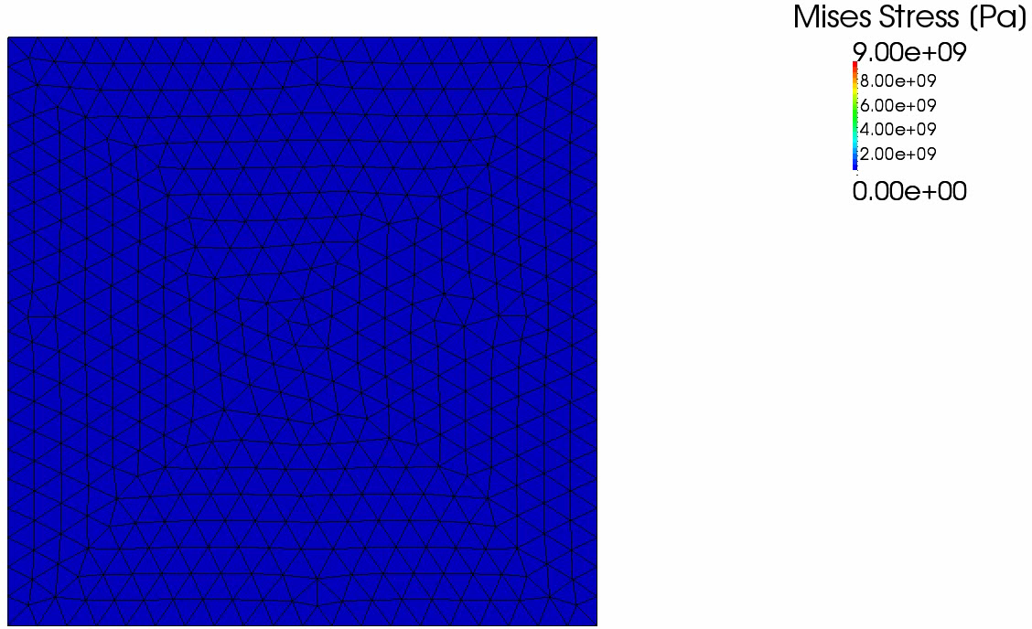
Verification of Our Selective S-FEM
Results

Slide 17
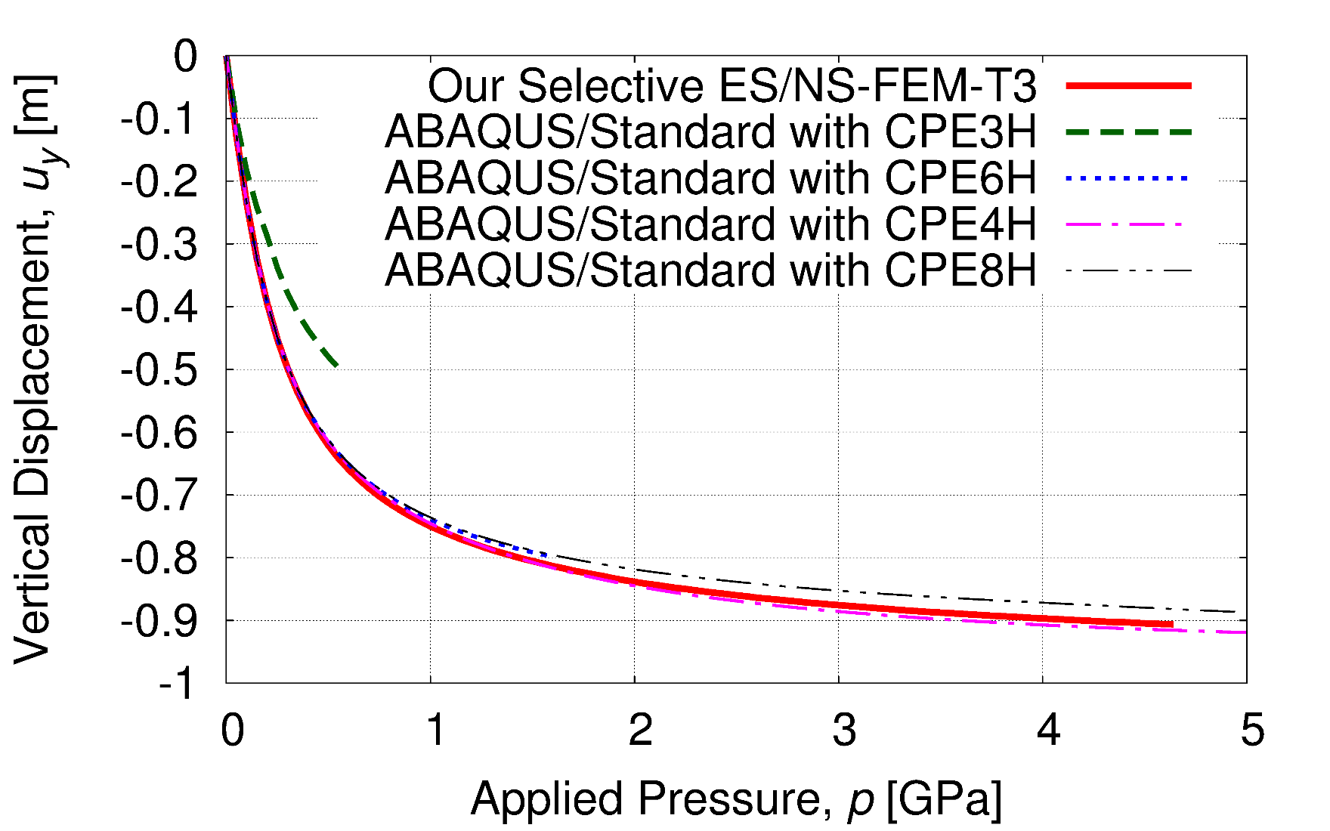
Verification of Our Selective S-FEM
Comparison to ABAQUS Hybrid Elements
Our selective S-FEM is free from volumetric locking!!

Slide 18
Part 2:
Procedure of our mesh rezoning method

Slide 19
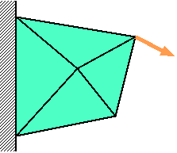
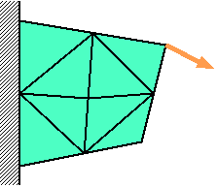
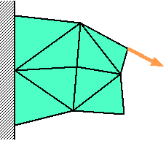



Procedure of Mesh Rezoning
Time:
t_{n-1}
Time:
t_{n}
Time:
t_{n+1}
Force
$$f^{\text{ext}}=f^{\text{int}}$$
$$f^{\text{ext}}≠f^{\text{int}}$$
$$f^{\text{ext}}=f^{\text{int}}$$
Solve
Equilibrium
Remesh
&
Map States
Resolve
Equilibrium
Solve
Equilibrium
The way of mapping varies with the material constitutive model.
(e.g. Elasto-plastic models necessitate some kind of correction.)

Slide 20
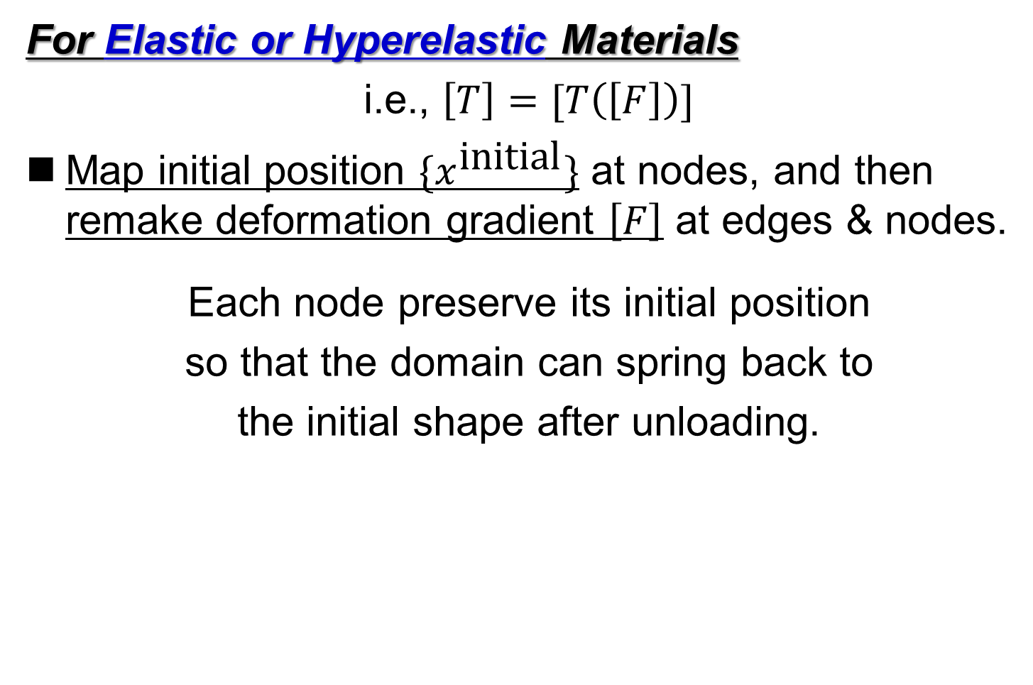
Mapping of Stress/Strain States
For Elastic or Hyperelastic Materials
i.e., $\left[T\right]=[T\left(\left[F\right]\right)]$
Map initial position $\{x^{\text{initial}}\}$ at nodes, and then remake deformation gradient $\left[F\right]$ at edges & nodes.
Each node preserve its initial position
so that the domain can spring back to
the initial shape after unloading.

Slide 21
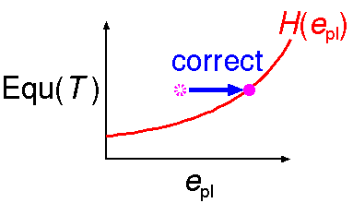
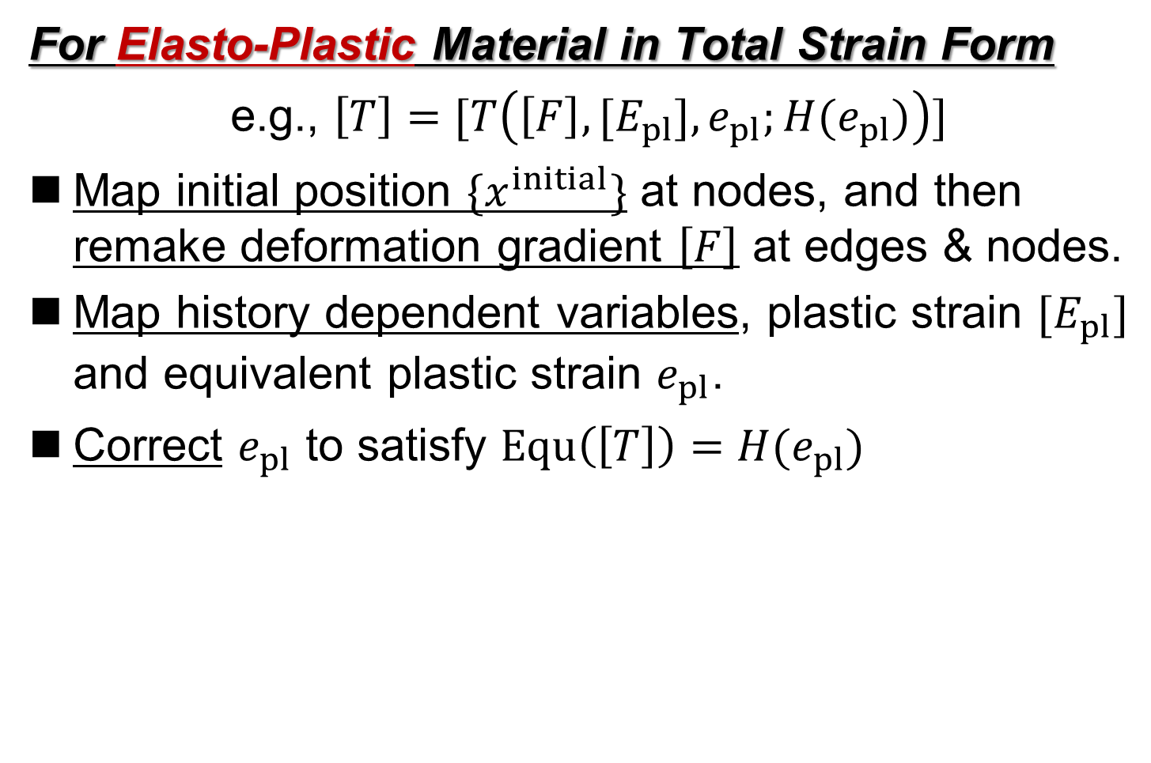
Mapping of Stress/Strain States
For Elasto-Plastic Material in Total Strain Form
e.g., $\left[T\right]=[T\left(\left[F\right],{[E}_{pl}], e_{pl};H(e_{pl})\right)]$
Map initial position $\{x^{initial}\}$ at nodes, and then
remake deformation gradient $\left[F\right]$ at edges & nodes.
Map history dependent variables, plastic strain $[E_{pl}]$ and equivalent plastic strain $e_{pl}$.
Correct $e_{pl}$ to satisfy $Equ\left(\left[T\right]\right)=H(e_{pl})$
= Mises Stress

Slide 22
Part 3:
Examples of Demonstrative Analysis

Slide 23
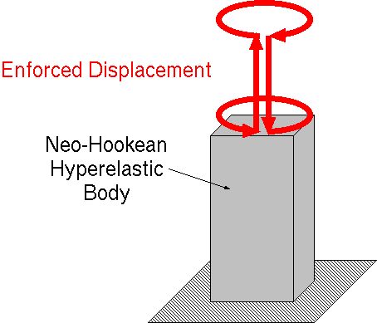
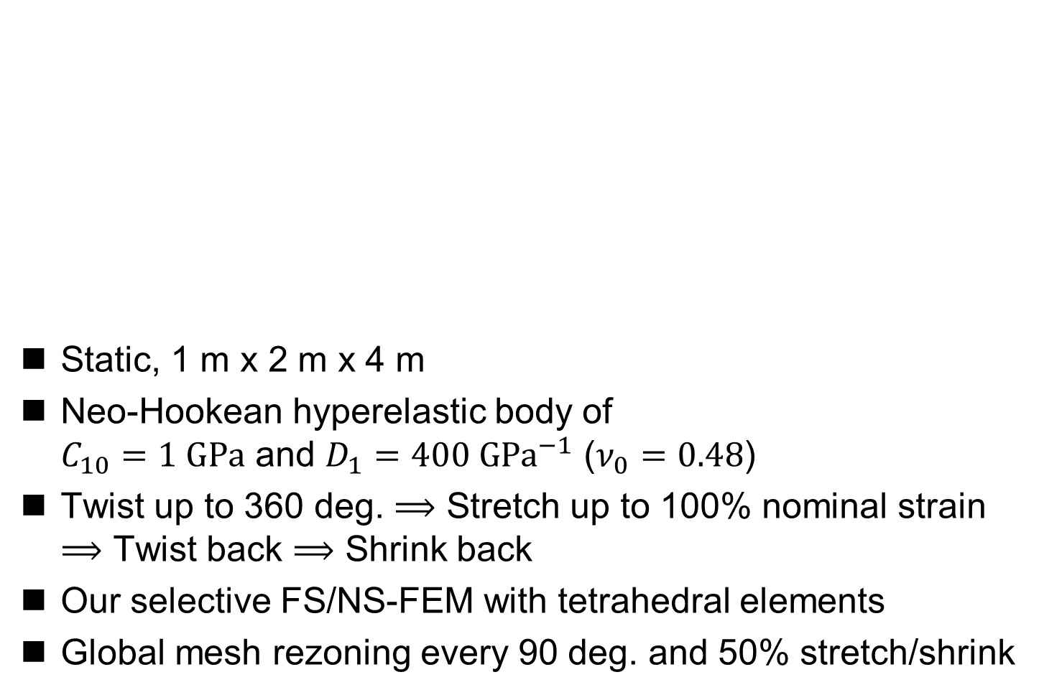
Twist and Stretch of Hyperelastic Body
Static, 1 m x 2 m x 4 m
Neo-Hookean hyperelastic body of
$C_{10}=1 GPa$ and $D_{1}=400 GPa^{−1}$ ($ν_{0}=0.48$)
Twist up to 360 deg. $⟹$ Stretch up to 100% nominal strain
$⟹$ Twist back $⟹$ Shrink back
Our selective FS/NS-FEM with tetrahedral elements
Global mesh rezoning every 90 deg. and 50% stretch/shrink

Slide 24
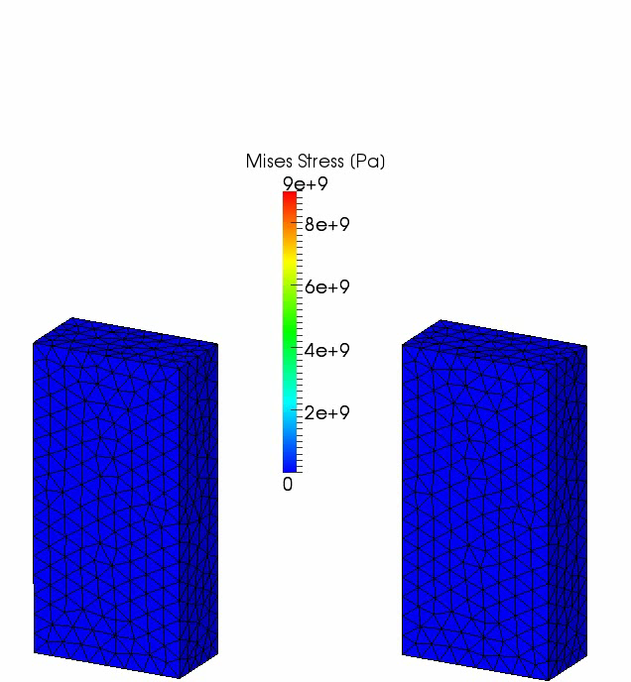
Twist and Stretch of Hyperelastic Body
Our selective
FS/NS-FEM
with
mesh rezoning
Our selective
FS/NS-FEM
without
mesh rezoning

Slide 25
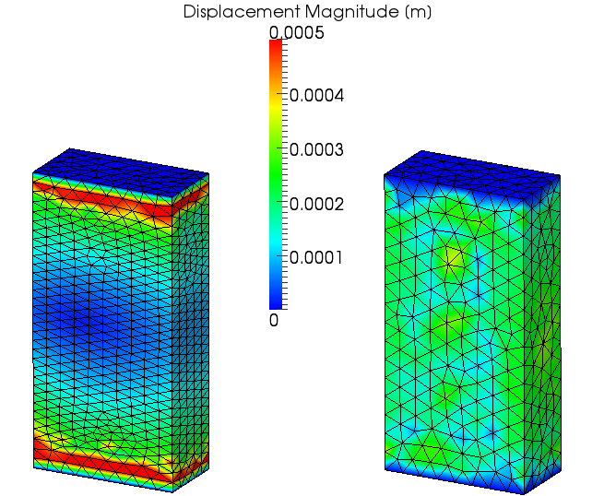
Twist and Stretch of Hyperelastic Body
Residual Displacement
It
spring
backed
almost
perfectly.

Slide 26
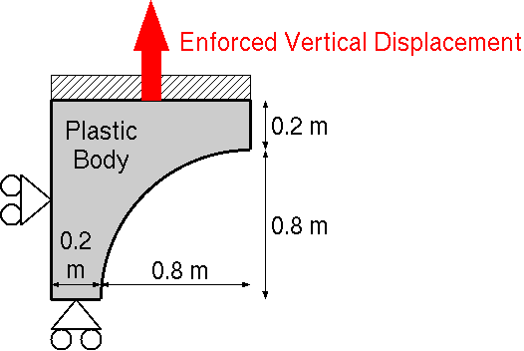
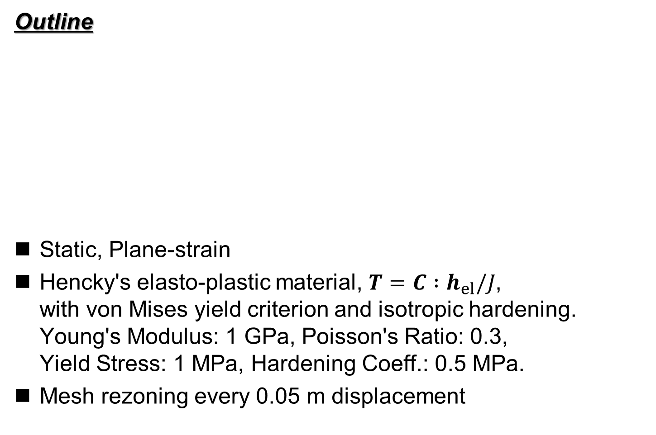
Necking of 2D Elasto-Plastic Body
Outline
Static, Plane-strain
Hencky's elasto-plastic material, $T=C :h_{el}/J$,
with von Mises yield criterion and isotropic hardening.
Young's Modulus: 1 GPa, Poisson's Ratio: 0.3,
Yield Stress: 1 MPa, Hardening Coeff.: 0.5 MPa.
Mesh rezoning every 0.05 m displacement

Slide 27
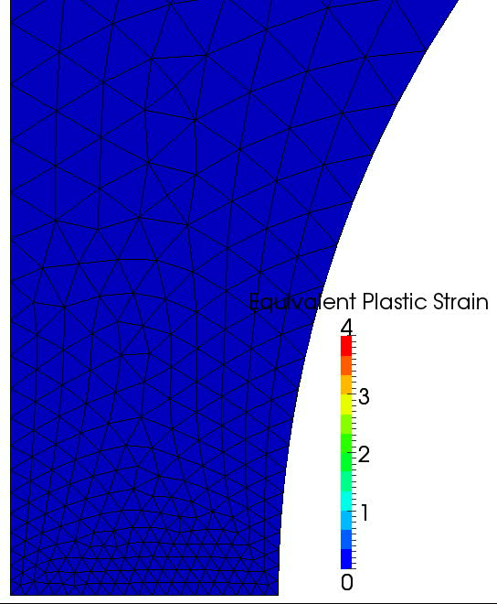
Necking of 2D Elasto-Plastic Body
Result
Zoom-in view
around the center

Slide 28
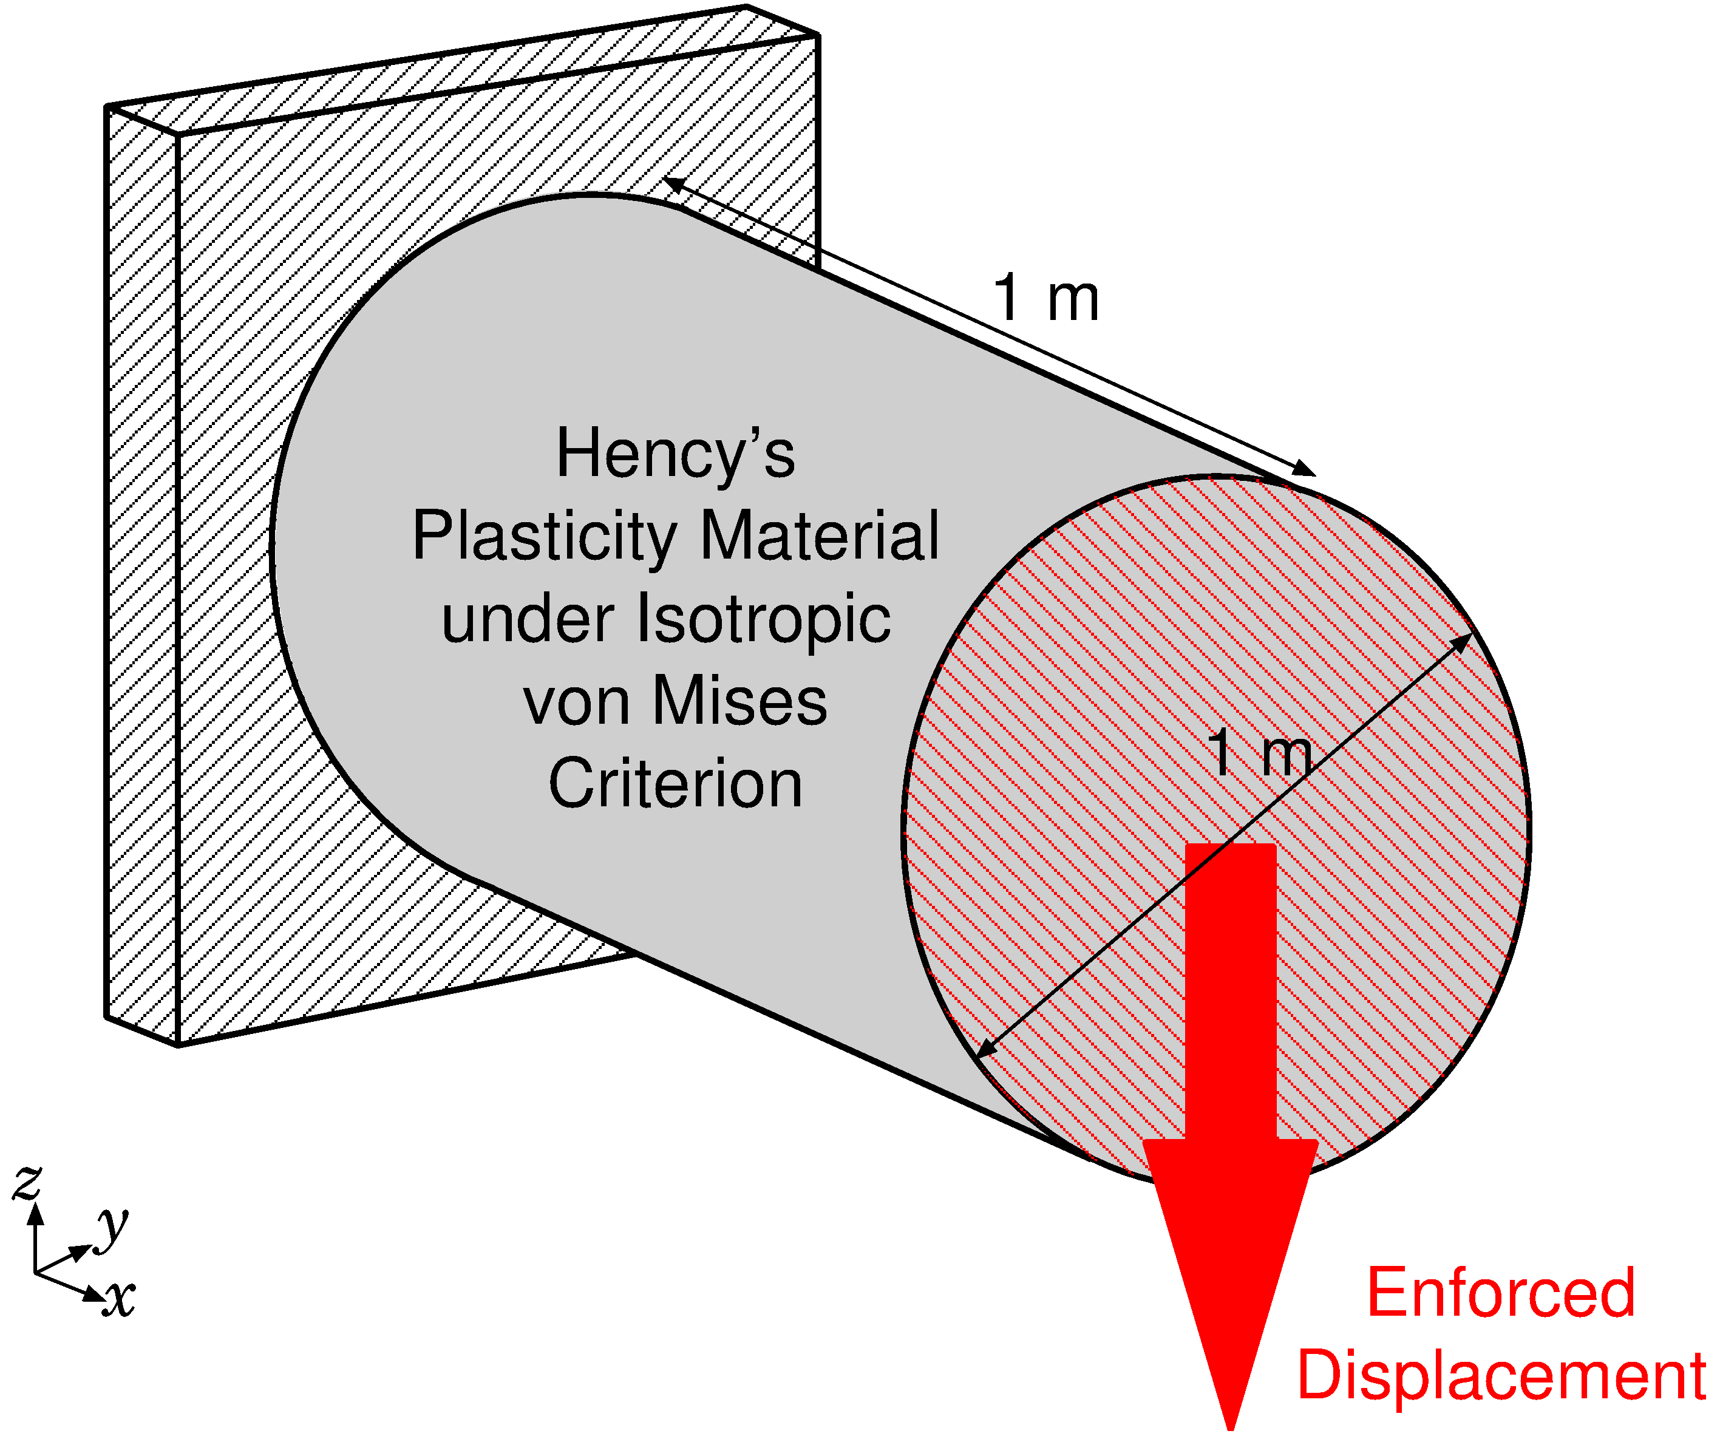
Shearing and Necking of 3D Plastic Rod
Outline
Static, 3D
Hencky’s Plasticity Material
with von Mises yield criterion and isotropic hardening.
(same as 2D case)

Slide 29
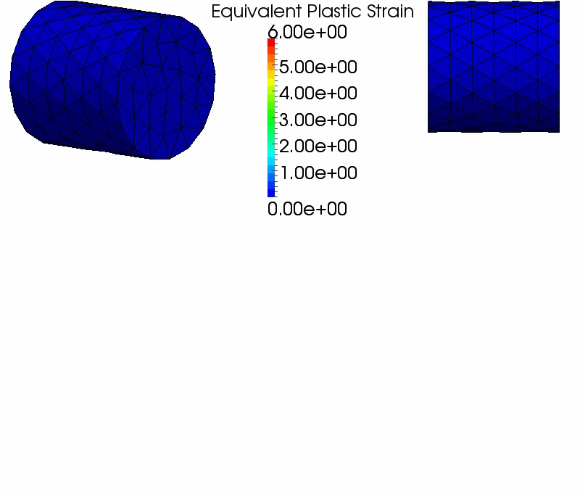
Shearing and Necking of 3D Plastic Rod
3D Result
The deformation
seems
to be valid.
After 2.8 m disp.,
mesh rezoning
error
occurred.

Slide 30
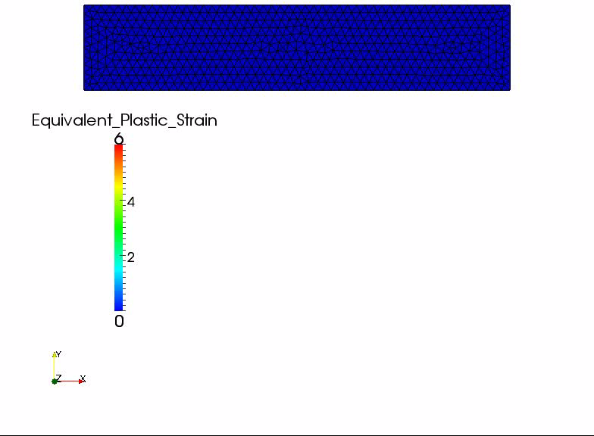
Shearing and Necking of 2D Plastic Bar
2D
Result

Slide 31
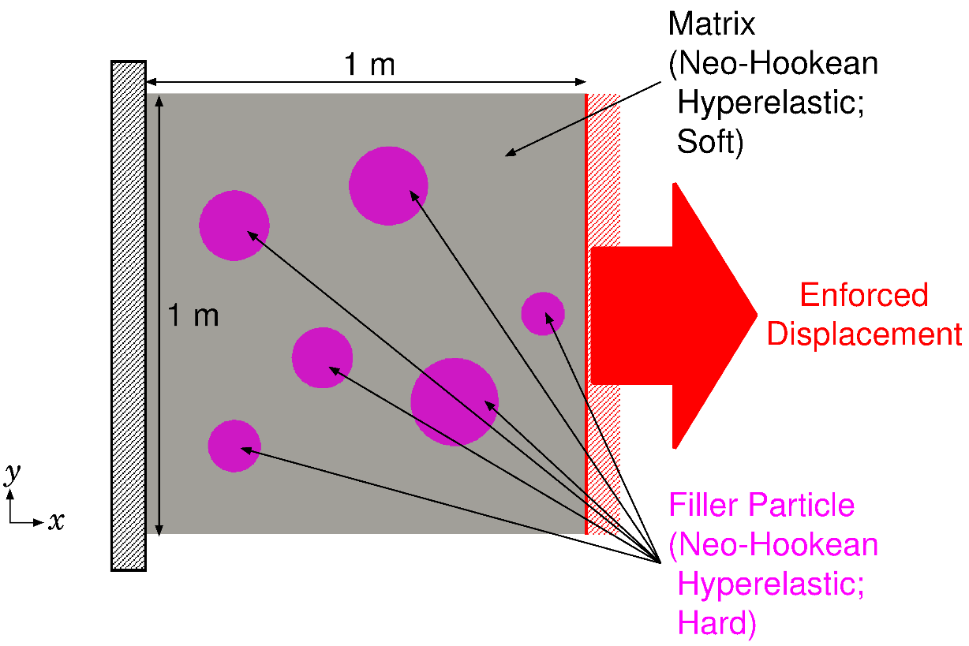

Tension of 2D Filler Particle Composite
Outline
Plane-strain static
Neo-Hookean Hyperelastic
  Filler: hard rubber（$E^{initial}=100 \text{GPa}, { ν}^{initial}=0.49$）
  Matrix: soft rubber（$E^{initial}=1 \text{GPa}, { ν}^{initial}=0.49$）

Slide 32
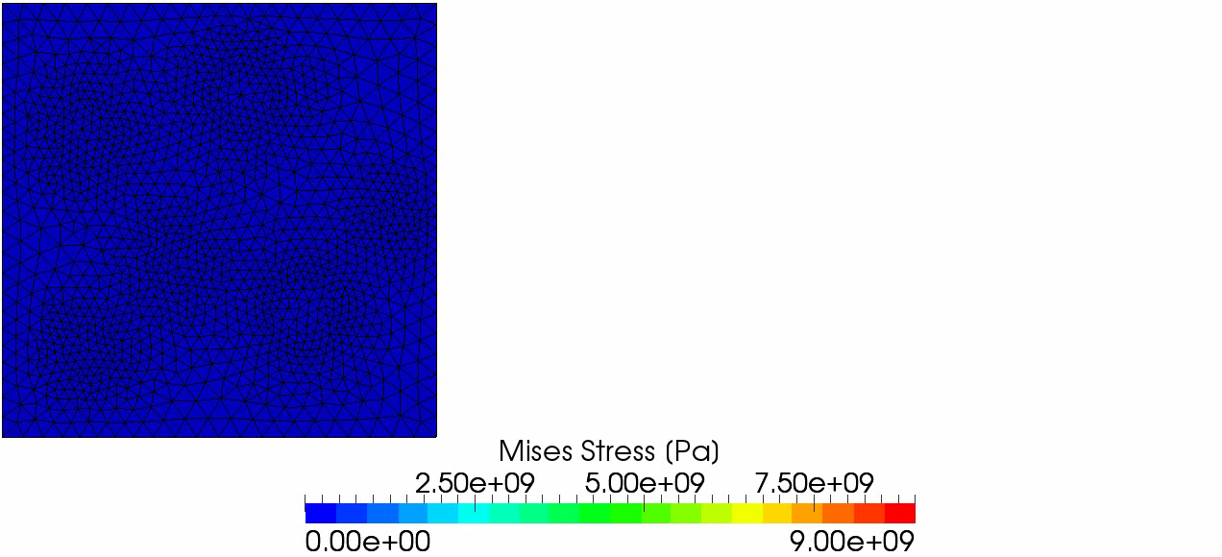
Tension of 2D Filler Particle Composite
2D Result
The deformation seems to be valid.
After 1.8 m disp.,
analysis is stopped due to mesh rezoning error.

Slide 33
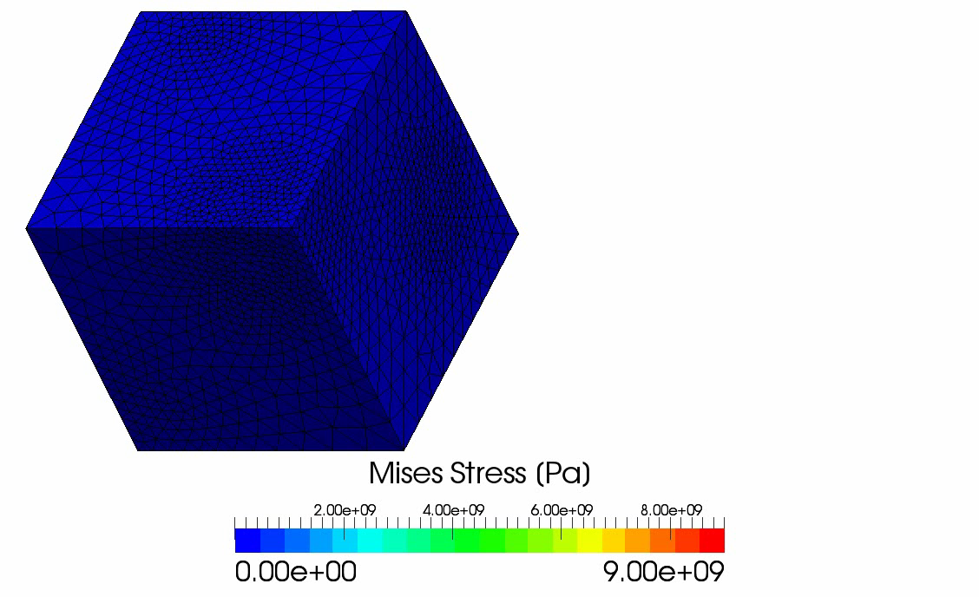
Tension of 3D Filler Particle Composite
Analysis resulted in convergence failure due to the singularity of stiffness after 1.58 m disp..
3D
Result
without
Mesh
Rezoning

Slide 34
Summary

Slide 35
Take-Home Messages
Our modified selective S-FEM with triangular or tetrahedral elements is locking free and very easy to implement.
Our S-FEM goes well together with mesh rezoning.
Our S-FEM is worth using even without mesh rezoning.

Slide 36
Summary and Future Work
Summary
  A new static-implicit mesh rezoning method for severely large deformation analysis is proposed.
  It adopts our modified selective S-FEM, which separates stress into deviatoric part and hydrostatic part.
  Its accuracy are verified with hyperelastic material and elasto-plastic material.
Future Work
  More V&V
  Local mesh rezoning
  Apply to contact forming, crack propagation, etc.
Thank you for your kind attention.
I appreciate your question in slow and easy English!!

Slide 37
Appendix

Slide 38
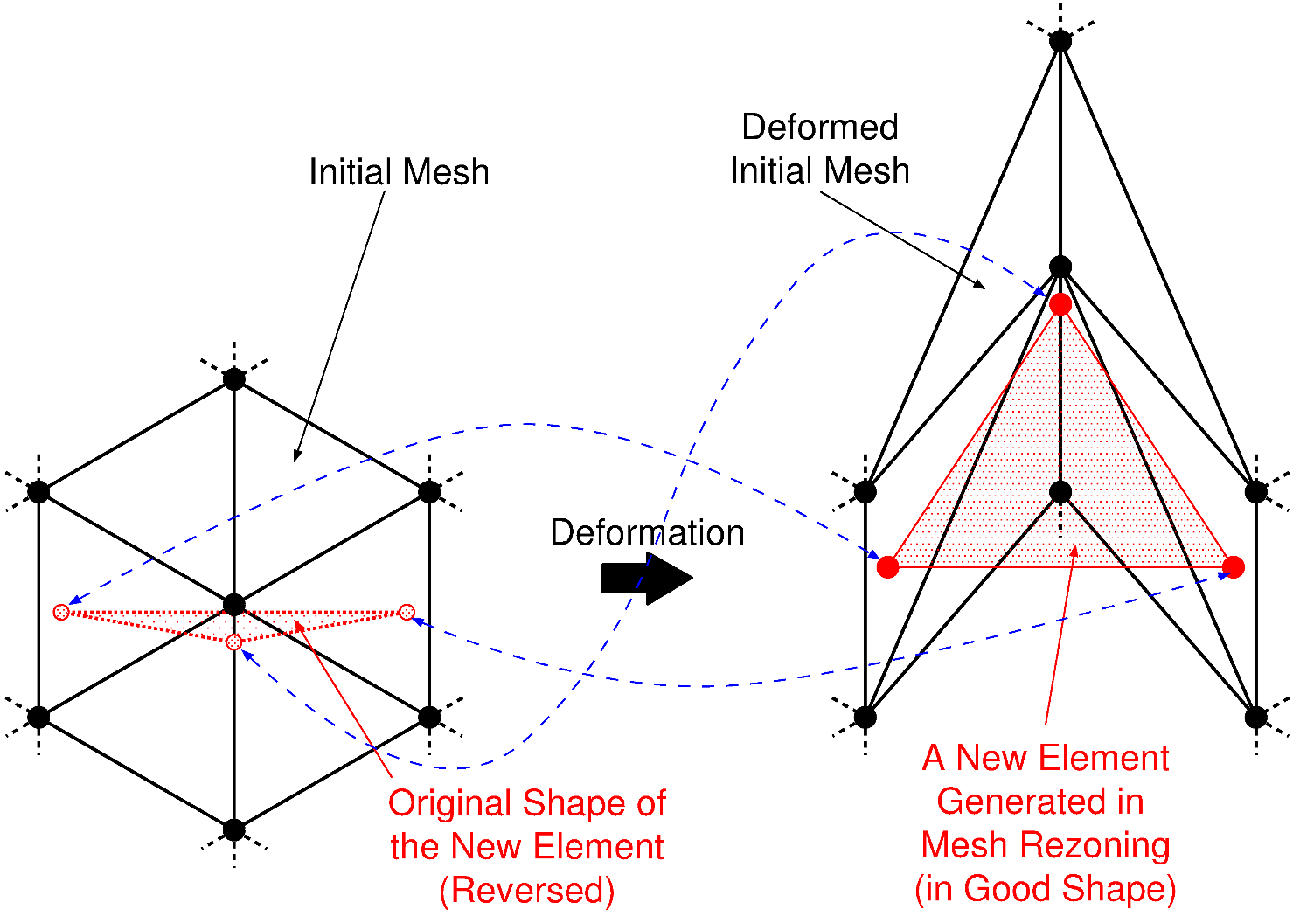
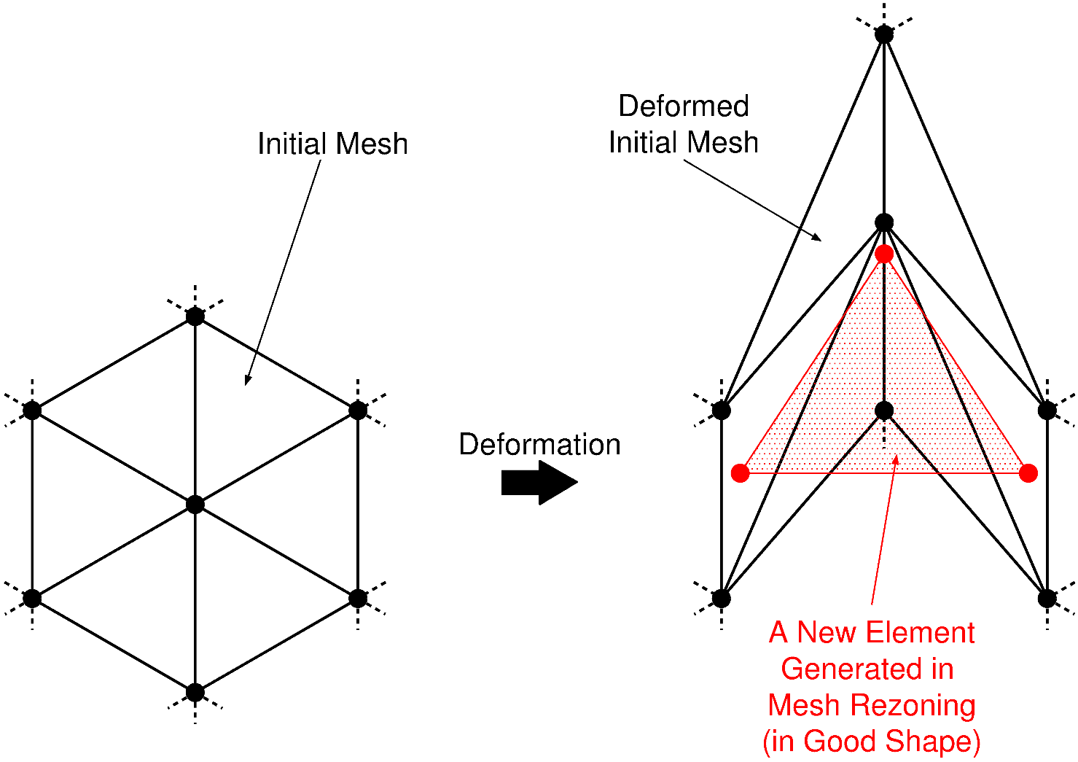
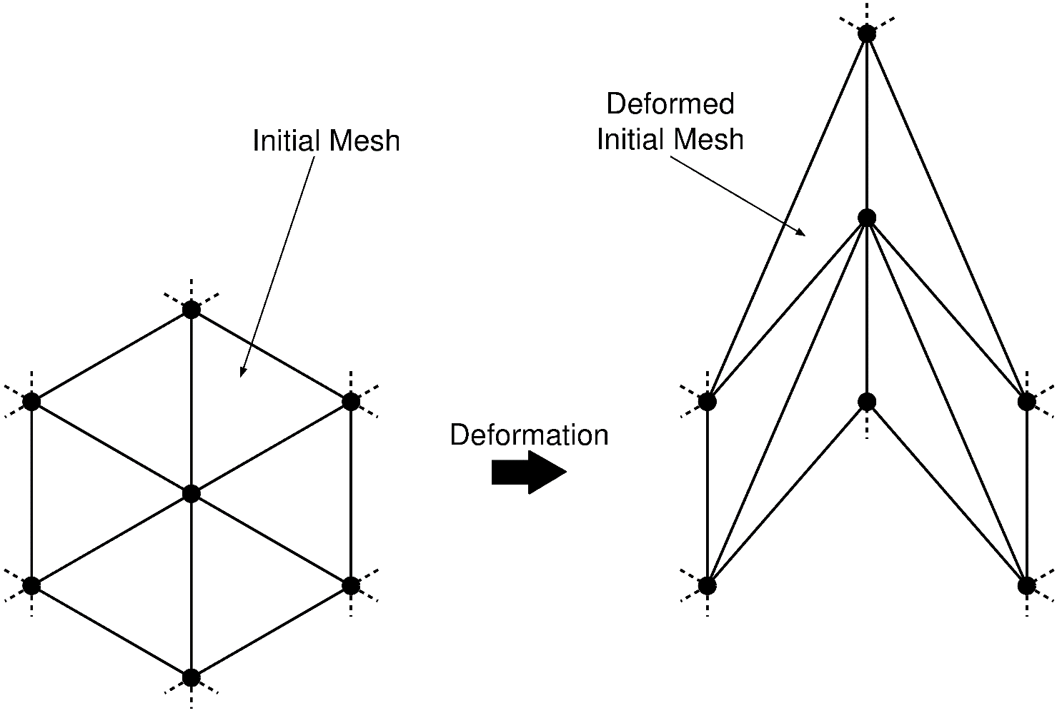
Reason for Mesh Rezoning Error
Remeshing on too distorted mesh brings
“originally reversed elements”.

Slide 39
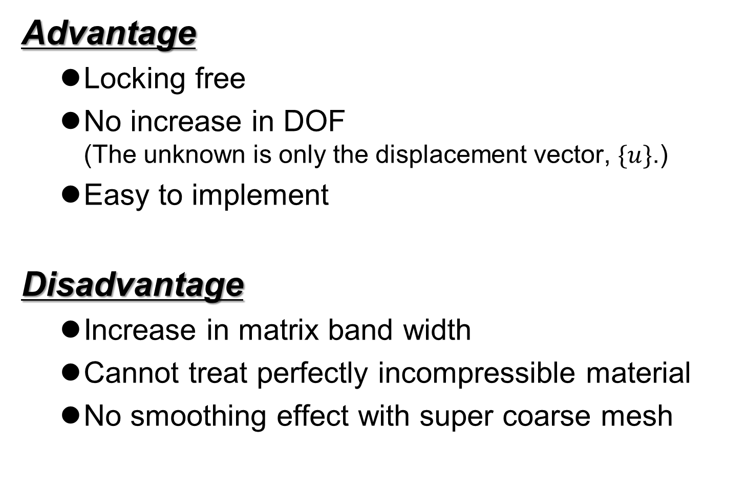
Characteristics of Our S-FEM
Advantage
  Locking free
  No increase in DOF
  (The unknown is only the displacement vector, $\{u\}$.)
  Easy to implement
Disadvantage
  Increase in matrix band width
  Cannot treat perfectly incompressible material
  No smoothing effect with super coarse mesh

